Slide 1
We’re so happy to have you here!

Slide 2
Celebration
Derk Jan van der Veen

Slide 4
1 Chronicles 16: 31 – 34 (NKJV) ³¹ Let the heavens rejoice, and let the earth be glad; And let them say among the nations, “The Lord reigns.” ³² Let the sea roar, and all its fullness; Let the field rejoice, and all that is in it.

Slide 5
1 Chronicles 16: 31 – 34 (NKJV) ³³ Then the trees of the woods shall rejoice before the Lord, For He is coming to judge the earth. ³⁴ Oh, give thanks to the Lord, for He is good! For His mercy endures forever.

Slide 6
Ezra 6: 16 (NKJV) ¹⁶ Then the children of Israel, the priests and the Levites and the rest of the descendants of the captivity, celebrated the dedication of this house of God with joy.

Slide 7
Philippians 4: 4 - 9 (NKJV) ⁴ Rejoice in the Lord always. Again I will say, rejoice! ⁵ Let your gentleness be known to all men. The Lord is at hand.

Slide 8
Philippians 4: 4 - 9 (NKJV) ⁶ Be anxious for nothing, but in everything by prayer and supplication, with thanksgiving, let your requests be made known to God; ⁷ and the peace of God, which surpasses all understanding, will guard your hearts and minds through Christ Jesus.

Slide 9
Philippians 4: 4 - 9 (NKJV) ⁸ Finally, brethren, whatever things are true, whatever things are noble, whatever things are just, whatever things are pure, whatever things are lovely, whatever things are of good report, if there is any virtue and if there is anything praiseworthy—meditate on these things.

Slide 10
Philippians 4: 4 - 9 (NKJV) ⁹ The things which you learned and received and heard and saw in me, these do, and the God of peace will be with you.

Slide 11
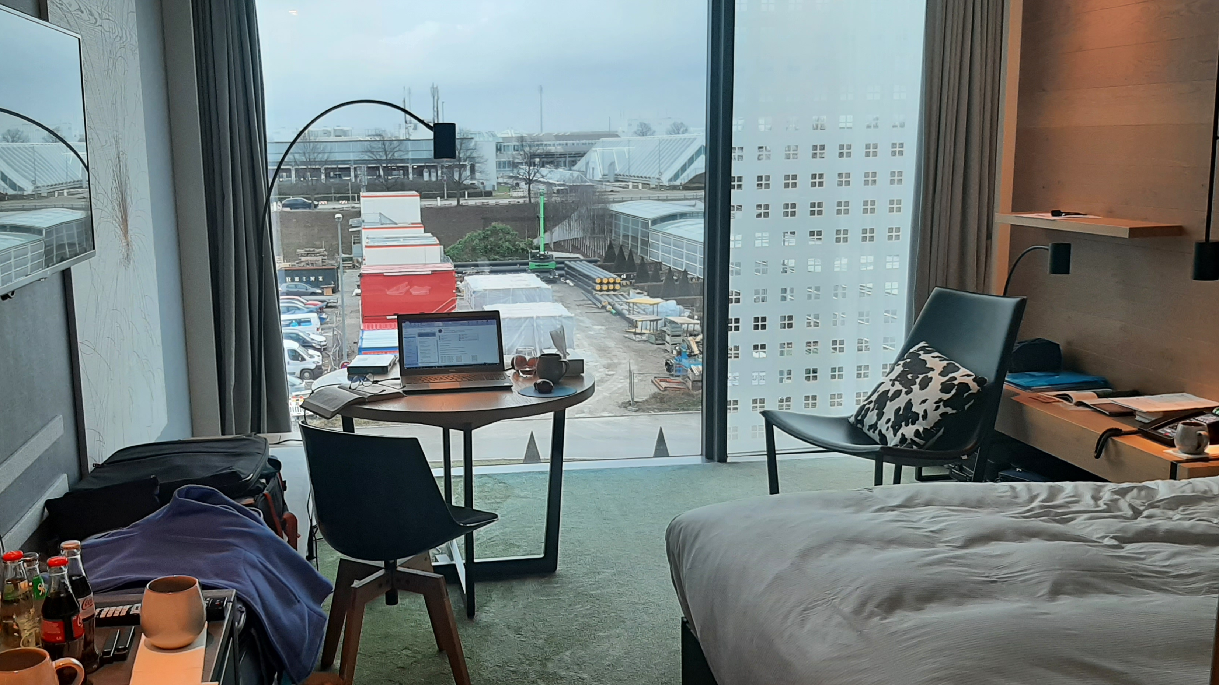

Slide 12
Thank you!

Slide 13
Philippians 4: 6 - 7 (NKJV) ⁶ Be anxious for nothing, but in everything by prayer and supplication, with thanksgiving, let your requests be made known to God; ⁷ and the peace of God, which surpasses all understanding, will guard your hearts and minds through Christ Jesus.

