Slide 1
Wholeness
Renee van der Veen

Slide 2
Wholeness

Slide 3
Self hate
Addictions
Polution
Animal cruelty
Control
Lovelesness
Love of self
Anger
Narcissism
Lack of Godly authority
Wholeness

Slide 4
⁴ For certain men have crept in stealthily [gaining entrance secretly by a side door].
Jude 1: 4 (AMPC)
Wholeness

Slide 5
Their doom was predicted long ago, ungodly (impious, profane) persons who pervert the grace (the spiritual blessing and favor) of our God into lawlessness and wantonness and immorality, and disown and deny our sole Master and Lord, Jesus Christ (the Messiah, the Anointed One).
Jude 1: 4 (AMPC)
Wholeness

Slide 6
⁴ For the weapons of our warfare are not physical [weapons of flesh and blood], but they are mighty before God for the overthrow and destruction of strongholds,
2 Corinthians 10 :4-5 (AMPC)
Wholeness

Slide 7
⁵ [Inasmuch as we] refute arguments and theories and reasonings and every proud and lofty thing that sets itself up against the [true] knowledge of God; and we lead every thought and purpose away captive into the obedience of Christ (the Messiah, the Anointed One),
2 Corinthians 10:4-5 (AMPC)
Wholeness

Slide 8
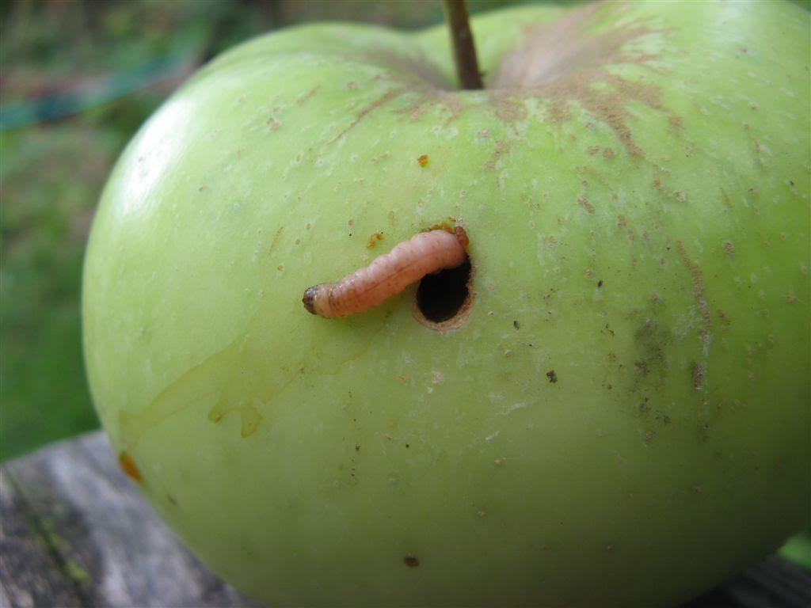
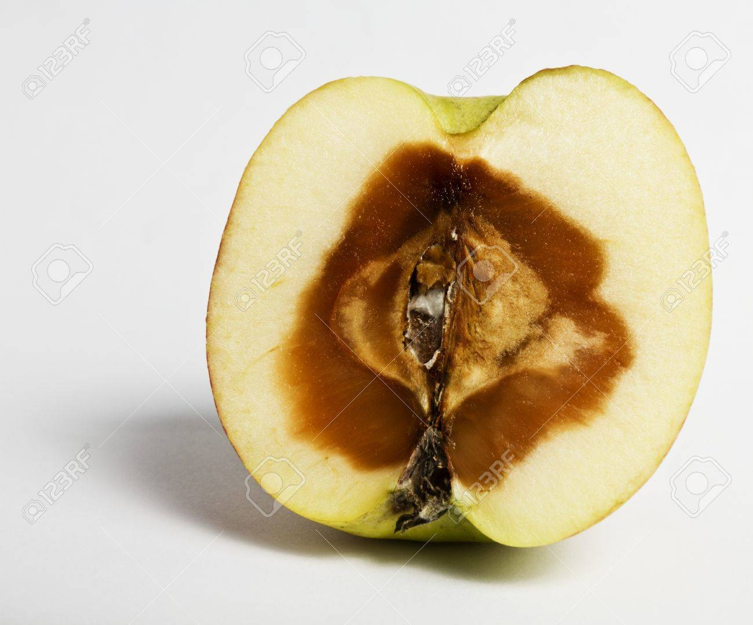
Wholeness

Slide 9
⁵ Now I want to remind you, though you were fully informed once for all, that though the Lord [at one time] delivered a people out of the land of Egypt, He subsequently destroyed those [of them] who did not believe [who refused to adhere to, trust in, and rely upon Him].
Jude 1:5 - 25 (AMPC)
Wholeness

Slide 10
⁶ And angels who did not keep (care for, guard, and hold to) their own first place of power but abandoned their proper dwelling place—these He has reserved in custody in eternal chains (bonds) under the thick gloom of utter darkness until the judgment and doom of the great day.
Jude 1:5 - 25 (AMPC)
Wholeness

Slide 11
⁷ [The wicked are sentenced to suffer] just as Sodom and Gomorrah and the adjacent towns—which likewise gave themselves over to impurity and indulged in unnatural vice and sensual perversity—are laid out [in plain sight] as an exhibit of perpetual punishment [to warn] of everlasting fire.
Jude 1:5 - 25 (AMPC)
Wholeness

Slide 12
⁹ But when [even] the archangel Michael, contending with the devil, judicially argued (disputed) about the body of Moses, he dared not [presume to] bring an abusive condemnation against him, but [simply] said, The Lord rebuke you!
Jude 1:5 - 25 (AMPC)
Wholeness

Slide 13
⁸ Nevertheless in like manner, these dreamers also corrupt the body, scorn and reject authority and government, and revile and libel and scoff at [heavenly] glories (the glorious ones).
Jude 1:5 - 25 (AMPC)
Wholeness

Slide 14
¹⁰ But these men revile (scoff and sneer at) anything they do not happen to be acquainted with and do not understand; and whatever they do understand physically [that which they know by mere instinct], like irrational beasts—by these they corrupt themselves and are destroyed (perish).
Jude 1:5 - 25 (AMPC)
Wholeness

Slide 15
¹¹ Woe to them! For they have run riotously in the way of Cain, and have abandoned themselves for the sake of gain [it offers them, following] the error of Balaam, and have perished in rebellion [like that] of Korah!
Jude 1:5 - 25 (AMPC)
Wholeness

Slide 16
¹² These are hidden reefs (elements of danger) in your love feasts, where they boldly feast sumptuously [carousing together in your midst], without scruples providing for themselves [alone]. They are clouds without water, swept along by the winds; trees, without fruit at the late autumn gathering time—twice (doubly) dead, [lifeless and] plucked up by the roots;
Jude 1:5 - 25 (AMPC)
Wholeness

Slide 17
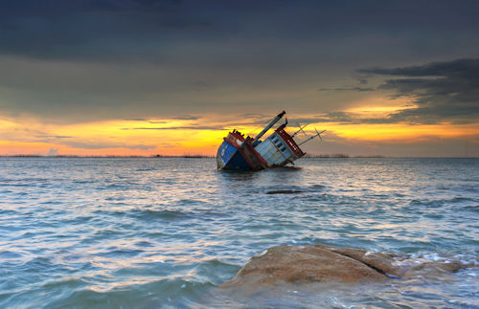
Wholeness

Slide 18
Wholeness

Slide 19
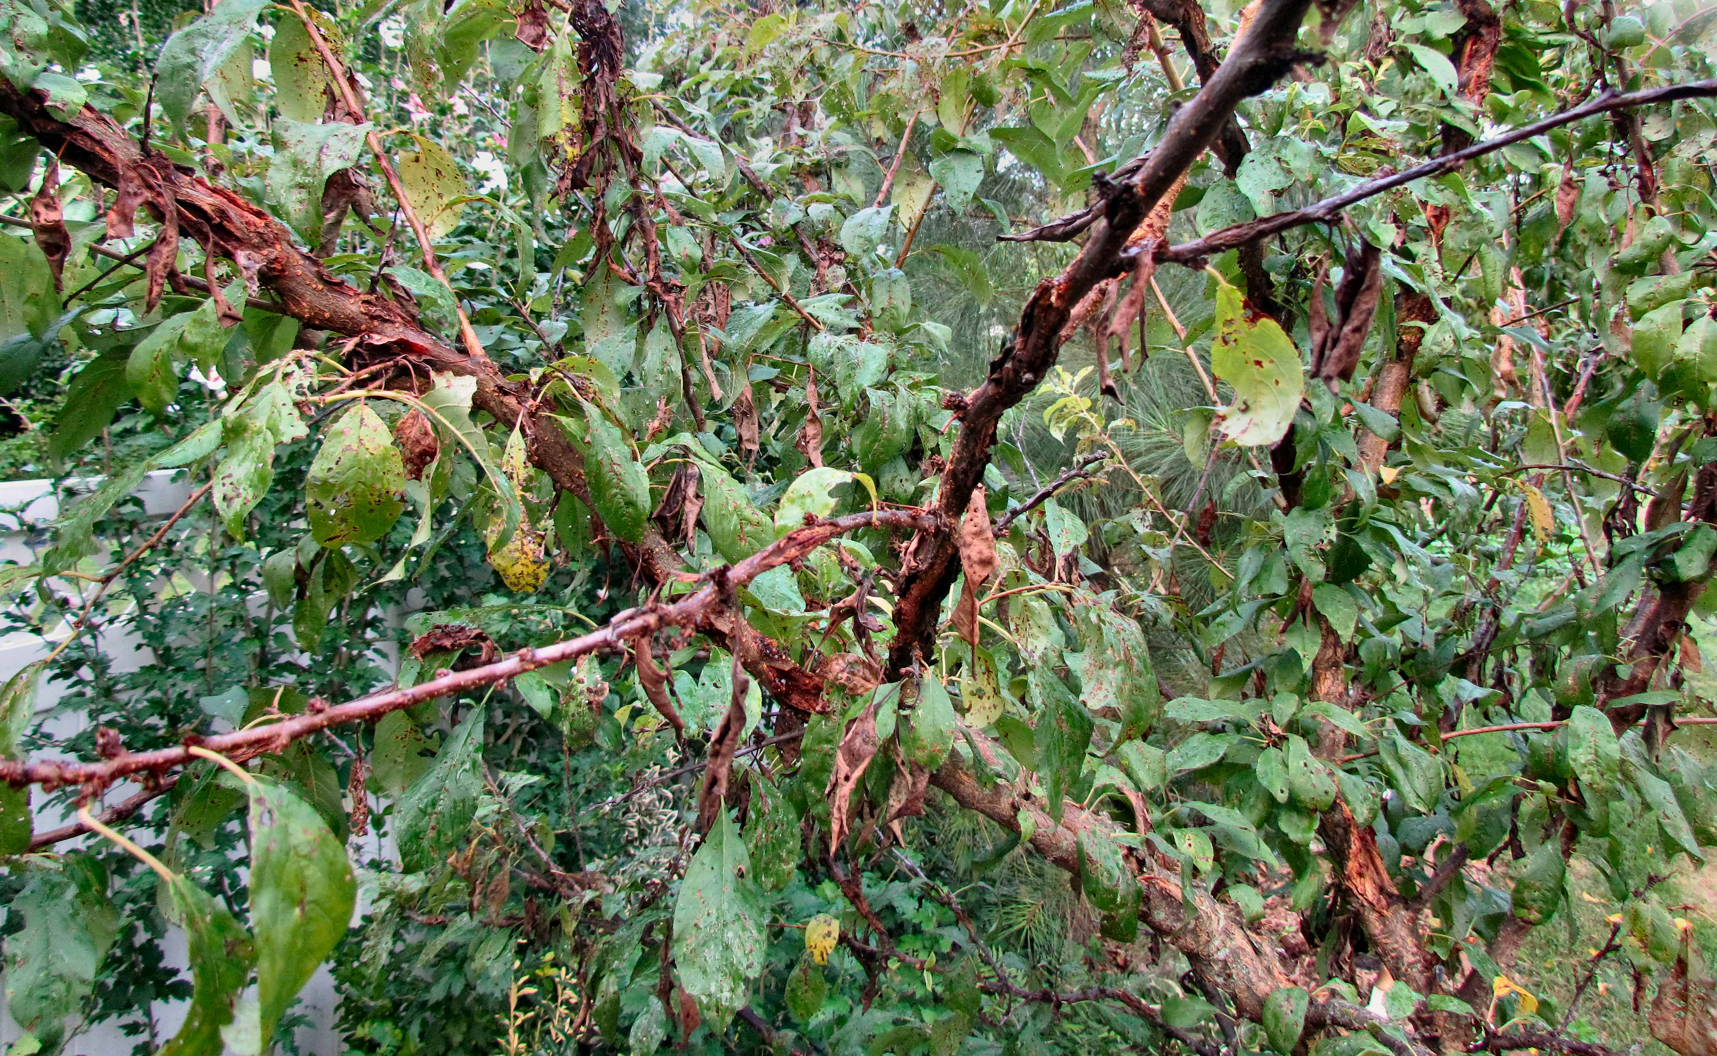
Wholeness

Slide 20
¹³ Wild waves of the sea, flinging up the foam of their own shame and disgrace; wandering stars, for whom the gloom of eternal darkness has been reserved forever.
Jude 1:5 - 25 (AMPC)
Wholeness

Slide 21
Wholeness

Slide 22
Wholeness

Slide 23
¹⁵ To execute judgment upon all and to convict all the impious (unholy ones) of all their ungodly deeds which they have committed [in such an] ungodly [way], and of all the severe (abusive, jarring) things which ungodly sinners have spoken against Him.
Jude 1:5 - 25 (AMPC)
Wholeness

Slide 24
¹⁶ These are inveterate murmurers (grumblers) who complain [of their lot in life], going after their own desires [controlled by their passions]; their talk is boastful and arrogant, [and they claim to] admire men’s persons and pay people flattering compliments to gain advantage.
Jude 1:5 - 25 (AMPC)
Wholeness

Slide 25
¹⁷ But you must remember, beloved, the predictions which were made by the apostles (the special messengers) of our Lord Jesus Christ (the Messiah, the Anointed One).
Jude 1:5 - 25 (AMPC)
Wholeness

Slide 26
¹⁸ They told you beforehand, In the last days (in the end time) there will be scoffers [who seek to gratify their own unholy desires], following after their own ungodly passions.
Jude 1:5 - 25 (AMPC)
Wholeness

Slide 27
¹⁹ It is these who are [agitators] setting up distinctions and causing divisions—merely sensual [creatures, carnal, worldly-minded people], devoid of the [Holy] Spirit and destitute of any higher spiritual life.
Jude 1:5 - 25 (AMPC)
Wholeness

Slide 28
How do we behave?
²⁰ But you, beloved, build yourselves up [founded] on your most holy faith [make progress, rise like an edifice higher and higher], praying in the Holy Spirit;
Jude 1:5 - 25 (AMPC)
Wholeness

Slide 29
²¹ Guard and keep yourselves in the love of God; expect and patiently wait for the mercy of our Lord Jesus Christ (the Messiah)—[which will bring you] unto life eternal.
Jude 1:5 - 25 (AMPC)
Wholeness

Slide 30
²² And refute [so as to] convict some who dispute with you, and on some have mercy who waver and doubt.
Jude 1:5 - 25 (AMPC)
Wholeness

Slide 31
²³ [Strive to] save others, snatching [them] out of [the] fire; on others take pity [but] with fear, loathing even the garment spotted by the flesh and polluted by their sensuality.
Jude 1:5 - 25 (AMPC)
Wholeness

Slide 32
God’s Promise!
²⁴ Now to Him Who is able to keep you without stumbling or slipping or falling, and to present [you] unblemished (blameless and faultless) before the presence of His glory in triumphant joy and exultation [with unspeakable, ecstatic delight]—
Jude 1:5 - 25 (AMPC)
Wholeness

Slide 33
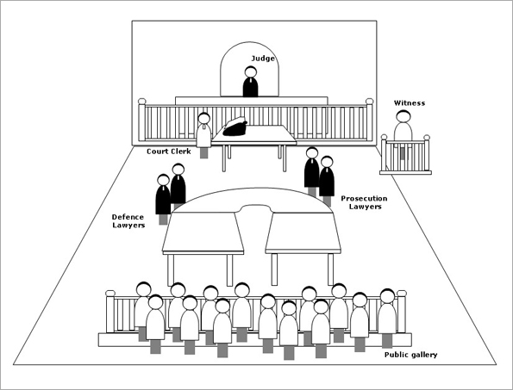
Wholeness

Slide 34
²⁵ To the one only God, our Savior through Jesus Christ our Lord, be glory (splendor), majesty, might and dominion, and power and authority, before all time and now and forever (unto all the ages of eternity). Amen (so be it).
Jude 1:5 - 25 (AMPC)
Wholeness

Slide 35
Jesus
Wholeness

