Slide 1
The Fear of the Lord
Renee van der Veen

Slide 2
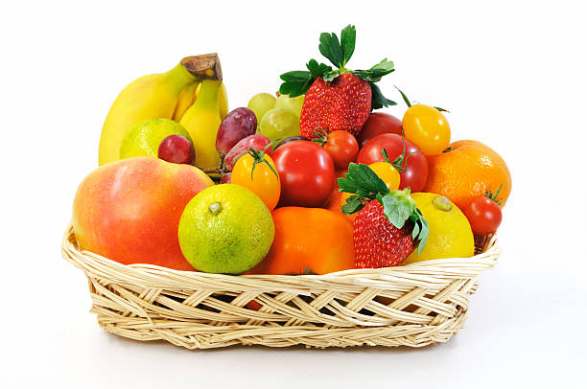
- Fear of the Lord
Fruit of the Spirit - Fear of the Lord
Blessings - Fear of the Lord
The Fear of the Lord

Slide 3
Fear of the Lord: 1.1 e-Sword: Proverbs 1:7a (NKJV) “The fear of the Lord is the beginning of knowledge,” (morally reverence) 1.2 Ecclesiastics 12:13 (NKJV) “Let us hear the conclusion of the whole matter: Fear God and keep His commandments, For this is man’s all.” (morally to refer; to point out more definitely the object of a verb)
The Fear of the Lord

Slide 4
Fear of man: (to stand in alarm, anxiety, awe, dread, suspicion
or cowering before mortal men)
The Fear of the Lord

Slide 5
The Fear of God includes but is not limited to respecting and reverencing Him for whom we are told to tremble before His presence Holy Fear gives God the place of glory, honour, reverence, thanksgiving, praise and pre-eminence He deserves
The Fear of the Lord

Slide 6
Cain
⁶ So the Lord said to Cain, “Why are you angry? And why has your countenance fallen? ⁷ If you do well, will you not be accepted? And if you do not do well, sin lies at the door. And its desire is for you, but you should rule over it.”
Genesis 4: 6-7 (NKJV)
The Fear of the Lord

Slide 7
David
⁸ And David became angry because of the Lord’s outbreak against Uzzah; and he called the name of the place Perez Uzzah to this day. ⁹ David was afraid of the Lord that day; and he said, “How can the ark of the Lord come to me?”
2 Samuel 6: 8-9 (NKJV)
The Fear of the Lord

Slide 8
David
¹⁸ “Also it shall be, when he sits on the throne of his kingdom, that he shall write for himself a copy of this law in a book, from the one before the priests, the Levites. ¹⁹ And it shall be with him, and he shall read it all the days of his life, that he may learn to fear the Lord his God and be careful to observe all the words of this law and these statutes,
Deuteronomy 17:18-19 (NKJV)
The Fear of the Lord

Slide 9
You will serve whom you fear.
The Fear of the Lord

Slide 10
You will serve whom you fear. If you fear God, you will serve Him.
The Fear of the Lord

Slide 11
You will serve whom you fear. If you fear God, you will serve Him. If your fear man, you will serve man.
The Fear of the Lord

Slide 12
You will serve whom you fear. If you fear God, you will serve Him. If your fear man, you will serve man. You must choose.
The Fear of the Lord

Slide 13
Places/areas where we struggle: 1. Authority
The Fear of the Lord

Slide 14
Places/areas where we struggle: 1. Authority 2. Lack of knowledge Therefore my people have gone into captivity, Because they have no knowledge; Their honorable men are famished, And their multitude dried up with thirst
Isaiah 5: 13 (NKJV)
The Fear of the Lord

Slide 15
Places/areas where we struggle: 1. Authority 2. Lack of knowledge My people are destroyed for lack of knowledge. Because you have rejected knowledge, I also will reject you from being priest for Me; Because you have forgotten the law of your God, I also will forget your children.
Hosea 4: 6 (NKJV)
The Fear of the Lord

Slide 16
Lot versus Abraham: And the Scripture was fulfilled which says, “Abraham believed God, and it was accounted to him for righteousness.” And he was called the friend of God.
James 2: 23 (NKJV)
The Fear of the Lord

Slide 17
Lot versus Abraham: Remember Lot’s wife.
Luke 17: 32 (NKJV)
The Fear of the Lord

Slide 18
Blessings of fearing God:
1. Promises angelic protection: The angel of the Lord encamps all around those who fear Him, And delivers them.
Psalm 34:7 (NKJV)
The Fear of the Lord

Slide 19
Blessings of fearing God:
2. Supplies His provision: Oh, fear the Lord, you His saints! There is no want to those who fear Him.
Psalm 34: 9 (NKJV)
The Fear of the Lord

Slide 20
Blessings of fearing God:
3. Fulfills our desires and delivers us from harm: He will fulfill the desire of those who fear Him; He also will hear their cry and save them.
Psalm 145: 19 (NKJV)
The Fear of the Lord

Slide 21
Blessings of fearing God:
4. Leads to riches, honour and life: By humility and the fear of the Lord Are riches and honor and life.
Proverbs 22: 4 (NKJV)
The Fear of the Lord

Slide 22
Blessings of fearing God:
5. Provides clarity and direction: Who is the man that fears the Lord? Him shall He teach in the way He chooses.
Psalm 25: 12 (NKJV)
The Fear of the Lord

Slide 23
Fruit of our labour: because of the Fear of the Lord
Fruit of the Spirit: because of the Fear of the Lord
Blessings: because of the Fear of the Lord
The Fear of the Lord

