Slide 1
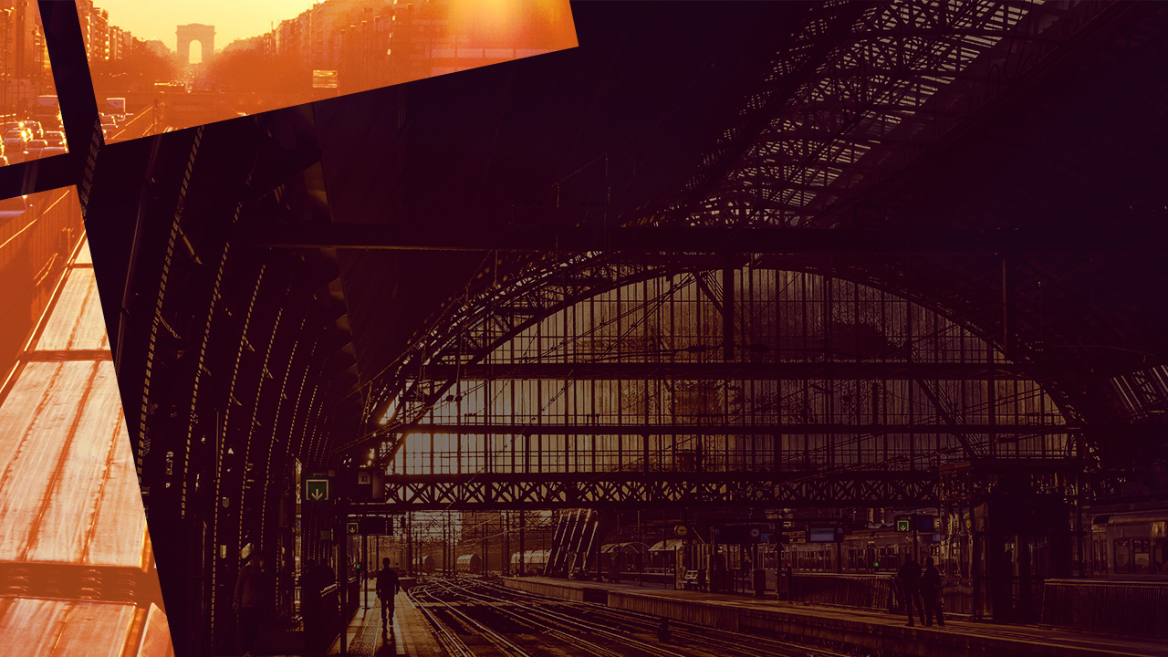
Love One Another – Part 1
jaco van rooyen

Slide 2
Scripture
Mark 14: 32-42

Slide 3
Scripture
³² Then they came to a place which was named Gethsemane; and He said to His disciples, “Sit here while I pray.” ³³ And He took Peter, James, and John with Him, and He began to be troubled and deeply distressed. ³⁴ Then He said to them, “My soul is exceedingly sorrowful, even to death. Stay here and watch.”
³⁵ He went a little farther, and fell on the ground, and prayed that if it were possible, the hour might pass from Him.

Slide 4
Scripture
³⁶ And He said, “Abba, Father, all things are possible for You. Take this cup away from Me; nevertheless, not what I will, but what You will.”
³⁷ Then He came and found them sleeping, and said to Peter, “Simon, are you sleeping? Could you not watch one hour? ³⁸ Watch and pray, lest you enter into temptation. The spirit indeed is willing, but the flesh is weak.”

Slide 5
Scripture
³⁹ Again He went away and prayed, and spoke the same words. ⁴⁰ And when He returned, He found them asleep again, for their eyes were heavy; and they did not know what to answer Him..
.

Slide 6
Scripture
⁴¹ Then He came the third time and said to them, “Are you still sleeping and resting? It is enough! The hour has come; behold, the Son of Man is being betrayed into the hands of sinners. ⁴² Rise, let us be going. See, My betrayer is at hand.”

Slide 7
Transparency
By being transparent we
…admit our human frailty
…communicate trust
…admit our need for each other

Slide 8
Prayer
By praying for others
…our focus are turned away from ourselves
…we identify with others
…our hearts are aligned with God

