Slide 1
Heart Transplant
Louw Pienaar

Slide 2
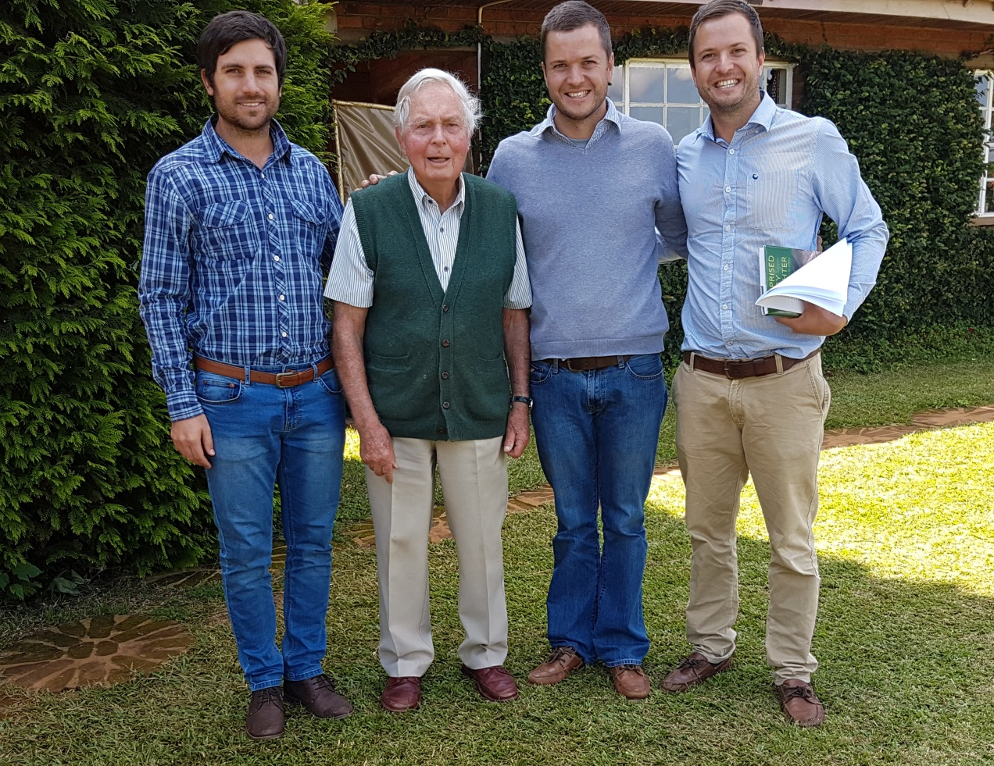
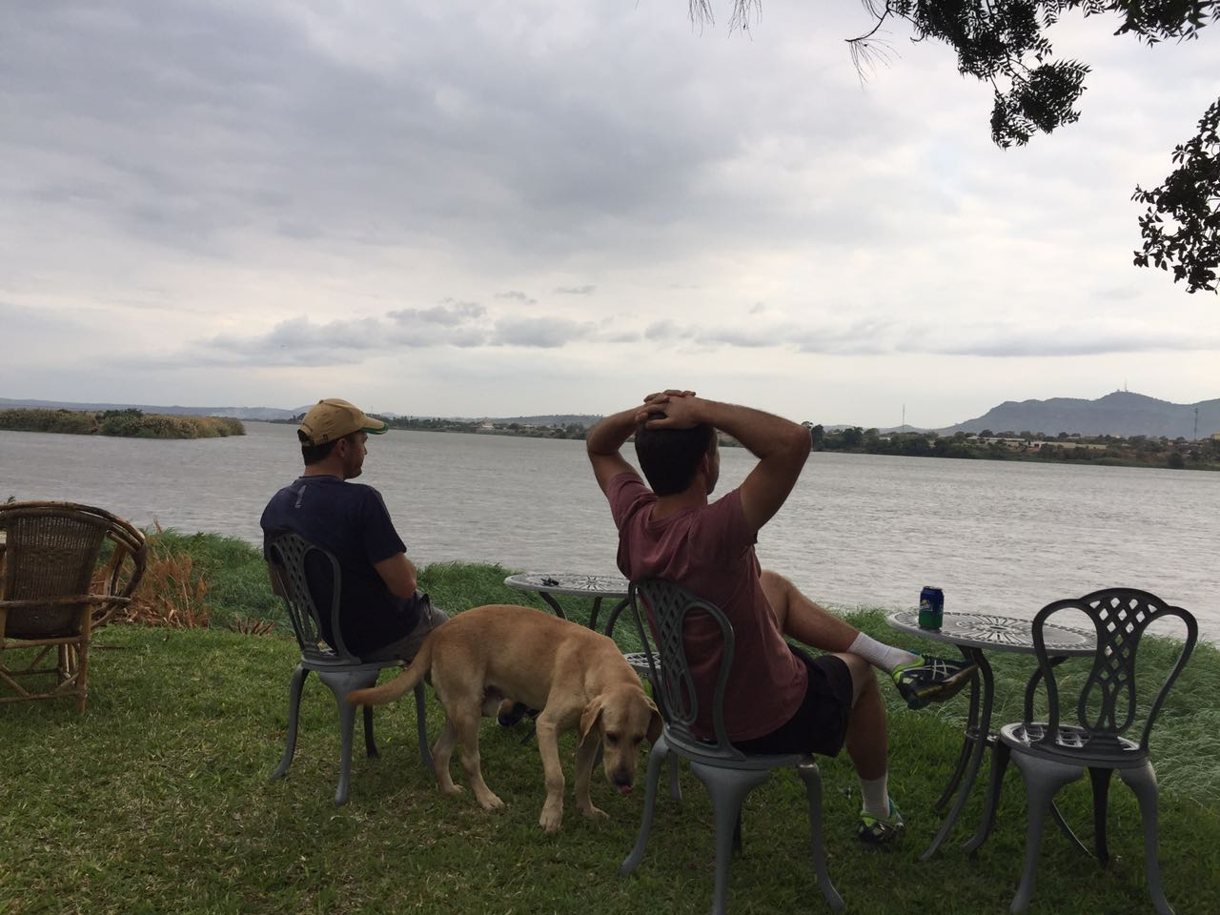
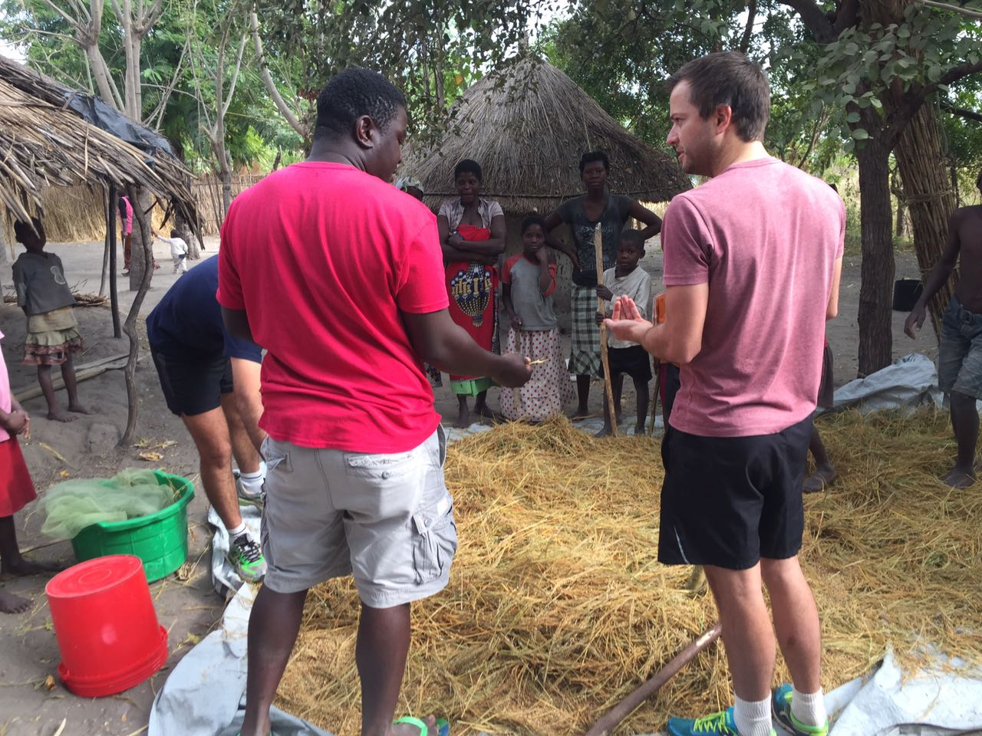
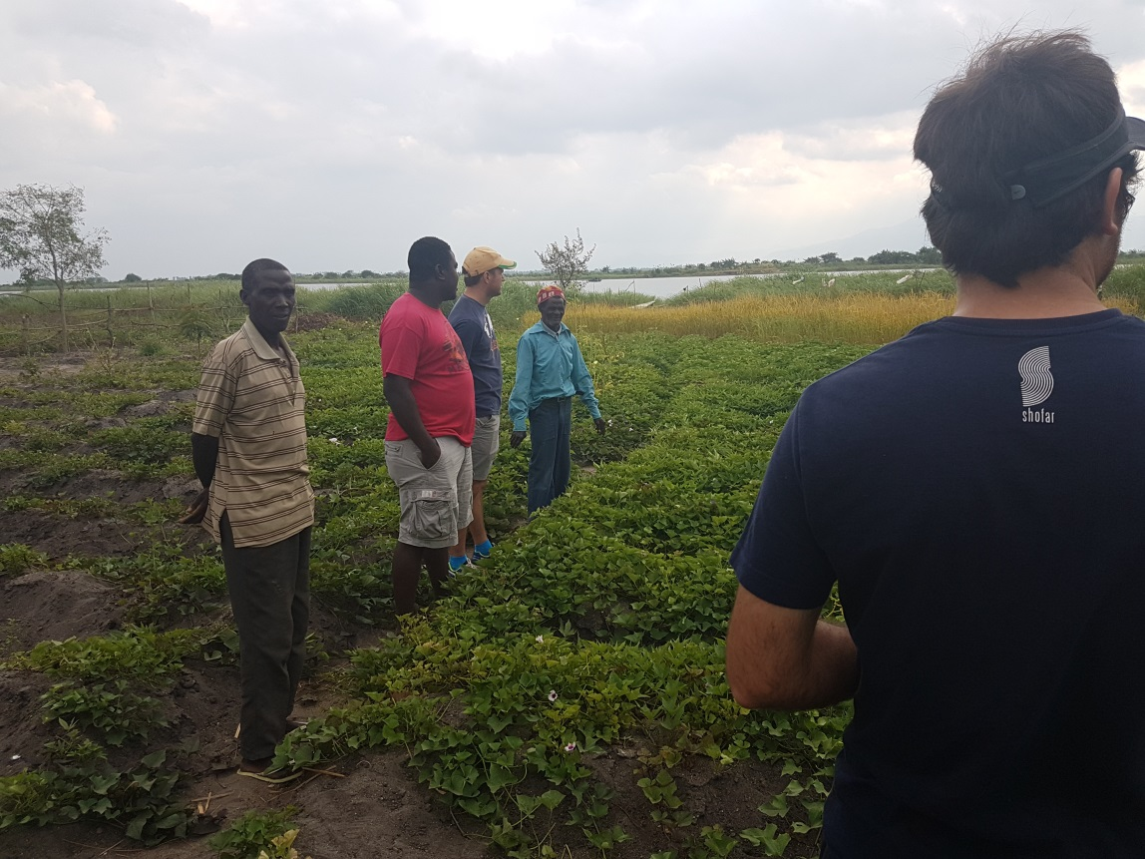
Malawi ‘17

Slide 3
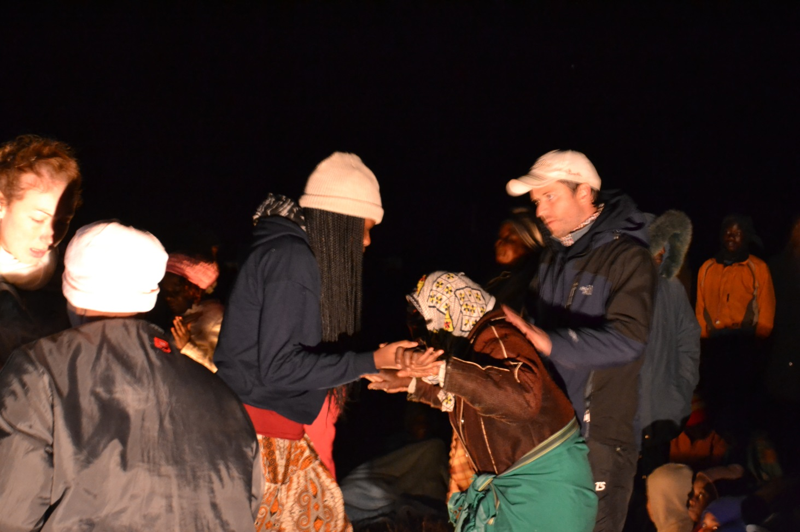
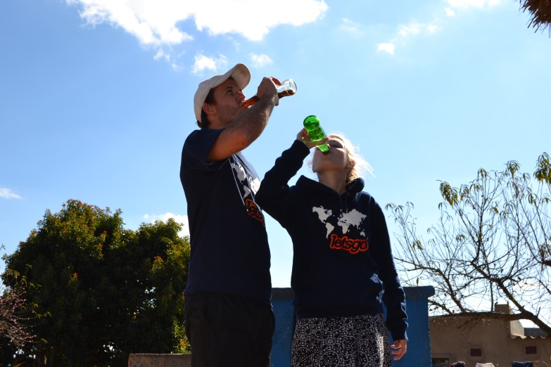
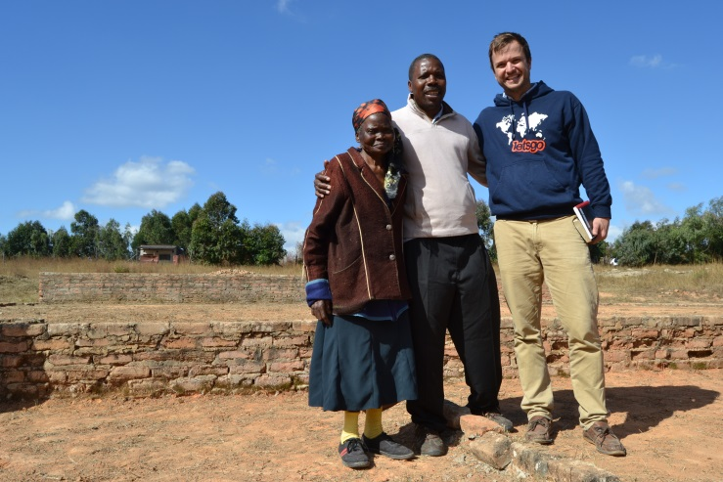
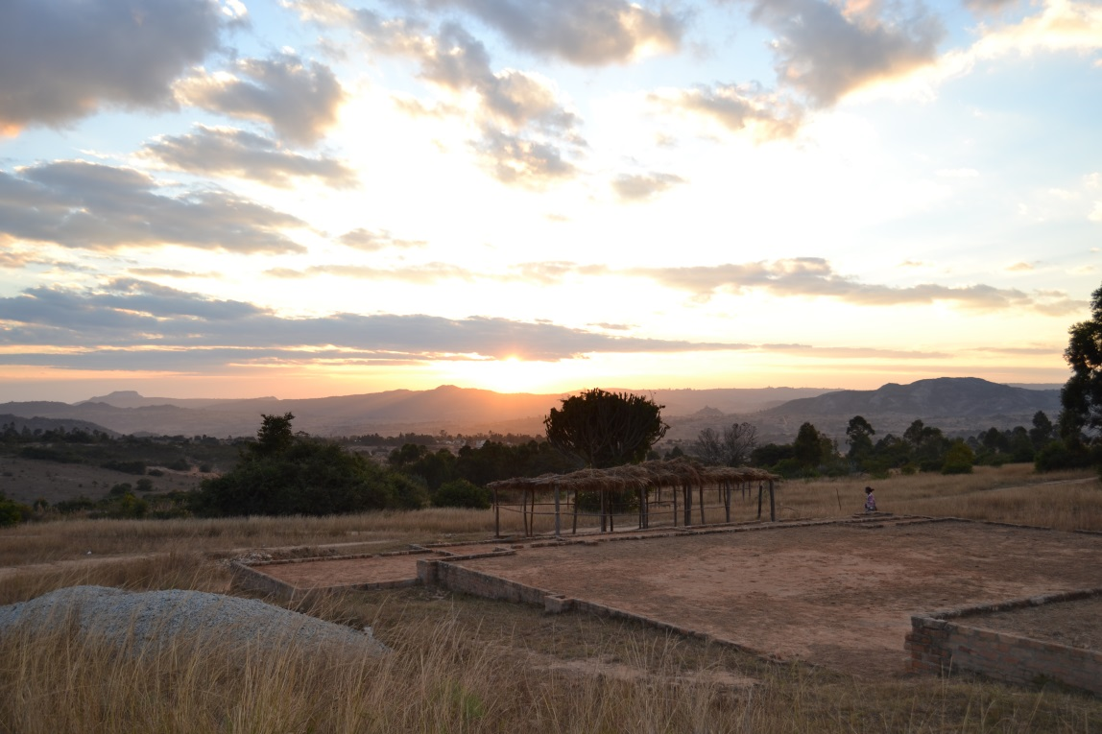
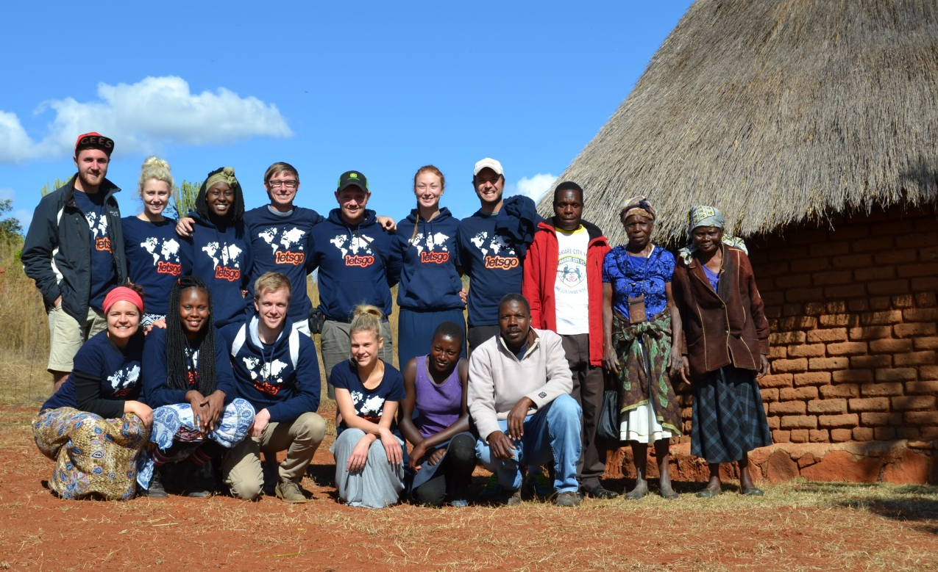
Zimbabwe ‘17

Slide 4
Matt 9: 35-38
³⁵ Then Jesus went about all the cities and villages, teaching in their synagogues, preaching the gospel of the kingdom, and healing every sickness and every disease among the people.³⁶ But when He saw the multitudes, He was moved with compassion for them, because they were weary and scattered, like sheep having no shepherd. ³⁷ Then He said to His disciples, “The harvest truly is plentiful, but the laborers are few. ³⁸ Therefore pray the Lord of the harvest to send out laborers into His harvest.”

Slide 5
The Heart
Greek: Leb (Lehv)
Heart, awareness, inner person (self), deepest thoughts.
Can refer both the physical organ (2 Kings 9:24) or a person’s inner yearnings (Psalm 37: 4)
The Word often refers to what God want to do in our hearts.

Slide 6
Ezekiel 36: 25-28
²⁵ Then I will sprinkle clean water on you, and you shall be clean; I will cleanse you from all your filthiness and from all your idols. ²⁶ I will give you a new heart and put a new spirit within you; I will take the heart of stone out of your flesh and give you a heart of flesh. ²⁷ I will put My Spirit within you and cause you to walk in My statutes, and you will keep My judgments and do them. ²⁸ Then you shall dwell in the land that I gave to your fathers; you shall be My people, and I will be your God.

Slide 7
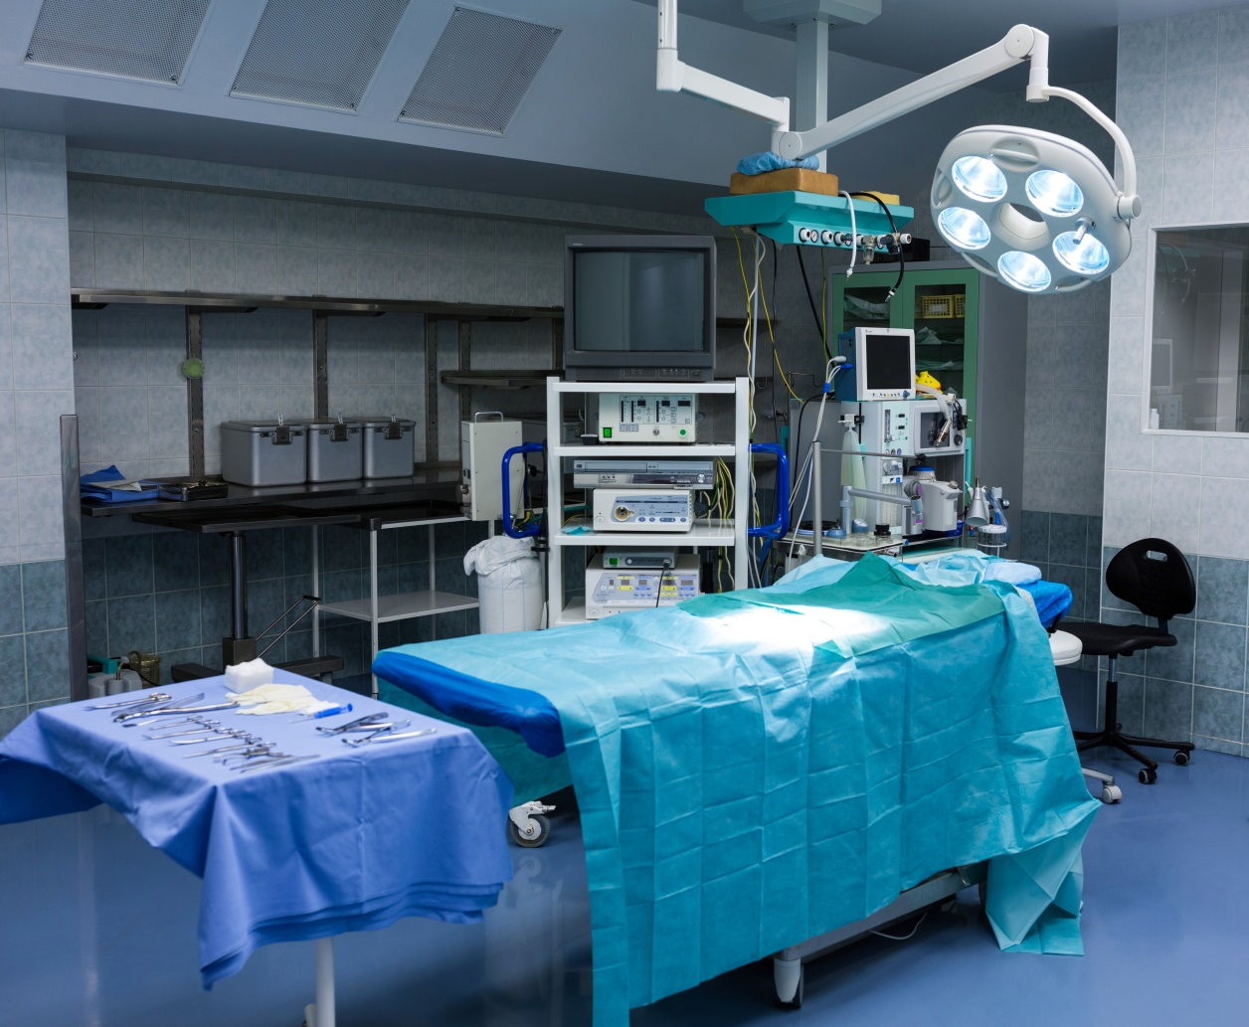
Heart Transplant: Operating Table
Identify
Ask
Surrender
Yield
Trust the surgeon
Pain
Promise
Peace

Slide 8
Q: What is the condition of your heart?
We sing songs: “Break my heart for break yours”
We pray “Lord I give You everything”; “Lord use me”
We read: Love the Lord for all your heart, and all…”
God asked me a while back if I’m willing to come to the operating table so He can change my heart. Its been an internal struggle

Slide 9
Luke 24: 13-36
¹³ Now behold, two of them were traveling that same day to a village called Emmaus, which was seven miles from Jerusalem. ¹⁴ And they talked together of all these things which had happened. ¹⁵ So it was, while they conversed and reasoned, that Jesus Himself drew near and went with them. ¹⁶ But their eyes were restrained, so that they did not know Him.
¹⁷ And He said to them, “What kind of conversation is this that you have with one another as you walk and are sad?” ¹⁸Then the one whose name was Cleopas answered and said to Him, “Are You the only stranger in Jerusalem, and have You not known the things which happened there in these days?”

Slide 10
Luke 24: 13-36 Continued
¹⁹ And He said to them, “What things?” So they said to Him, “The things concerning Jesus of Nazareth, who was a Prophet mighty in deed and word before God and all the people, ²⁰ and how the chief priests and our rulers delivered Him to be condemned to death, and crucified Him. ²¹ But we were hoping that it was He who was going to redeem Israel. Indeed, besides all this, today is the third day since these things happened. ²²Yes, and certain women of our company, who arrived at the tomb early, astonished us. ²³ When they did not find His body, they came saying that they had also seen a vision of angels who said He was alive.

Slide 11
Luke 24: 13-36 Continued
²⁴ And certain of those who were with us went to the tomb and found it just as the women had said; but Him they did not see.”
²⁵ Then He said to them, “O foolish ones, and slow of heart to believe in all that the prophets have spoken! ²⁶ Ought not the Christ to have suffered these things and to enter into His glory?” ²⁷ And beginning at Moses and all the Prophets, He expounded to them in all the Scriptures the things concerning Himself. ²⁸ Then they drew near to the village where they were going, and He indicated that He would have gone farther. ²⁹ But they constrained Him, saying, “Abide with us, for it is toward evening, and the day is far spent.” And He went in to stay with them.

Slide 12
Luke 24: 13-36 Continued
³⁰ Now it came to pass, as He sat at the table with them, that He took bread, blessed and broke it, and gave it to them. ³¹ Then their eyes were opened and they knew Him; and He vanished from their sight. ³² And they said to one another, “Did not our heart burn within us while He talked with us on the road, and while He opened the Scriptures to us?” ³³ So they rose up that very hour and returned to Jerusalem, and found the eleven and those who were with them gathered together, ³⁴ saying, “The Lord is risen indeed, and has appeared to Simon!” ³⁵ And they told about the things that had happened on the road, and how He was known to them in the breaking of bread.

Slide 13
Revelation of Jesus
Many Christians today
They Walk with Him
They Talk with Him
They Read about Him
But
They do not know Him. They cannot recognise Him or receive from Him.
“Did not out hearts burn within us?”

Slide 14
John 14: 27
²⁷ Peace I leave with you, My peace I give to you; not as the world gives do I give to you. Let not your heart be troubled, neither let it be afraid.
Philippians 4: 6-7
⁶ Be anxious for nothing, but in everything by prayer and supplication, with thanksgiving, let your requests be made known to God;⁷ and the peace of God, which surpasses all understanding, will guard your hearts and minds through Christ Jesus.

