Slide 1
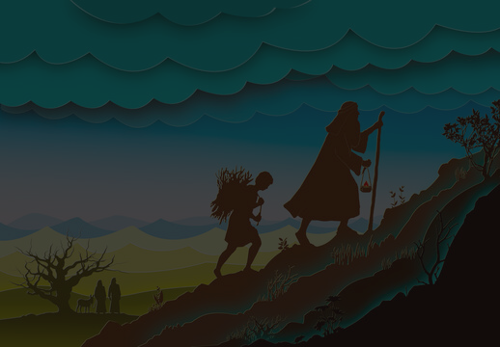

OBEDIENCE
Stephan Verhoef

Slide 2
John 14:21 (ESV)
21 Whoever has my commandments and keeps them, he it is who loves me.
1 John 5:3 (ESV)
3 For this is the love of God, that we keep his commandments. And his commandments are not burdensome.

Slide 3
1 Samuel 2:29-30 (ESV)
29 Why then do you scorn my sacrifices and my offerings that I commanded, and honor your sons above me by fattening yourselves on the choicest parts of every offering of my people Israel? 30 Therefore the Lord, the God of Israel, declares: I promised that your house and the house of your father should go in and out before me forever,

Slide 4
1 Samuel 2:29-30 (ESV)
but now the Lord declares: Far be it from me, for those who honor me I will honor, and those who despise me shall be lightly esteemed.

Slide 5
James 4:17 (ESV)
17 So whoever knows the right thing to do and fails to do it, for him it is sin.

Slide 6
Sermon Points
Obey God immediately.

Slide 7
Psalm 119:60 (ESV)
60 I hasten and do not delay
to keep your commandments.

Slide 8
Genesis 22:1-3 (ESV)
1 After these things God tested Abraham and said to him, Abraham! And he said, Here am I. 2 He said, Take your son, your only son Isaac, whom you love, and go to the land of Moriah, and offer him there as a burnt offering on one of the mountains of which I shall tell you.

Slide 9
Genesis 22:1-3 (ESV)
3 So Abraham rose early in the morning, saddled his donkey, and took two of his young men with him, and his son Isaac. And he cut the wood for the burnt offering and arose and went to the place of which God had told him.

Slide 10
Sermon Points
Obey God immediately.
Obey God even if it does not make sense.

Slide 11
Proverbs 3:5 (ESV)
5 Trust in the Lord with all your heart,
and do not lean on your own understanding.

Slide 12
Sermon Points
Obey God immediately.
Obey God even if it does not make sense.
Obey God even when you cannot see the personal benefit.

Slide 13
Matthew 16:25 (ESV)
25 For whoever would save his life will lose it, but whoever loses his life for my sake will find it.

Slide 14
Philippians 1:29 (ESV)
29 For it has been granted to you that for the sake of Christ you should not only believe in him but also suffer for his sake.

Slide 15
1 Peter 4:1 (ESV)
1 Since therefore Christ suffered in the flesh, arm yourselves with the same way of thinking.

Slide 16
John 15:20 (ESV)
20 Remember what I told you: ‘A servant is not greater than his master.’ If they persecuted me, they will persecute you also. If they obeyed my teaching, they will obey yours also.

Slide 17
Proverbs 14:26 (NKJV)
26 In the fear of the Lord there is strong confidence,
And His children will have a place of refuge.

Slide 18
Sermon Points
Obey God immediately.
Obey God even if it does not make sense.
Obey God even when you cannot see the personal benefit.
Obey God even if it is painful.

Slide 19
1 Samuel 15:22-23 (ESV)
22 And Samuel said,
Has the Lord as great delight in burnt offerings and sacrifices, as in obeying the voice of the Lord?
Behold, to obey is better than sacrifice,
and to listen than the fat of rams.

Slide 20
1 Samuel 15:22-23 (ESV)
23 For rebellion is as the sin of divination,
and presumption is as iniquity and idolatry.
Because you have rejected the word of the Lord,
he has also rejected you from being king.

Slide 21
Sermon Points
Obey God immediately.
Obey God even if it does not make sense.
Obey God even when you cannot see the personal benefit.
Obey God even if it is painful.
Obey God to completion.

Slide 22
Reflective Questions
When last did you preach the word, outside of church and small group?

Slide 23
Reflective Questions
When last did you preach the word, outside of church and small group?
Is there a hard conversation you should have, that you have set aside and delayed?

Slide 24
Reflective Questions
When last did you preach the word, outside of church and small group?
Is there a hard conversation you should have, that you have set aside and delayed?
Is there anyone who you must forgive, because not doing so is disobedience towards God?

