Slide 1
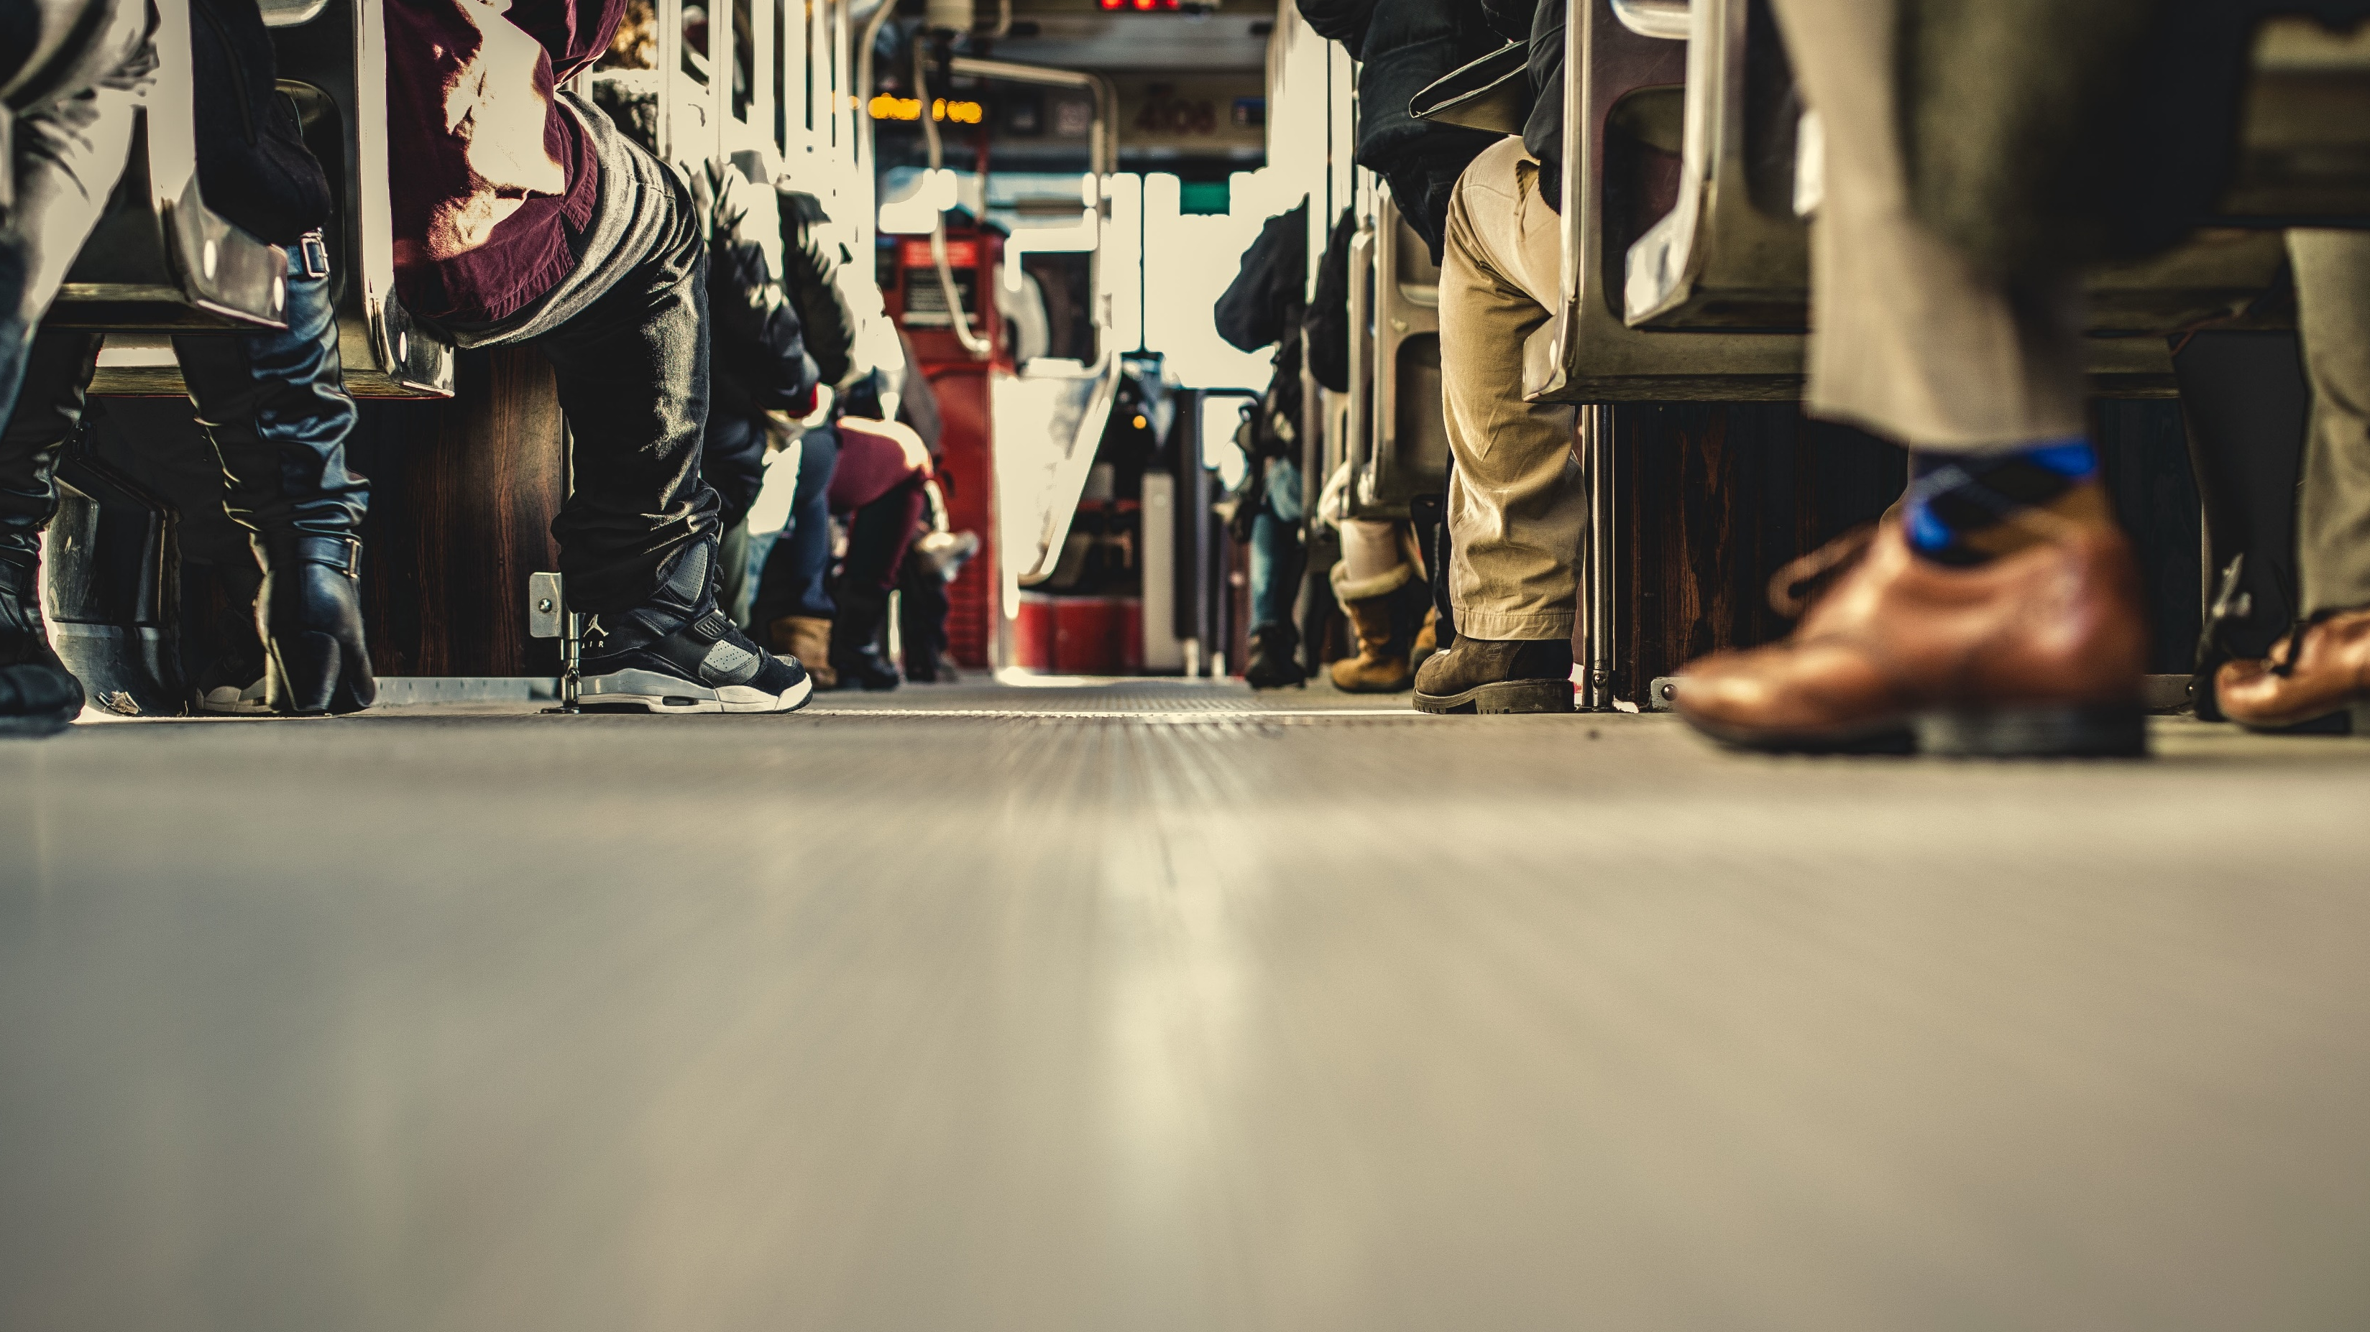
2 Tim 3:10-14
Staan vas in die geloof
Deel 2
Notes:
PRAY. Read the scripture BEFORE. Book of Tim. Pauls last letter. Sitting down to sit your last letter.
Paul contrasts, conduct of his life with that of false teachers,
urging Timothy to follow his example.
Paul prepares his young friend to stand firm amid increasing opposition, error, and suffering in the church.
Reminded of SEL GROEP This week.We all have some of these sin.
As long as we TOENEEM in heiligheid en NIE in Sonde.
BELY ons op ‘n Sunday and Wednesday or is it very encouraging every time?
The warning people will LOVE THEMSELVES. It's all about stealing God’s glory for self, they go from bad to worse.
When following God, we let go of our self-love, but we love God. We leave our ways and take on His ways. We see this tension in these passages, contrasting the Kingdom of God and the Kingdom of Darkness.

Slide 2
2 Tim 3:10-14
10 Maar jy het my nagevolg in leer, lewenswandel en lewensdoel, in geloof, geduld, liefde en volharding, 11 in vervolging en ontbering soos my te beurt geval het in Antiogië, Ikonium en Listra. Watter vervolging moes ek nie alles verduur nie! Maar die Here het my uit almal gered. 12 Almal wat in Christus Jesus toegewy aan God wil lewe, sal ook vervolg word
Notes:
Read twice

Slide 3
2 Tim 3:10-14
13 Maar goddelose mense en bedrieërs sal voortgaan van kwaad tot erger. Hulle mislei ander en word self mislei. 14 Maar jy, bly by wat jy geleer het en wat jy vas glo. Jy weet tog wie jou leermeesters was

Slide 4
2 Tim 3:10-14
10 Maar jy het my nagevolg in leer, lewenswandel en lewensdoel, in geloof, geduld, liefde en volharding, 11 in vervolging en ontbering soos my te beurt geval het in Antiogië, Ikonium en Listra. Watter vervolging moes ek nie alles verduur nie! Maar die Here het my uit almal gered. 12 Almal wat in Christus Jesus toegewy aan God wil lewe,
Notes:
Verse 11-12 - Read
We start of with these verses this morning, and once again. Is not the most encouraging thing to hear.
This is something NOT a lot of preachers will say. If you want to love Jesus, you will experience persecution. Challenges, times of difficulty. The NT teaches that we shouldn’t be verras wees van vervolging en verdrukking nie. We are swimming upstream.
We see Paul says that tribulation and persecution will come from OUTSIDE the church as in Antioch, Ikonium and Lystra, but then he also goes on to say that these imposters will go from bad to worse. Which means they shall come from WITHIN the church as well. Paul said that people inside the church attacked him, IN 2 COR he defends his apostleship to a church he found. Likewise, Jesus was criticized and killed from religious authorities. Likewise, the church will have people that persecute us. They are deceiving and being deceived.
Acts14 - through many tribulations, we must enter the kingdom of God. Acts 14:19-20 we see that Paul was stoned, left outside to die. This was Timothy’s hometown Lystra. God revived Paul, and he literally went back inside, sharing the gospel. Paul says, Timothy you have seen this.

Slide 5
Staan vas in die geloof
Hou 'n godvrugtige gesindheid deur beproewinge en vervolging
2 Tim 3:11-12
Watter vervolging moes ek nie alles verduur nie! Maar die Here het my uit almal gered. 12 Almal wat in Christus Jesus toegewy aan God wil lewe, sal ook vervolg word
Notes:
Acts14 - through many tribulations, we must enter the kingdom of God. Acts 14:19-20 we see that Paul was stoned, left outside to die. This was Timothy’s hometown Lystra. God revived Paul, and he literally went back inside, sharing the gospel. Paul says, Timothy you have seen this.
He knew that God will rescue Him even he continues. Becuase God decides.
And when God rescues us from persecution it’s not always that you haven’t taken some shots, even some physical pains, but God rescues us in a way that we stayed faithful, and we’ve grown in the faith.
That we continued giving Him glory and we remain faithful.
POINT 1 - Hou 'n godvrugtige gesindheid deur beproewinge en vervolging - ALTYD OPSOEK to give God glory
En dis nie net vervolging, but the enemy also comes with geestelike Aanvalle. Like we see in Job.
“All who desire to live a godly life, will be persecuted.” - Sounds so challenging.
HOEKOM is daar so baie verdrukkking deur mense?
Die ding is dat godvrugtige lewe die goddeloosheid van ander BLOOTSTEL. Mense hou nie daarvan om teregtewys te word nie.
Instede van bely of their ungodliness and turning to Christ, they seek to destroy the one who has shown them up for what they really are. It is totally irrationale gedrag, of course, but that is characteristic of fallen man.
Its their verdedigingsmeganisme om te wys dat hulle oukei is.

Slide 6
Staan vas in die geloof
Hou 'n godvrugtige gesindheid deur beproewinge en vervolging
Ons moet leer hoe om gesonde lering en gesonde mense te volg
2 Tim 3:13-14
13 Maar goddelose mense en bedrieërs sal voortgaan van kwaad tot erger. Hulle mislei ander en word self mislei. 14 Maar jy, bly by wat jy geleer het en wat jy vas glo. Jy weet tog wie jou leermeesters was
Notes:
Verse 14 - POINT 2 - We need to learn how to follow godly teaching and godly people
The what is the teaching and the WHOM is the people.
Now that we know the WHAT, How will we know who to follow? WHOM you have learned it?
If Paul says this to Timothy he is referring to the faithful people, Timothy has learned the correct doctrine, most probably referring to his grandmother and mother he has previously referred to but also referring to Paul, himself.
The question we need to ask:
Who are you learning from?
Who are you teaching?

Slide 7
Hoe kan ek goddelike mense identifiseer wat ek moet volg?
Hulle moet deursigtig lewe (deel goed en sleg)
Hulle leer God se woord reg
Hulle beoefen wat hulle verkondig
Hulle dra die vrug van die Gees
Hulle aanvaar gewillig lyding vir Christus
Notes:
How do you determine faithful people to learn from?
We need to follow them closely. We saw Tim and Paul having this very close relationship. And to follow them closely they need to be transparent, about their weaknesses and their strengths. They need to set an example to you in terms of their transparency and humility.
We mean these godly people knows that God receives all the glory. When we say teach correctly we mean lifting Jesus up high. Showing to the work on the cross teaching in humility.
Their lives should be a representation of living a life unto God. Be careful though, they are also people, they are also sinful, we don’t expect perfection fom anyone. But we can see that they love Jesus and their lives are lived upon the glory of God.
22Die vrug van die Gees, daarteenoor, is liefde, vreugde, vrede, geduld, vriendelikheid, goedhartigheid, getrouheid, 23nederigheid en selfbeheersing.
The show a positive attitude towards challenges in life, they are positive seeing that God is in control. Always busy teaching us things and growing through the process.

Slide 8
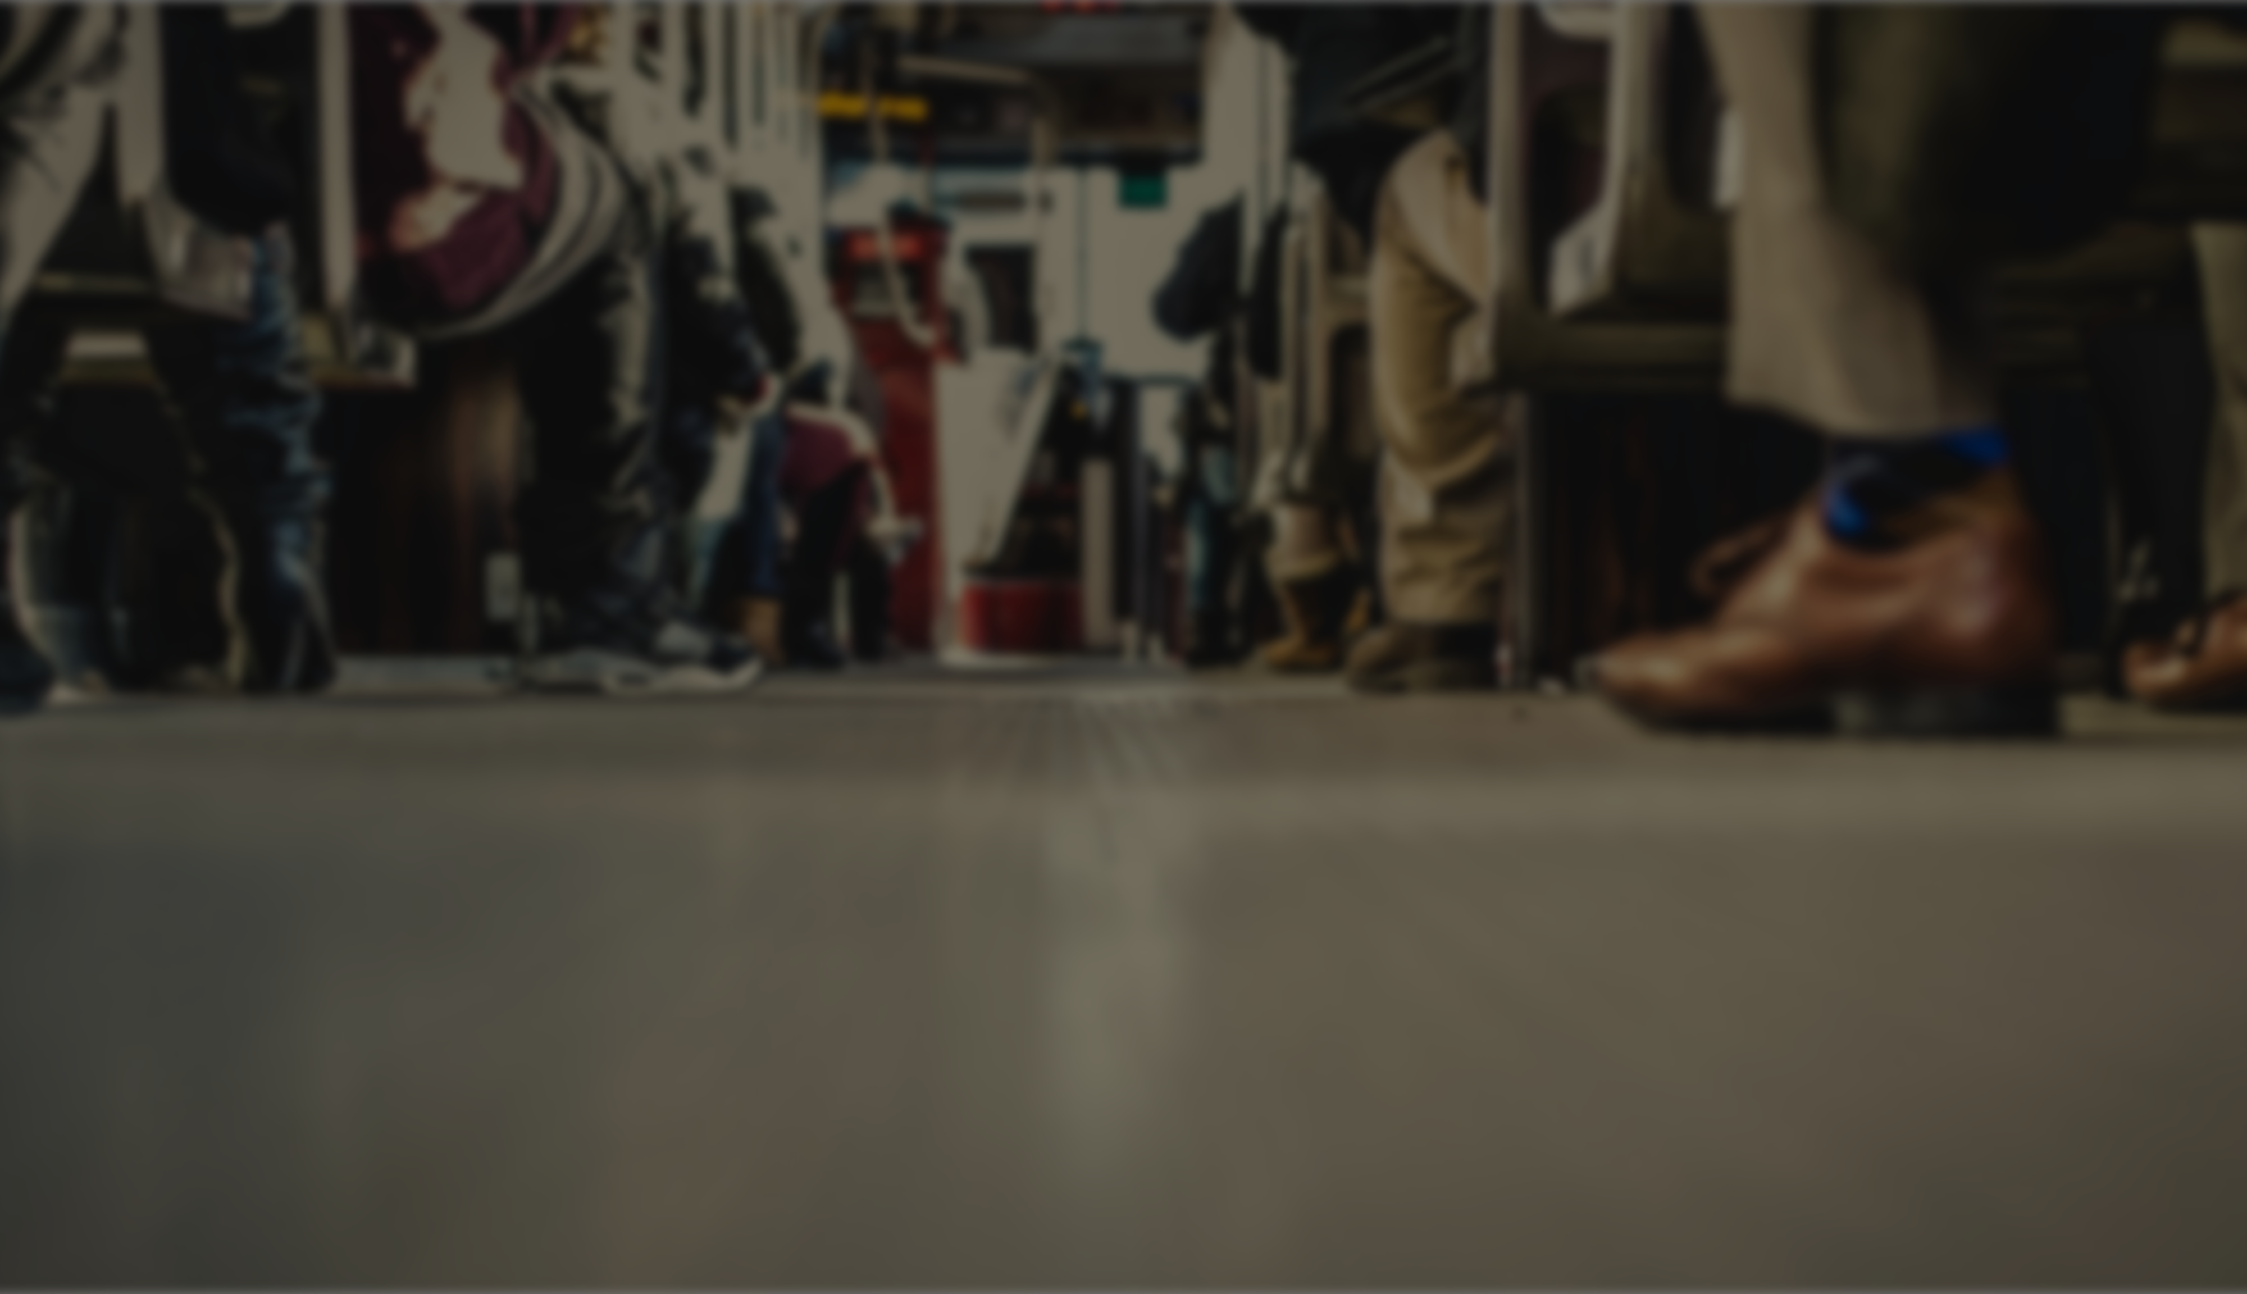
Gebedspunte
Bid vir 'n gewilligheid, en God se leiding om ons te leer hoe om 'n godvrugtige gesindheid te behou tydens beproewinge en vervolging
Bid vir God se leiding wanneer dit kom by die luister na lering en wie se voorbeeld om te volg
Caption
Notes:
2. En dat wat ek weet reg is en dat ek sal aanhiou om dit te toets.

