Slide 1
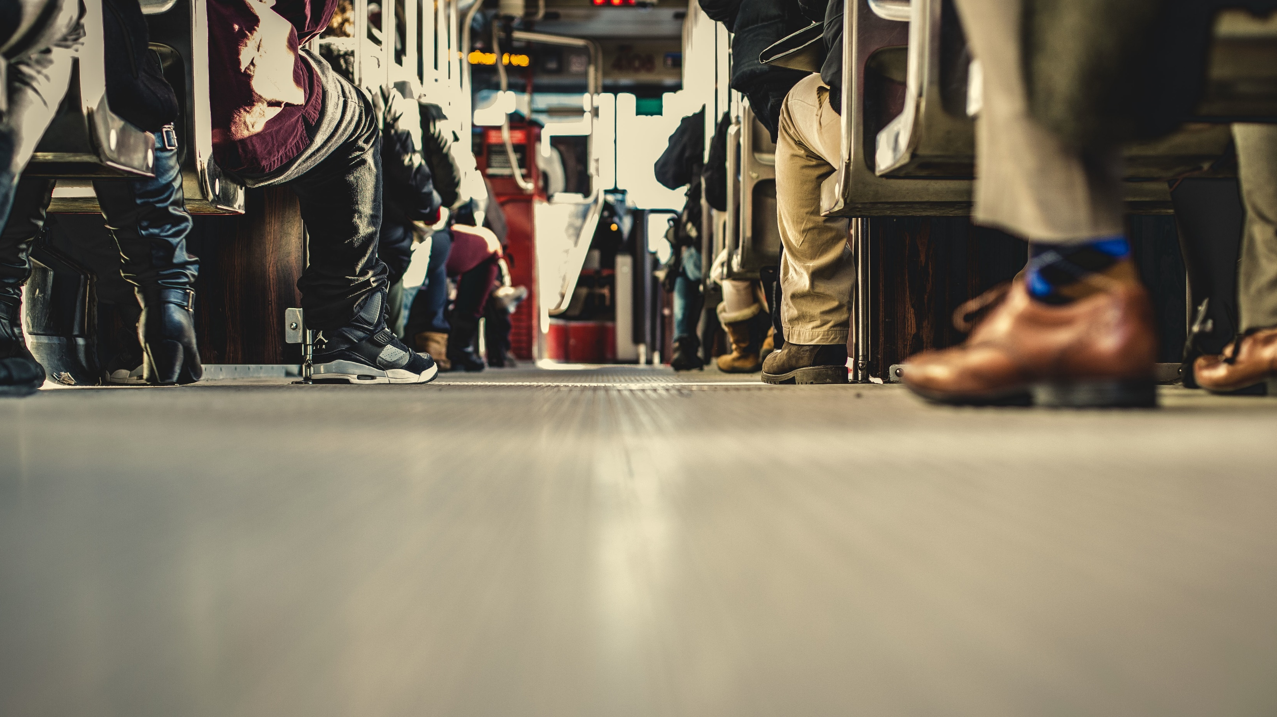
2 Tim 3:10-14
Standing Firm in the Faith
Part 1
Notes:
PRAY. Read the scripture BEFORE. Book of Tim. Pauls last letter. Sitting down to sit your last letter.
Paul contrasts the conduct of his life(V10-14) with that of false teachers (V1-9)
urging Timothy to follow his example of faithfulness, endurance, and perseverance in the face of persecution.
Continues Paul's exhortations to Timothy as he prepares his young friend to stand firm amid increasing opposition, error, and suffering in the church.
Context Overview:
Paul's letter to Timothy, his "beloved son,", encourages, and WANRS about the DIFFICULT task of leading the church.
In the preceding verses V1-9, Paul describes false teachers' growing apostasy and corrupt behavior in the last days. 19 examples of moral ugliness, of sins these people are characterized with by their moral depravity,
self-centeredness, and rejection of truth.
Against this backdrop, Paul urges Timothy to remain faithful, and to continue despite the trials that will come.

Slide 2
2 Tim 3:1-9
1 But understand this, that in the last days there will come times of difficulty. 2 For people will be lovers of self, lovers of money, proud, arrogant, abusive, disobedient to their parents, ungrateful, unholy, 3 heartless, unappeasable, slanderous, without self-control, brutal, not loving good, 4 treacherous, reckless, swollen with conceit, lovers of pleasure rather than lovers of God, 5 having the appearance of godliness, but denying its power. Avoid such people.
Notes:
Read before

Slide 3
2 Tim 3:1-9
6 For among them are those who creep into households and capture weak women, burdened with sins and led astray by various passions, 7 always learning and never able to arrive at a knowledge of the truth. 8 Just as Jannes and Jambres opposed Moses, so these men also oppose the truth, men corrupted in mind and disqualified regarding the faith. 9 But they will not get very far, for their folly will be plain to all, as was that of those two men.
Notes:
Read before

Slide 4
2 Tim 3:10-14
10 You, however, have followed my teaching, my conduct, my aim in life, my faith, my patience, my love, my steadfastness, 11 my persecutions and sufferings that happened to me at Antioch, at Iconium, and at Lystra—which persecutions I endured; yet from them all the Lord rescued me. 12 Indeed, all who desire to live a godly life in Christ Jesus will be
Notes:
Read twice

Slide 5
2 Tim 3:10-14
persecuted, 13 while evil people and impostors will go on from bad to worse, deceiving and being deceived. 14 But as for you, continue in what you have learned and have firmly believed, knowing from whom you learned it.

Slide 6
2 Tim 3:10-14
10 You, however, have followed my teaching, my conduct, my aim in life, my faith, my patience, my love, my steadfastness, 11 my persecutions and sufferings that happened to me at Antioch, at Iconium, and at Lystra—which persecutions I endured; yet from them all the Lord rescued me. 12 Indeed, all who desire to live a godly life in Christ Jesus will be
Notes:
We first see Paul saying, “You, however.” Contrasting all these negative things to Timothy.
Saying you have followed my life, my teaching, my conduct etc.
And then later in VERSE 14 saying “But as for you, Continue what you have learned”.
Even though Timothy had followed Paul’s teaching and example thus far, Paul felt it necessary to exhort him to continue doing so in the future, especially when he encountered persecution, as he surely would (3:12)
What is the big CONTRAST? The biggest contrast is we as believers we have an upward trend, where Paul says they have a downward trend!
We also have sin, 1John 1:8. Says you are deceived if you think you don’t have sin. BUT we hopefully, by Gods grace grow, we get better, we get less sin. Where in the end times, they get increasingly WORSE!
Therefore the contrast between believers and false teachers will get increasingly MORE!
And therefore it will get increasingly more difficult to do the right things! Persecution will increase!
That’s why Paul is exhorting Timothy to keep the faith!

Slide 7
2 Tim 3:10-14
10 You, however, have followed my teaching, my conduct, my aim in life, my faith, my patience, my love, my steadfastness, 11 my persecutions and sufferings that happened to me at Antioch, at Iconium, and at Lystra—which persecutions I endured; yet from them all the Lord rescued me. 12 Indeed, all who desire to live a godly life in Christ Jesus will be
Notes:
2. A godly example is known for someone’s character -
My conduct
This word means “a way of life”.
This would include everything about a person. The way he lives his life.
how he spends his time, how he manages money and possessions, what kind of entertainment he enjoys,
and how he relates to his family, friends, fellow workers, and even to strangers.
Is he rude or sensitive? Is he oblivious to the needs of others or kind and caring? Christianity is a way of life that affects all of life.
A godly example lives under the lordship of Jesus Christ.
Q: Can people see you worship Jesus?
3. My Aim in Life (purpose).
Paul was a man of purpose. His purpose was to help bring about God’s purpose , to proclaim the name of Jesus.
He did everything for the glory of God (1 Cor. 10:31). He related every aspect of his life to the supreme purpose of knowing Christ Jesus his Lord. And he saw this in Timothy as well. Phil 3:8 - 8 Indeed, I count everything as loss because of the surpassing worth of knowing Christ Jesus my Lord. For his sake I have suffered the loss of all things and count them as rubbish, in order that I may gain Christ
Q: Do you live for your own glory, or for the glory of God?

Slide 8
Standing firm in the faith
Are you following this similar way of life Paul described?
2 Tim 3:10
10 You, however, have followed my teaching, my conduct, my aim in life, my faith, my patience, my love, my steadfastness,
Notes:
Brings to 1st point
1. Are you following this similar way of life that Paul is describing?
How does teaching, conduct, your aim in life, your faith, your patience, your love, your steadfastness in faith look like?

Slide 9
Standing firm in the faith
Are you following this similar way of life Paul described?
Are you living a transparent life?
2 Tim 3:10
10 You, however, have followed my teaching, my conduct, my aim in life, my faith, my patience, my love, my steadfastness,
Notes:
Transparency is the 1st thing we lose when we stop to stand firm in the faith.
Paul was definitely not perfect, but he strived towards perfection.
He really wanted to grow and pursue a holy life, and therefore allowed Timothy to love close to him.
The more we begin to live in the light and walk in the light with others the easier it will be to stand firm.
1 John 1:7 says, “But if we walk in the light as he himself is in the light, we have fellowship with one another and the blood of Jesus his Son cleanses us from all sin.”
We are far from perfect, but we follow a perfect God who can use even our imperfections to encourage others who are similarly imperfect.
While an ungodly example practices hypocrisy and puts on a mask to appear holy,
a godly example lives a transparent life, which includes both his successes and failures

Slide 10
Prayer Points
For looking to Jesus, asking Him to convict us of wrong ways of life
For a transparency, boldness to share sins with our brothers and sisters in the faith
Caption
Notes:
2 Points
Explain and read

