Slide 1
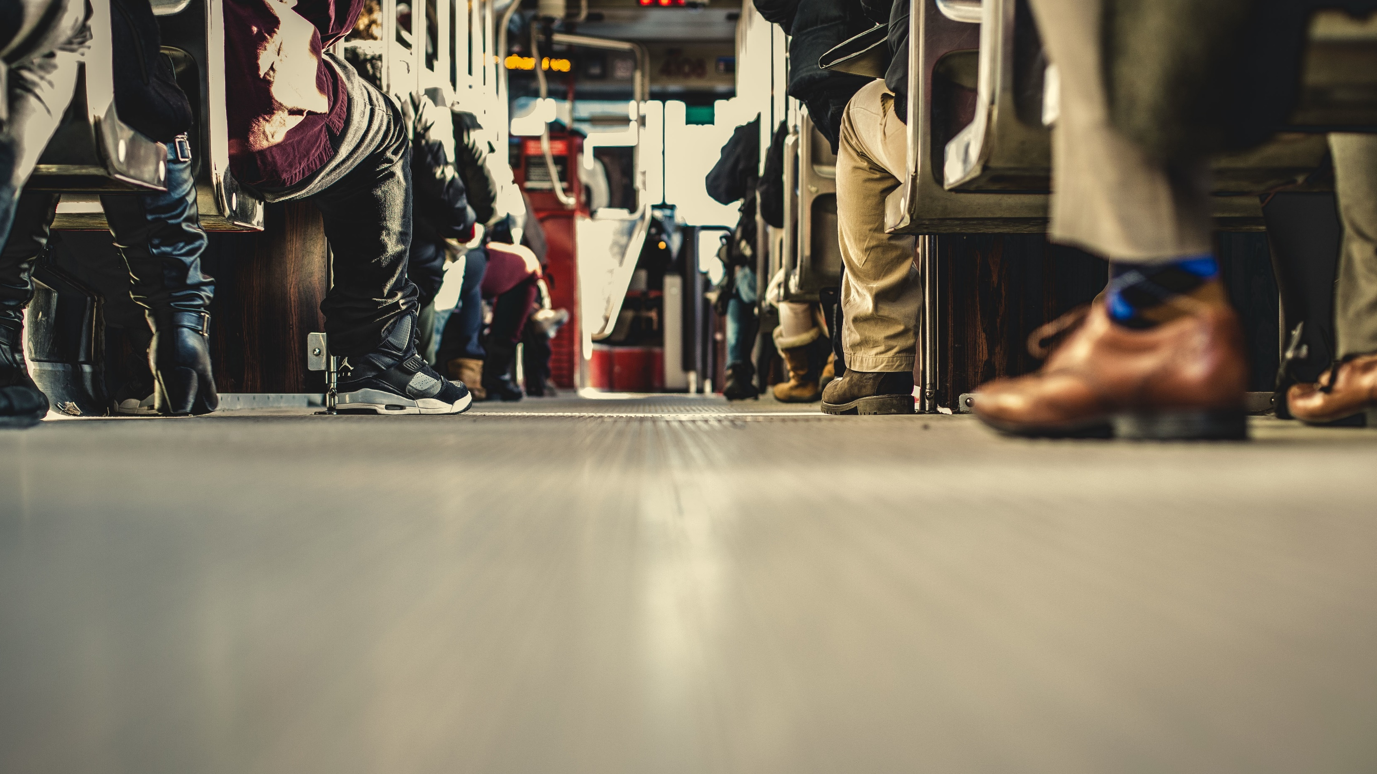
2 Tim 3:10-14
Staan vas in die geloof
Deel 1
Notes:
PRAY. Read the scripture BEFORE. Book of Tim. Pauls last letter. Sitting down to sit your last letter.
Paul contrasts the conduct of his life(V10-14) with that of false teachers (V1-9)
urging Timothy to follow his example of faithfulness, endurance, and perseverance in the face of persecution.
He continues Paul's exhortations to Timothy as he prepares his young friend to stand firm amid increasing opposition, error, and suffering in the church.
Paul's letter to Timothy, his "beloved son,", encourages, and WARN about the DIFFICULT task of leading the church. In the preceding verses V1-9, Paul describes false teachers' growing apostasy and corrupt behavior in the last days.. 19 examples of moral ugliness, of sins these people are characterized with by their moral depravity,
self-centeredness, and rejection of truth.
Against this backdrop, Paul urges Timothy to remain faithful, and to continue despite the trials that will come.

Slide 2
2 Tim 3:1-9
1 Dít moet jy weet: in die laaste dae sal daar swaar tye kom. 2 Die mense sal selfsugtig wees, geldgierig, grootpraterig en verwaand, beledigend teenoor hulle medemense en ongehoorsaam aan hulle ouers, ondankbaar en ongodsdienstig; 3hulle sal liefdeloos en onversoenlik wees, kwaadpraters, bandeloos en wreed, sonder liefde vir die goeie; 4 hulle sal verraaiers wees, roekeloos en hooghartig. Hulle sal eerder liefde vir genot hê as liefde vir
Notes:
Read before

Slide 3
2 Tim 3:1-9
God. 5Hulle sal nog die uiterlike skyn van die godsdiens hê, maar die krag van die godsdiens sal hulle nie ken nie. Bly weg van sulke mense af. 6Party van hulle dring in die huise in en kry liggelowige vroue wat met sonde belaai is en deur allerlei sinlike begeertes gedryf word, in hulle mag, 7vroue wat altyd iets wil leer, maar tog nooit tot die kennis van die waarheid kan kom nie. 8Net soos Jannes en Jambres hulle teen Moses verset het,
Notes:
Read before

Slide 4
2 Tim 3:1-9
so verset hierdie mense hulle teen die waarheid, mense wat in die verstand verward is en in die geloof 'n mislukking. 9Maar hulle sal nie ver kom nie, omdat hulle dwaasheid vir almal duidelik sal wees, net soos dit die geval was met Jannes en Jambres.
Notes:
Read before

Slide 5
2 Tim 3:10-14
10 Maar jy het my nagevolg in leer, lewenswandel en lewensdoel, in geloof, geduld, liefde en volharding, 11 in vervolging en ontbering soos my te beurt geval het in Antiogië, Ikonium en Listra. Watter vervolging moes ek nie alles verduur nie! Maar die Here het my uit almal gered. 12 Almal wat in Christus Jesus toegewy aan God wil lewe,
Notes:
Read twice

Slide 6
2 Tim 3:10-14
sal ook vervolg word. 13 Maar goddelose mense en bedrieërs sal voortgaan van kwaad tot erger. Hulle mislei ander en word self mislei. 14 Maar jy, bly by wat jy geleer het en wat jy vas glo. Jy weet tog wie jou leermeesters was

Slide 7
2 Tim 3:10-14
10 Maar jy het my nagevolg in leer, lewenswandel en lewensdoel, in geloof, geduld, liefde en volharding, 11 in vervolging en ontbering soos my te beurt geval het in Antiogië, Ikonium en Listra. Watter vervolging moes ek nie alles verduur nie! Maar die Here het my uit almal gered. 12 Almal wat in Christus Jesus toegewy aan God wil lewe,
Notes:
We first see Paul saying, “Maar jy.” Contrasting all these negative things to Timothy.
Saying you have followed my life, my teaching, my conduct etc.
And then later in VERSE 14 saying “Maar jy, bly by wat jy geleer het en wat jy vas glo. Jy weet tog wie jou leermeesters was ”v 14.
Even though Timothy had followed Paul’s teaching and example thus far, Paul felt it necessary to exhort him to continue doing so in the future, especially when he encountered persecution, as he surely would (3:12)
What is the big CONTRAST? The biggest contrast is we as believers we have an upward trend, where Paul says they have a downward trend!
We also have sin, 1John 1:8. Says you are deceived if you think you don’t have sin. BUT we hopefully, by Gods grace grow, we get better, we get less sin. Where in the end times, they get increasingly WORSE!
Therefore the contrast between believers and false teachers will get increasingly MORE!
And therefore it will get increasingly more difficult to do the right things! Persecution will increase!
That’s why Paul is exhorting Timothy to keep the faith!

Slide 8
2 Tim 3:10-14
10 Maar jy het my nagevolg in leer, lewenswandel en lewensdoel, in geloof, geduld, liefde en volharding, 11 in vervolging en ontbering soos my te beurt geval het in Antiogië, Ikonium en Listra. Watter vervolging moes ek nie alles verduur nie! Maar die Here het my uit almal gered. 12 Almal wat in Christus Jesus toegewy aan God wil lewe,
Notes:
Let’s look at the things Paul highlights here. What is it that Paul says Timothy faithfully followed him in.
1. My Teaching - Paul will charge Timothy to preach the word of God. As we have seen so many times.
1 Tim 1:3- dring ek nou weer by jou daarop aan om in Efese te bly. Daar is sekere mense wat vals leerstellings versprei, en jy moet hulle dit verbied
Therefore let us be vigilant and listen well to what others teach us, and also of course do we teach others?
It won’t take you long to discern that someone is using the Bible as an inspirational springboard.
Also, a godly Bible teacher does not skip the difficult sections and doctrines. He teaches the whole purpose of God.
Note also (1 Tim 3:15) ’n Godvresende leier gebruik die Skrif om mense te lei - “deur Redding tot geloof alleenlik deur Jesus Christus”- Altyd te wys na Jesus. The eternal life.
We see that Paul also later mentions that Timothy has been acquainted with the sacred writings from a young age.
God’s Word can give even a child the wisdom that leads to salvation, which means, salvation from God’s righteous judgment on our sins. That salvation does not come by keeping the moral precepts of the Bible, or even by believing the Bible.
Rather, salvation comes through faith in Christ Jesus alone. Sound doctrine. The fact that you know you are in sin and have a problem, and that the solution is Jesus.
V: Leer jy jou kinders? Deel jy jou geloof? Help hulle om die Bybel te verstaan?
V: Of dalk is jy iemand sonder kinders. Lees jy die Bybel? Leer jy ander die Bybel? Ken jy die Bybel? You can not say you have faith in Jesus, and don’t be interested in Him.

Slide 9
Staan vas in die geloof
Leef jy ’n lewe wat ooreenstem met wat Paulus beskryf?
2 Tim 3:10
10 Maar jy het my nagevolg in leer, lewenswandel en lewensdoel, in geloof, geduld, liefde en volharding,
Notes:
Brings to 1st point
1. Are you following this similar way of life that Paul is describing?
How does teaching, conduct, your aim in life, your faith, your patience, your love, your steadfastness in faith look like?

Slide 10
Staan vas in die geloof
Leef jy ’n lewe wat ooreenstem met wat Paulus beskryf?
Lewe jy ’n lewe van deursigtigheid?
2 Tim 3:10
10 Maar jy het my nagevolg in leer, lewenswandel en lewensdoel, in geloof, geduld, liefde en volharding,
Notes:
Transparency is the 1st thing we lose when we stop to stand firm in the faith.
Paul was definitely not perfect, but he strived towards perfection.
He really wanted to grow and pursue a holy life, and therefore allowed Timothy to love close to him.
The more we begin to live in the light and walk in the light with others the easier it will be to stand firm.
1 John 1:7 says, “7Maar as ons in die lig wandel soos Hy in die lig is, dan het ons gemeenskap met mekaar; en die bloed van Jesus Christus, sy Seun, reinig ons van alle sonde.
We are far from perfect, but we follow a perfect God who can use even our imperfections to encourage others who are similarly imperfect.
While an ungodly example practices hypocrisy and puts on a mask to appear holy,
a godly example lives a transparent life, which includes both his successes and failures

Slide 11
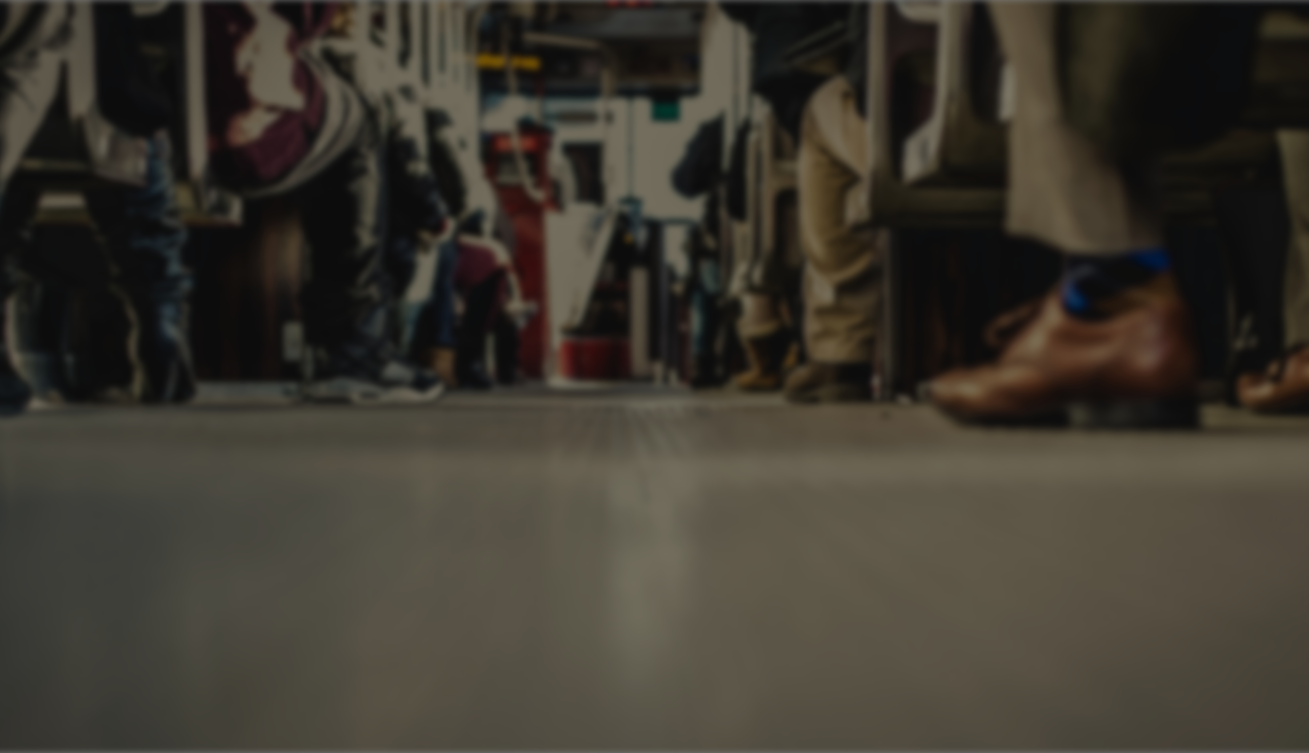
Gebedspunte
Om aan te hou kyk na Jesus, en te vra dat hy jou kom bewus maak van verkeerde maniere / gewoontes van lewe (sonde)
Vir groei na ’n meer deursigtige lewe, om vrymoedheid te hê om na medegelowiges te gaan en jou sondes te bely
Caption
Notes:
Pray.
2 points.

