Slide 1
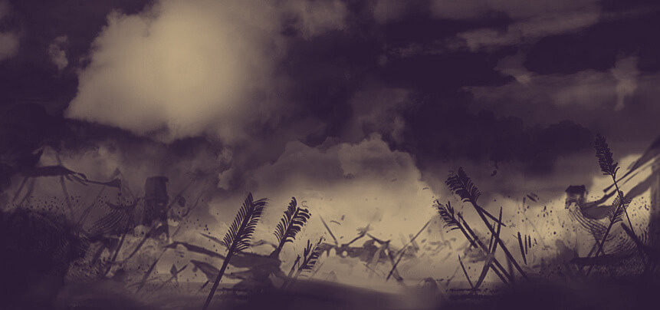

BEYOND THE BATTLE
Stephan Verhoef

Slide 2
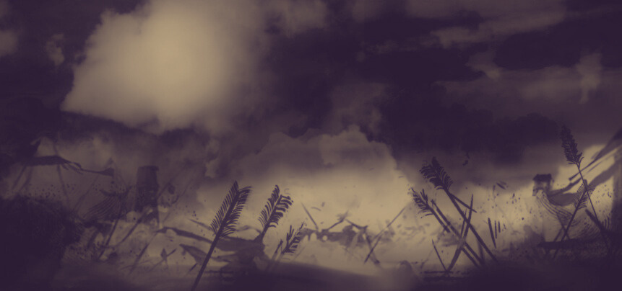

How do false teachers and battle
connect with one another?

Slide 3
2 Peter 2:2 (ESV)
2 And many will follow their sensuality, and because of them the way of truth will be blasphemed.

Slide 4
Ephesians 6:10-18 (ESV)
10 Finally, be strong in the Lord and in the strength of his might. 11 Put on the whole armor of God, that you may be able to stand against the schemes of the devil. 12 For we do not wrestle against flesh and blood, but against the rulers, against the authorities, against the cosmic powers over this present darkness, against the spiritual forces of evil in the heavenly places. 13 Therefore take up the whole armor of God, that you may be able to withstand in the evil day, and having done all, to stand firm.

Slide 5
Ephesians 6:10-18 (ESV)
14 Stand therefore, having fastened on the belt of truth, and having put on the breastplate of righteousness, 15 and, as shoes for your feet, having put on the readiness given by the gospel of peace. 16 In all circumstances take up the shield of faith, with which you can extinguish all the flaming darts of the evil one; 17 and take the helmet of salvation, and the sword of the Spirit, which is the word of God, 18 praying at all times in the Spirit, with all prayer and supplication. To that end, keep alert with all perseverance, making supplication for all the saints.

Slide 6
Ephesians 6:10-12 (ESV)
10 Finally, be strong in the Lord and in the strength of his might. 11 Put on the whole armor of God, that you may be able to stand against the schemes of the devil. 12 For we do not wrestle against flesh and blood, but against the rulers, against the authorities, against the cosmic powers over this present darkness, against the spiritual forces of evil in the heavenly places.

Slide 7
2 Timothy 2: 25b - 26 (ESV)
25b God may perhaps grant them repentance leading to a knowledge of the truth, 26 and they may come to their senses and escape from the snare of the devil, after being captured by him to do his will.

Slide 8
Ephesians 6:13-17 (ESV)
13 Therefore take up the whole armor of God, that you may be able to withstand in the evil day, and having done all, to stand firm. 14 Stand therefore, having fastened on the belt of truth, and having put on the breastplate of righteousness, 15 and, as shoes for your feet, having put on the readiness given by the gospel of peace. 16 In all circumstances take up the shield of faith, with which you can extinguish all the flaming darts of the evil one; 17 and take the helmet of salvation, and the sword of the Spirit, which is the word of God.

Slide 9
The Armor of God
  Belt
  Breastplate
  Shoes
  Shield
  Helmet
  Sword
= Truth
= Righteousness
= Readiness (Gospel)
= Faith
= Salvation
= Spirit (Scripture)

Slide 10
Ephesians 4:11-14 (ESV)
11 And he gave the apostles, the prophets, the evangelists, the shepherds and teachers, 12 to equip the saints for the work of ministry, for building up the body of Christ, 13 until we all attain to the unity of the faith and of the knowledge of the Son of God, to mature manhood, to the measure of the stature of the fullness of Christ, 14 so that we may no longer be children, tossed to and fro by the waves and carried about by every wind of doctrine, by human cunning, by craftiness in deceitful schemes. 15 Rather, speaking the truth in love, we are to grow up in every way into him who is the head, into Christ,

Slide 11
The Armor of God
  Belt
  Breastplate
  Shoes
  Shield
  Helmet
  Sword
= Truth
= Righteousness
= Readiness (Gospel)
= Faith
= Salvation
= Spirit (Scripture)

Slide 12
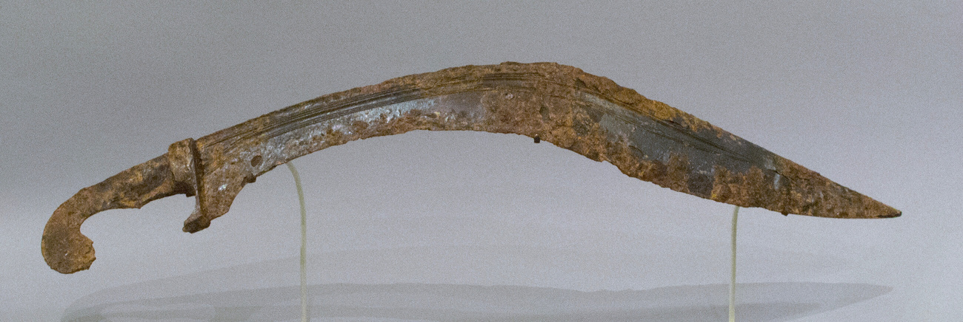
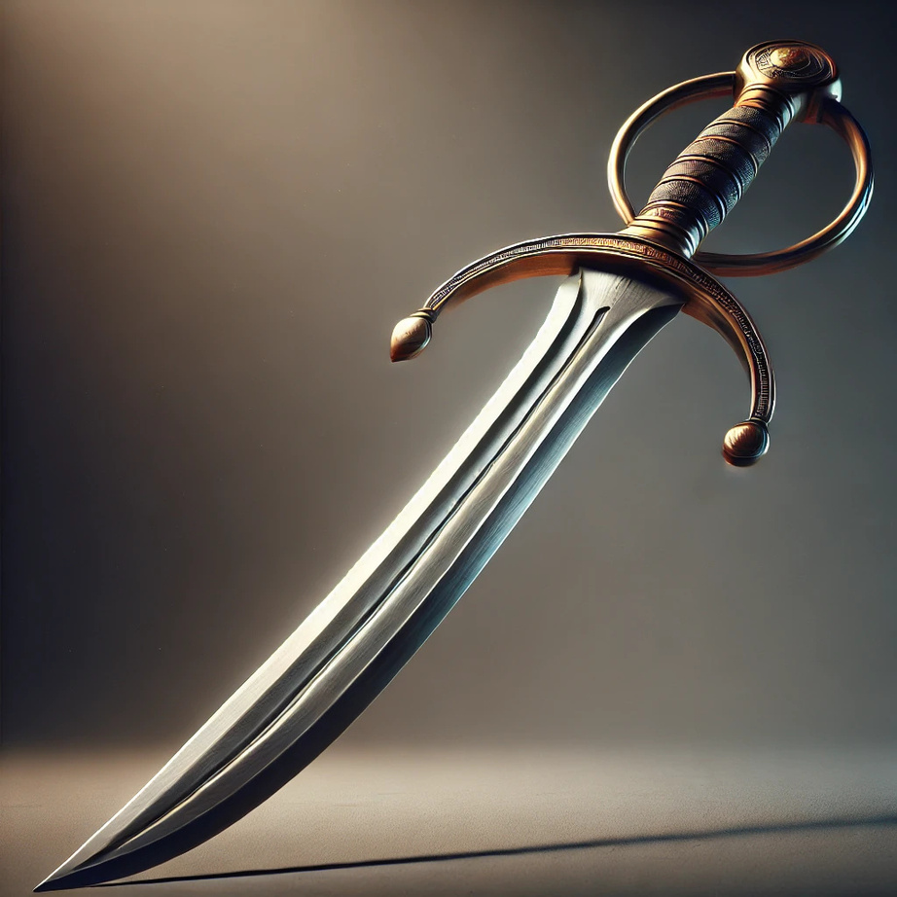
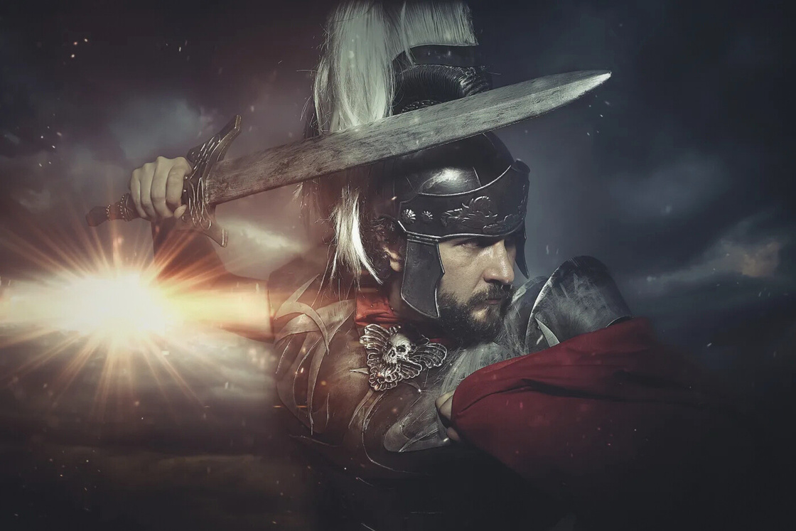
The Armor of God
machaira

Slide 13
2 Corinthians 10:3-5 (ESV)
3 For though we walk in the flesh, we are not waging war according to the flesh. 4 For the weapons of our warfare are not of the flesh but have divine power to destroy strongholds. 5 We destroy arguments and every lofty opinion raised against the knowledge of God, and take every thought captive to obey Christ.

Slide 14
Isaiah 59:17 (ESV)
He put on righteousness as a breastplate,
and a helmet of salvation on his head;
he put on garments of vengeance for clothing,
and wrapped himself in zeal as a cloak.

Slide 15
Reflective Questions
1. Are you still or have you ever been in Jesus?

Slide 16
Reflective Questions
1. Are you still or have you ever been in Jesus?
2. How do we handle false teachers or people that have been
led astray?

Slide 17
Reflective Questions
1. Are you still or have you ever been in Jesus?
2. How do we handle false teachers or people that have been
led astray?
3. Are you open to correction if you are the one that has been
led astray?

