Slide 1
The truth will set you free
Part 5
But what is the truth
Renier Louwrens

Slide 2
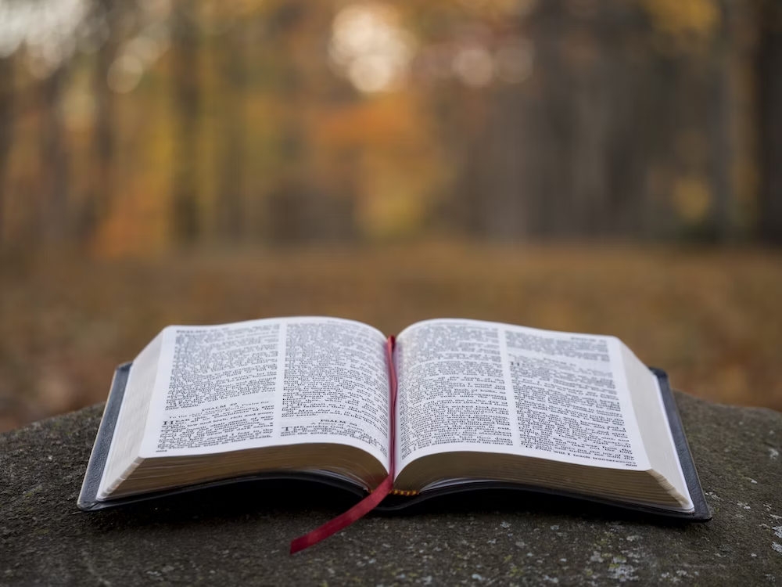
The Bible is the only truth
Notes:
Die Bybel sê mos dat.
Erens in die Bybel sê dit
Christine moet mos.

Slide 3
False ammunition series.
False ammunition
Danger
You shall not judge
12 Nov 2023
Matt 7:1
The false ammunition
Matt 7:3-5
Matt 18
The Truth
Jesus knocks on our hearts
18 Feb 2024
Easter
07 April 2024
Rev 3:20
The false ammunition
Rev 3
John 3
The truth
Matt18:15-20
Heb 10:25
f
The Truth
Matt 26
The false ammunition
Matt 26
The Truth
Where 2 or more are
09 June 2024
Matt18:19-20
g
The false ammunition
Notes:
Today is going to be practical. Is that fine? Will you answer the questions?
If you were not here for the first sermons of this series, don’t stress, I am going to catch you up quickly, you an also get these sermons from the Shofar website. They were on 12 Nov and 18 Feb. If you were here, then also don’t worry, we are swiftly going to move over into the Easter leg of this series.
What is very important today is to note a couple of things which this sermon is not focussing on.
Prophecies – This story is full of prophecies being fulfilled and one can easily do a sermon about that. So if at some stage you think hey but what about the prophecy, know that it is there, but what God wants us to focus on in the next 30min is another mesasage.
Also. The main message from Pass over stays the death and resurrection of Jesus to

Slide 4
Discipleship – Reflecting on Tim
There is no Christianity without discipleship

Slide 5
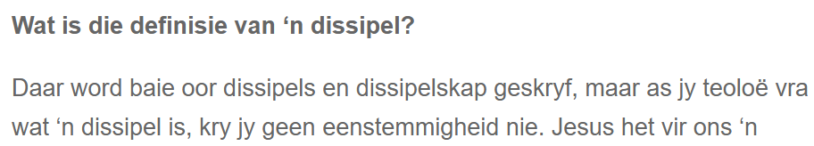
What is a disciple
Alot is written about disciples and discipleship, but even the greatest theologens can’t agree on a definition

Slide 6
What does Jesus say is a disciple
Love God above anything else
25 Large crowds were traveling with Jesus, and turning to them he said: 26 “If anyone comes to me and does not hate father and mother, wife and children, brothers and sisters—yes, even their own life—such a person cannot be my disciple.(Luke 14:25 – 26).
Live in th elight of God
31 To the Jews who had believed him, Jesus said, “If you hold to my teaching, you are really my disciples. 32 Then you will know the truth, and the truth will set you free.”(Johannes 8:31 – 32).

Slide 7
What does Jesus say is a disciple
Accept the will of God completely and without exception
Take up your cross(Luke 9:23)
Gehoorsaam Jesus
Om Jesus te volg (Lukas 9:23), beteken dat ons op sy pad loop. Dit beteken ons is gehoorsaam aan die Een wat ons volg. Ons moet Hom gehoorsaam al is dit ongemaklik en kos dit ons iets.

Slide 8
Discipleship
What does it mean to you?

Slide 9
Discipleship
What does it mean to you?
The world does not know

Slide 10
Discipleship
What does it mean to you?
The world does not know.
The Word does know.

Slide 11
Discipleship – The world
Specific people are called to be desciples and disciple makers.
Before I can help someone, I need to ensure that I completely understand discipleship and everything around it. If not, I cannot teach them.
I must disciple people, but I can only disciple certain people.
Discipleship is a one way growth process where you show people where they went wrong to help them be better.

Slide 12
Discipleship – Reflecting on Tim
There is no Christianity without discipleship
Discipleship is anything we do to bring people closes to Jesus – the methods will differ during the process

Slide 13
Discipleship – Matt 28
16 Then the eleven disciples went to Galilee, to the mountain where Jesus had told them to go. 17 When they saw him, they worshiped him; but some doubted. 18 Then Jesus came to them and said, “All authority in heaven and on earth has been given to me.

Slide 14
Discipleship – Matt 28
19 Therefore go and make disciples of all nations, baptizing them in the name of the Father and of the Son and of the Holy Spirit, 20 and teaching them to obey everything I have commanded you. And surely I am with you always, to the very end of the age.”

Slide 15
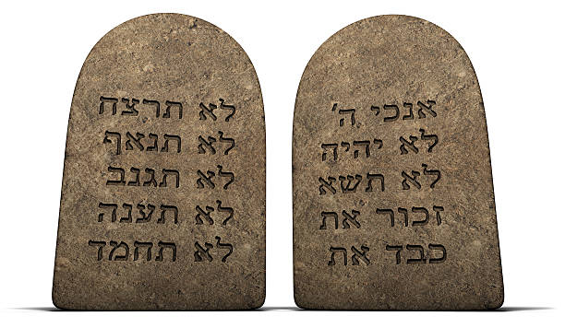
Discipleship – Matt 28
Notes:
As Christene een nie Christene ken ons almal die 10 opdragte wat God vir Moses gegee het, wat ‘n opdrag is aan ons en waarvolgens ons moet lewe.
Maar wat maak Matt 28 anders? Dis basies net ‘n 11de gebod. Kom ons kyk.
Die eerste 5 gaan oor God lief hê en die volgende 5 gaan oor mense lief hê. Matt 28 is ‘n opsomming daarvan.

Slide 16
Discipleship – Matt 28
19 Therefore go and make disciples of all nations, baptizing them in the name of the Father and of the Son and of the Holy Spirit, 20 and teaching them to obey everything I have commanded you. And surely I am with you always, to the very end of the age.”

Slide 17
Discipleship – The world
Specific people are called to be desciples and disciple makers.
Before I can help someone, I need to ensure that I completely understand discipleship and everything around it. If not, I cannot teach them.
I must disciple people, but I can only disciple certain people.
Discipleship is a one way growth process where you show people where they went wrong to help them be better.

Slide 18
Discipleship – Replacing with truth
Discipleship is a command from God, it is not a calling for some and not for others.
Notes:
CV’s by die werk.

Slide 19

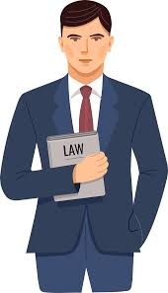
The perfect candidate CV
Qualification
Experience
Facilities
Success stories
References
Knowledge
Vontinuous learning
Possible further qualifications
Support services
…….

Slide 20
Discipleship – Matt 28
16 Then the eleven disciples went to Galilee, to the mountain where Jesus had told them to go. 17 When they saw him, they worshiped him; but some doubted. 18 Then Jesus came to them and said, “All authority in heaven and on earth has been given to me.

Slide 21

The Perfect candidate’s CV
Live a life which follows Jesus
Notes:
Jesus het vir die dissipels gesê om dissipels te maak. Hulle is dissipels want hy het hulle dissipel.
Hy het hulle nader aan Hom gebring.
Nou moet hulle ander nader aan Hom bring.
Hy het nie gesê, “Nou dat julle perfek is, gaan uit” nie. Hy het hulle aangespreek as dissipels en toe gesê gaan maak nog.
Hoe gereeld leer die wêreld ons nie ander nie. Ons dink ons moet eers perfek wees.
Wie dink jy is jy om vir my te sê

Slide 22
Discipleship – The world
Discipleship is a command from God, it is not a calling for some and not for others.
Before I can help someone, I need to ensure that I completely understand discipleship and everything around it. If not, I cannot teach them.
I must disciple people, but I can only disciple certain people.
Discipleship is a one way growth process where you show people where they went wrong to help them be better.

Slide 23
Dissipelskap – Waarheid vervanging
Discipleship is a command from God, it is not a calling for some and not for others.
I don’t have to be perfect to disciple someone, I can still be me as I am now and be obedient by discipling

Slide 24
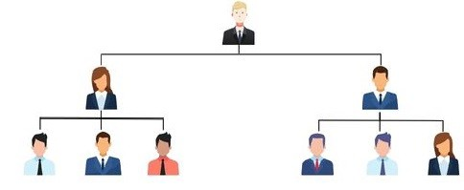
Who may I disciple
Notes:
First off – Most of us have the wrong image about Judas.
Someone sinister, sneaky, with shifty eyes, he lies all the time, he hissed a little bit when he talked and muddered to himself under his breath.
The reality is that Judas was nothing like that. He was a very respected person, even one of the most trusted of the disciples. Now if your mind blows now and you cn’t believe that the person who betrayed Jesus was actually trusted, then just think about this. From 2 people who followed Jesus everywhere, he was the one elected by his pears to be in charge of the purse. Who in your group of 5 would you give the purse to? He was entrusted by those around him. Also think of when Jesus said

Slide 25
Who may I disciple
Notes:
Storie van sport sterre wat alhoewel hulle die beste is gedissipel word deur ander wat hulle kan help groei.

Slide 26
Who may I disciple
Notes:
Sport mense wat die heel beste is.
Wie gaan anders die hoog geagdes dissipel? Dis ons.

Slide 27
Colossians 3
"Let the word of Christ dwell in you richly, teaching and admonishing one another in all wisdom,
Notes:
Hier kry ons ons kriteria, ons is nie beperk oor wie ons leer nie, ons is wel gelei in wat ons leer.

Slide 28
Discipleship – The world
Discipleship is a command from God, it is not a calling for some and not for others.
I don’t have to be perfect to disciple someone, I can still be me as I am now and be obedient by discipling
I must disciple people, but I can only disciple certain people.
Discipleship is a one way growth process where you show people where they went wrong to help them be better.

Slide 29
Dissipelskap – Waarheid vervanging
Dissipelskap is ‘n opdrag van God, nie ‘n roeping vir party nie.
Ek hoef nie perfek te wees om iemand anders nader aan Jesus te bring nie, net bereidwillig.
Jesus wants us to walk a road with anyone, to disciple all over, no matter how eartlhy structure and hierarchy looks. Heaven is for all.

Slide 30
Dissipelskap – Waarheid vervanging
Dissipelskap is ‘n opdrag van God, nie ‘n roeping vir party nie.
Ek hoef nie perfek te wees om iemand anders nader aan Jesus te bring nie, net bereidwillig.
Jesus wants us to walk a road with anyone, to disciple all over, no matter how eartlhy structure and hierarchy looks. Heaven is for all.
Discipleship is about leading people to God, no matter who they are, how good we feel we are or how perfect they seem

Slide 31
Reflection
Who does God send on your path to disciple?
Notes:
To understand what this verse says, we must first understand what it does not say.
The context this is usually used in is in small groups or on outreaches

