Slide 1


2 Tim 2:1-7
Part 2: As a good soldier
of Jesus

Slide 2

The Gospel through generations
We can only give to others what we have.
We guard the Gospel by entrusting it to faithful men.
Faithful men are men of character.
We don’t just do this for Jesus, we also do it with Jesus.
Caption

Slide 3
2 Tim 2:1-7 (ESV)
¹You then, my child, be strengthened by the grace that is in Christ Jesus, ² and what you have heard from me in the presence of many witnesses entrust to faithful men, who will be able to teach others also. ³ Share in suffering as a good soldier of Christ Jesus.⁴ No soldier gets entangled in civilian pursuits, since his aim is to please the one who enlisted him.
Caption

Slide 4
2 Tim 2:1-7 (ESV)
⁵ An athlete is not crowned unless he competes according to the rules. ⁶ It is the hard-working farmer who ought to have the first share of the crops. ⁷ Think over what I say, for the Lord will give you understanding in everything.
Caption

Slide 5
2 Tim 2:3-4 (ESV)
³ Share in suffering as a good soldier of Christ Jesus.⁴ No soldier gets entangled in civilian pursuits, since his aim is to please the one who enlisted him.
Caption

Slide 6
As a good soldier of Jesus
We will suffer for the things we value.
Caption

Slide 7
2 Tim 2:4 (ESV)
⁴ No soldier gets entangled in civilian pursuits, since his aim is to please the one who enlisted him.
Caption

Slide 8
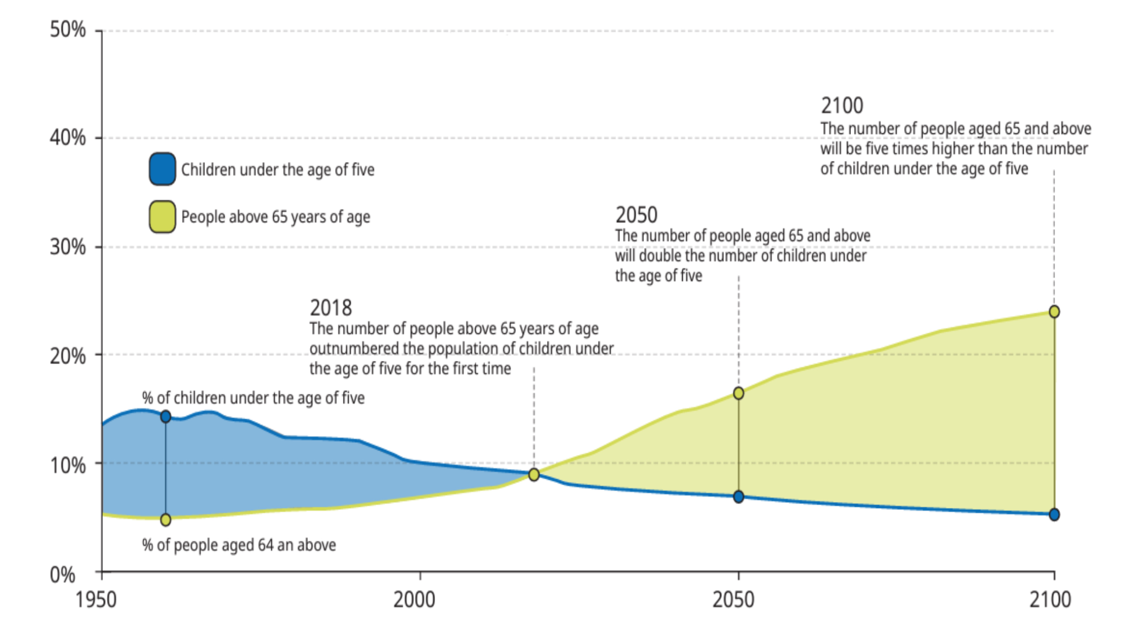
Caption
Caption

Slide 9
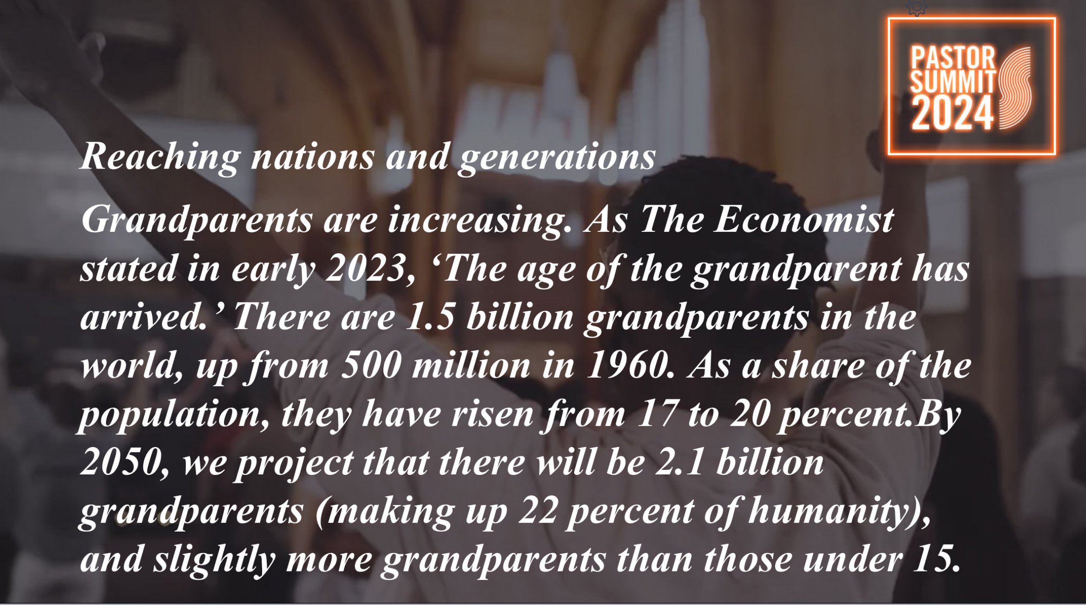
Caption
Caption
Caption

Slide 10
As a good soldier of Jesus
We will suffer for the things we value.
Our lives will be shaped by what or who holds our hearts and minds.
Caption

Slide 11
Deut 6:1-2 (NIV)
¹ These are the commands, decrees and laws the Lord your God directed me to teach you to observe in the land that you are crossing the Jordan to possess, ²so that you, your children and their children after them may fear the Lord your God as long as you live by keeping all his decrees and commands that I give you, and so that you may enjoy long life.
Caption

Slide 12
As a good soldier of Jesus
Are you willing to share in suffering for the Gospel?
Who or what currently holds your heart and mind?
Caption

