Slide 1
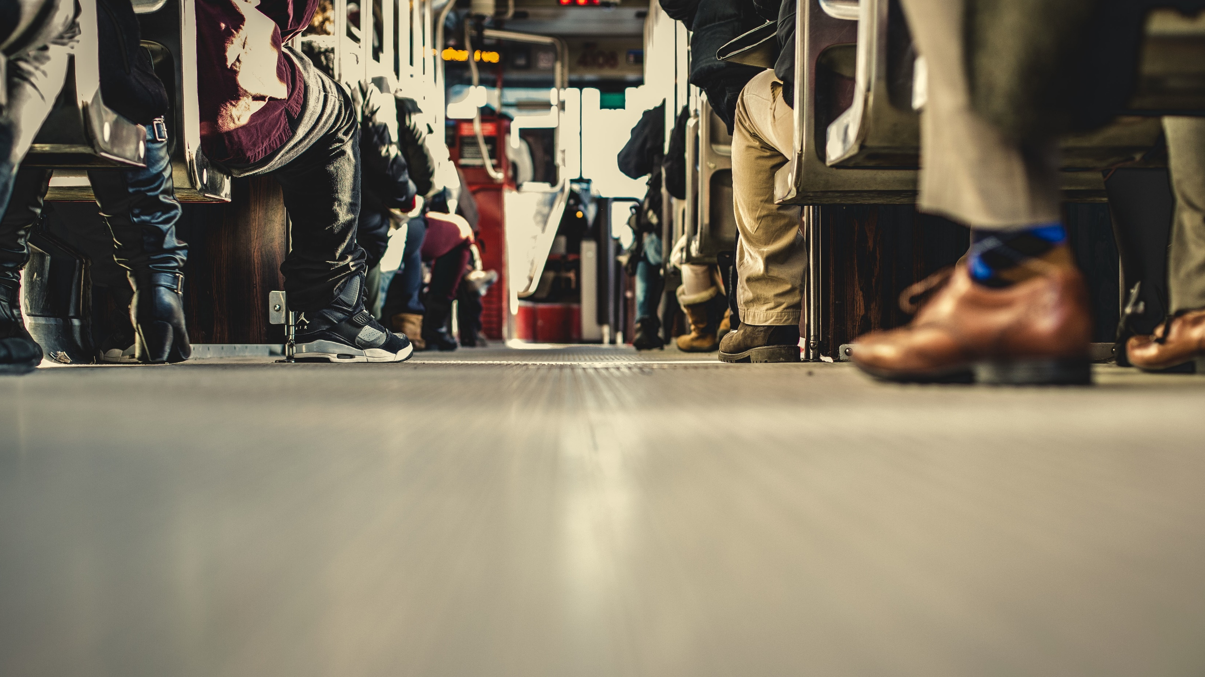
2 Tim 1:1-2
Grace, mercy, and peace

Slide 2
2 Tim 1:1-2 (ESV)
¹ Paul, an apostle of Christ Jesus by the will of God according to the promise of the life that is in Christ Jesus, ² To Timothy, my beloved child: Grace, mercy, and peace from God the Father and Christ Jesus our Lord.
Caption

Slide 3
2 Tim 1:1 (ESV)
¹ Paul, an apostle of Christ Jesus by the will of God according to the promise of the life that is in Christ Jesus,
Caption

Slide 4
2 Tim 1:2 (ESV)
² To Timothy, my beloved child: Grace, mercy, and peace from God the Father and Christ Jesus our Lord.
Caption

Slide 5
2 Tim 1:2 (ESV)
² To Timothy, my beloved child: Grace, mercy, and peace from God the Father and Christ Jesus our Lord.
Caption

Slide 6
Grace, mercy, and peace
Do you see Jesus as your Saviour and King?
Do you relate to Scripture as the words of our king that produces life
Do you have a Paul and Timothy in your life?
Caption

