Slide 1
The Truth will set You Free
Part 4
But what is the truth?
Renier Louwrens
Notes:
Ons gaan begin met ‘n abie belangrike konsep in die samelewing en dit staaf deur die Bybel. Daarna gaan ons kyk na ‘n voorbeeld hiervan en dit weer staaf in Matteus.
My commitment is om die skrif oop te breek soos God dit op my hart geplaas het die laaste 4 weke. Wat ek jou wil vr ais om die vrae wat ek gaan vra te beantwoord.

Slide 2
Chocolate chip muffin?
Notes:
Recap – Wanneer dit wat jy nog altyd geglo het werklik en die waarheid is, uitdraai om in die oomblik wat jy dit die meeste nodig het, dit nie eintlik waar is nie.

Slide 3
Chocolate chip muffin?
Rum and raisin muffin?
Notes:
Recap – Wanneer dit wat jy nog altyd geglo het werklik en die waarheid is, uitdraai om in die oomblik wat jy dit die meeste nodig het, dit nie eintlik waar is nie.

Slide 4
The Truth will set You Free
Part 4
But what is the truth?
Renier Louwrens
Notes:
Ons gaan begin met ‘n abie belangrike konsep in die samelewing en dit staaf deur die Bybel. Daarna gaan ons kyk na ‘n voorbeeld hiervan en dit weer staaf in Matteus.
My commitment is om die skrif oop te breek soos God dit op my hart geplaas het die laaste 4 weke. Wat ek jou wil vr ais om die vrae wat ek gaan vra te beantwoord.

Slide 5
The Bible is the truth
Notes:
My promise to you again today is that we won’t base anything on opinions or feelings, but we will support it with the Word.

Slide 6
False ammunition series.
False ammunition
Danger
You shall not judge
12 Nov 2023
Matt 7:1
The false ammunition
Matt 7:3-5
Matt 18
The Truth
Jesus knocks on our hearts
18 Feb 2024
Easter
07 April 2024
Rev 3:20
The false ammunition
Rev 3
John 3
The truth
Matt18:15-20
Heb 10:25
f
The Truth
Matt 26
The false ammunition
Matt 26
The Truth
Where 2 or more are
09 June 2024
Matt18:19-20
g
The false ammunition
Notes:
Today is going to be practical. Is that fine? Will you answer the questions?
If you were not here for the first sermons of this series, don’t stress, I am going to catch you up quickly, you an also get these sermons from the Shofar website. They were on 12 Nov and 18 Feb. If you were here, then also don’t worry, we are swiftly going to move over into the Easter leg of this series.
What is very important today is to note a couple of things which this sermon is not focussing on.
Prophecies – This story is full of prophecies being fulfilled and one can easily do a sermon about that. So if at some stage you think hey but what about the prophecy, know that it is there, but what God wants us to focus on in the next 30min is another mesasage.
Also. The main message from Pass over stays the death and resurrection of Jesus to

Slide 7
John 3 [ESV]
16 “For God so loved the world, that he gave his only Son, that whoever believes in him should not perish but have eternal life.
Notes:
Let the main thing stay the main thing
What is very important today is to note a couple of things which this sermon is not focussing on.
Prophecies – This story is full of prophecies being fulfilled and one can easily do a sermon about that. So if at some stage you think hey but what about the prophecy, know that it is there, but what God wants us to focus on in the next 30min is another mesasage.
Also. The main message from Pass over stays the death and resurrection of Jesus to

Slide 8
When what I believed does not work
Notes:
Recap – Wanneer dit wat jy nog altyd geglo het werklik en die waarheid is, uitdraai om in die oomblik wat jy dit die meeste nodig het, dit nie eintlik waar is nie.

Slide 9
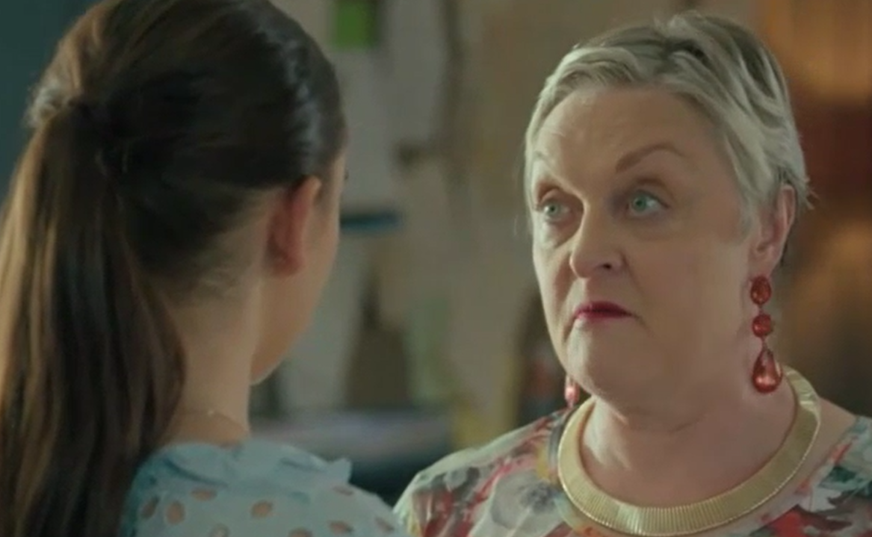
“Dis in die Bybel”
Notes:
Karen.

Slide 10
Matt 18
19 “Again, truly I tell you that if two of you on earth agree about anything they ask for, it will be done for them by my Father in heaven. 20 For where two or three gather in my name, there am I with them.”
Notes:
To understand what this verse says, we must first understand what it does not say.
The context this is usually used in is in small groups or on outreaches

Slide 11
Disappointment
Disappointment = expectation > reality
=
>
Notes:
First off – Most of us have the wrong image about Judas.
Someone sinister, sneaky, with shifty eyes, he lies all the time, he hissed a little bit when he talked and muddered to himself under his breath.
The reality is that Judas was nothing like that. He was a very respected person, even one of the most trusted of the disciples. Now if your mind blows now and you cn’t believe that the person who betrayed Jesus was actually trusted, then just think about this. From 2 people who followed Jesus everywhere, he was the one elected by his pears to be in charge of the purse. Who in your group of 5 would you give the purse to? He was entrusted by those around him. Also think of when Jesus said

Slide 12
The importance of context

Slide 13
Matt 18
Dealing With Sin in the Church
15 “If your brother or sister[b] sins,[c] go and point out their fault, just between the two of you. If they listen to you, you have won them over. 16 But if they will not listen, take one or two others along, so that ‘every matter may be established by the testimony of two or three witnesses.’
Notes:
First off – Most of us have the wrong image about Judas.
Someone sinister, sneaky, with shifty eyes, he lies all the time, he hissed a little bit when he talked and muddered to himself under his breath.
The reality is that Judas was nothing like that. He was a very respected person, even one of the most trusted of the disciples. Now if your mind blows now and you cn’t believe that the person who betrayed Jesus was actually trusted, then just think about this. From 2 people who followed Jesus everywhere, he was the one elected by his pears to be in charge of the purse. Who in your group of 5 would you give the purse to? He was entrusted by those around him. Also think of when Jesus said

Slide 14
Matt 18
17 If they still refuse to listen, tell it to the church; and if they refuse to listen even to the church, treat them as you would a pagan or a tax collector.
18 “Truly I tell you, whatever you bind on earth will be[e] bound in heaven, and whatever you loose on earth will be[f] loosed in heaven.
Notes:
First off – Most of us have the wrong image about Judas.
Someone sinister, sneaky, with shifty eyes, he lies all the time, he hissed a little bit when he talked and muddered to himself under his breath.
The reality is that Judas was nothing like that. He was a very respected person, even one of the most trusted of the disciples. Now if your mind blows now and you cn’t believe that the person who betrayed Jesus was actually trusted, then just think about this. From 2 people who followed Jesus everywhere, he was the one elected by his pears to be in charge of the purse. Who in your group of 5 would you give the purse to? He was entrusted by those around him. Also think of when Jesus said

Slide 15
Matt 18
19 “Again, truly I tell you that if two of you on earth agree about anything they ask for, it will be done for them by my Father in heaven. 20 For where two or three gather in my name, there am I with them.”
Notes:
First off – Most of us have the wrong image about Judas.
Someone sinister, sneaky, with shifty eyes, he lies all the time, he hissed a little bit when he talked and muddered to himself under his breath.
The reality is that Judas was nothing like that. He was a very respected person, even one of the most trusted of the disciples. Now if your mind blows now and you cn’t believe that the person who betrayed Jesus was actually trusted, then just think about this. From 2 people who followed Jesus everywhere, he was the one elected by his pears to be in charge of the purse. Who in your group of 5 would you give the purse to? He was entrusted by those around him. Also think of when Jesus said

Slide 16
Matt 18 Application
It is not to describe God’s provision when we ask or to lament the power of Godly community
It serves as instruction, guidance, and a promise from God when we address sin inside the church.
Notes:
First off – Most of us have the wrong image about Judas.
Someone sinister, sneaky, with shifty eyes, he lies all the time, he hissed a little bit when he talked and muddered to himself under his breath.
The reality is that Judas was nothing like that. He was a very respected person, even one of the most trusted of the disciples. Now if your mind blows now and you cn’t believe that the person who betrayed Jesus was actually trusted, then just think about this. From 2 people who followed Jesus everywhere, he was the one elected by his pears to be in charge of the purse. Who in your group of 5 would you give the purse to? He was entrusted by those around him. Also think of when Jesus said

Slide 17
Matt 18 Application
It is not to describe God’s provision when we ask or to lament the power of Godly community
God’s provision – Jer 29 v 11 (next time)
Power of Godly community – Heb 10 v 25
Notes:
First off – Most of us have the wrong image about Judas.
Someone sinister, sneaky, with shifty eyes, he lies all the time, he hissed a little bit when he talked and muddered to himself under his breath.
The reality is that Judas was nothing like that. He was a very respected person, even one of the most trusted of the disciples. Now if your mind blows now and you cn’t believe that the person who betrayed Jesus was actually trusted, then just think about this. From 2 people who followed Jesus everywhere, he was the one elected by his pears to be in charge of the purse. Who in your group of 5 would you give the purse to? He was entrusted by those around him. Also think of when Jesus said

Slide 18
Hebrews 10
23Let us hold fast the confession of our hope without wavering, for he who promised is faithful. 24And let us consider how to stir up one another to love and good works, 25not neglecting to meet together, as is the habit of some, but encouraging one another, and all the more as you see the Day drawing near.
Notes:
First off – Most of us have the wrong image about Judas.
Someone sinister, sneaky, with shifty eyes, he lies all the time, he hissed a little bit when he talked and muddered to himself under his breath.
The reality is that Judas was nothing like that. He was a very respected person, even one of the most trusted of the disciples. Now if your mind blows now and you cn’t believe that the person who betrayed Jesus was actually trusted, then just think about this. From 2 people who followed Jesus everywhere, he was the one elected by his pears to be in charge of the purse. Who in your group of 5 would you give the purse to? He was entrusted by those around him. Also think of when Jesus said

Slide 19
Hebrews 10
23Let us hold fast the confession of our hope without wavering, for he who promised is faithful. 24And let us consider how to stir up one another to love and good works, 25not neglecting to meet together, as is the habit of some, but encouraging one another, and all the more as you see the Day drawing near.
Notes:
This is a command from God – it is because he knows what is best for us. It ensures continuous growth. It prevents deception, it builds up leaders and raises disciples.

Slide 20
My possible contribution
Stop attending church/small group etc.
Stop disciplining others who are attending
Entertain conversations which will allow others to drift away from Godly meetings slowly.
Notes:
First off – Most of us have the wrong image about Judas.
Someone sinister, sneaky, with shifty eyes, he lies all the time, he hissed a little bit when he talked and muddered to himself under his breath.
The reality is that Judas was nothing like that. He was a very respected person, even one of the most trusted of the disciples. Now if your mind blows now and you cn’t believe that the person who betrayed Jesus was actually trusted, then just think about this. From 2 people who followed Jesus everywhere, he was the one elected by his pears to be in charge of the purse. Who in your group of 5 would you give the purse to? He was entrusted by those around him. Also think of when Jesus said

Slide 21
My contribution
Stop attending church/small group etc.
Stop disciplining others who are attending
Entertain conversations which will allow others to drift away from Godly meetings slowly.
Active gossip
Accepting gossip
Neglecting to set up the necessary conversations to address disunity or offense.
Notes:
First off – Most of us have the wrong image about Judas.
Someone sinister, sneaky, with shifty eyes, he lies all the time, he hissed a little bit when he talked and muddered to himself under his breath.
The reality is that Judas was nothing like that. He was a very respected person, even one of the most trusted of the disciples. Now if your mind blows now and you cn’t believe that the person who betrayed Jesus was actually trusted, then just think about this. From 2 people who followed Jesus everywhere, he was the one elected by his pears to be in charge of the purse. Who in your group of 5 would you give the purse to? He was entrusted by those around him. Also think of when Jesus said

Slide 22
My contribution
Stop attending church/small group etc.
Stop disciplining others who are attending
Entertain conversations which will allow others to drift away from Godly meetings slowly.
Active gossip
Accepting gossip
Neglecting to set up the necessary conversations to address disunity or offense.
Notes:
First off – Most of us have the wrong image about Judas.
Someone sinister, sneaky, with shifty eyes, he lies all the time, he hissed a little bit when he talked and muddered to himself under his breath.
The reality is that Judas was nothing like that. He was a very respected person, even one of the most trusted of the disciples. Now if your mind blows now and you cn’t believe that the person who betrayed Jesus was actually trusted, then just think about this. From 2 people who followed Jesus everywhere, he was the one elected by his pears to be in charge of the purse. Who in your group of 5 would you give the purse to? He was entrusted by those around him. Also think of when Jesus said

Slide 23
Our action points today
Redeem Matt 18 (Where 2 or more….)
Think of a conversation you were part of which needs to be revisited.
Think of a conversation you heard, which needs a setup between 2 other parties
Notes:
First off – Most of us have the wrong image about Judas.
Someone sinister, sneaky, with shifty eyes, he lies all the time, he hissed a little bit when he talked and muddered to himself under his breath.
The reality is that Judas was nothing like that. He was a very respected person, even one of the most trusted of the disciples. Now if your mind blows now and you cn’t believe that the person who betrayed Jesus was actually trusted, then just think about this. From 2 people who followed Jesus everywhere, he was the one elected by his pears to be in charge of the purse. Who in your group of 5 would you give the purse to? He was entrusted by those around him. Also think of when Jesus said

Slide 24
Our action points today
Redeem Matt a8 (Where 2 or more….)
Think of a conversation you were part of which needs to be revisited.
Think of a conversation you heard, which needs a setup between 2 other parties
These are necessities to protect God’s church.
Send a Whatsapp of accountability before you get up.

