Slide 1
Die waarheid sal jou vrymaak
Deel 4
Renier Louwrens
Notes:
Ons gaan begin met ‘n abie belangrike konsep in die samelewing en dit staaf deur die Bybel. Daarna gaan ons kyk na ‘n voorbeeld hiervan en dit weer staaf in Matteus.
My commitment is om die skrif oop te breek soos God dit op my hart geplaas het die laaste 4 weke. Wat ek jou wil vr ais om die vrae wat ek gaan vra te beantwoord.

Slide 2
Die waarheid sal jou vrymaak
Deel 4
Maar wat is die waarheid?
Renier Louwrens

Slide 3
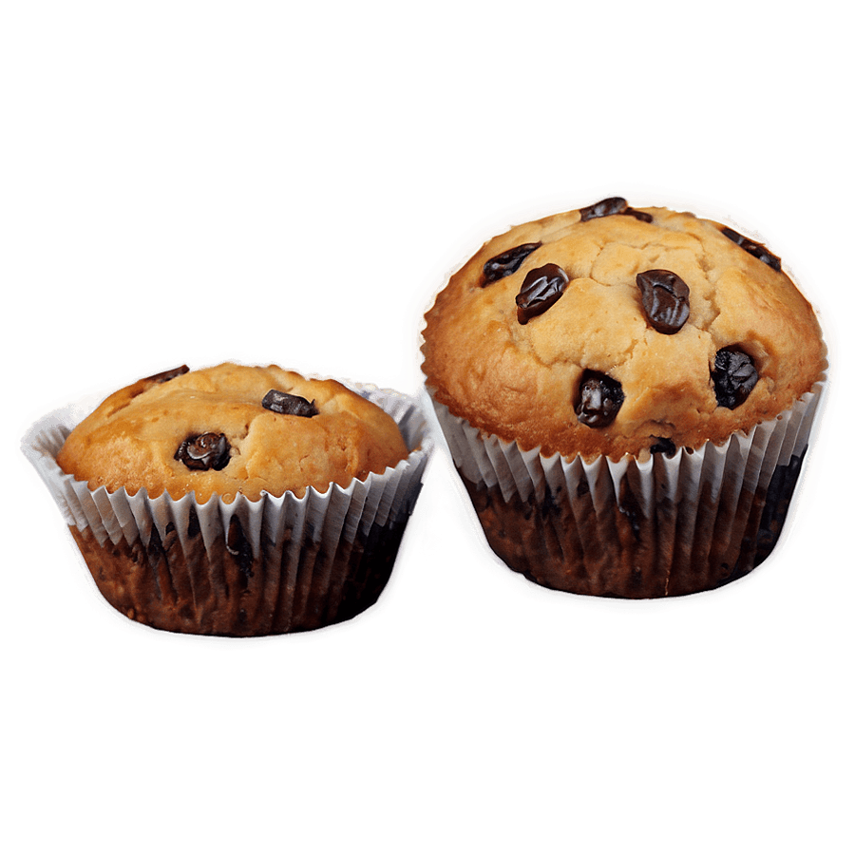
Chocolate chip muffin?
Notes:
Recap – Wanneer dit wat jy nog altyd geglo het werklik en die waarheid is, uitdraai om in die oomblik wat jy dit die meeste nodig het, dit nie eintlik waar is nie.

Slide 4
Chocolate chip muffin?
Rum and raisin muffin?
Notes:
Recap – Wanneer dit wat jy nog altyd geglo het werklik en die waarheid is, uitdraai om in die oomblik wat jy dit die meeste nodig het, dit nie eintlik waar is nie.

Slide 5
Die waarheid sal jou vrymaak
Maar wat is die waarheid?
Johannes 8 v30-32?
Renier Louwrens

Slide 6
Die Bybel is die waarheid
Notes:
My promise to you again today is that we won’t base anything on opinions or feelings, but we will support it with the Word.

Slide 7
Vals ammunisie.
Vals ammunisie
Die gevaar
Jer 29
Die waarheid
Jy mag nie oordeel nie
12 November 2023
Matt 7:1
Die vals ammunisie
Matt 7:3-5
Matt 18
Die waarheid
God beplan vir my voorspoed
18 Februarie 2024
Jer 29:11
Die vals ammunisie
Paasfees
9 Apr 2024
Matt 26
Die vals ammunisie
Matt 26
Die waarheid
Waar 2 of meer saam is…..
9 Junie 2024
Matt 18:19-20
Die vals ammunisie
Matt 18:15-20
Heb 10:25
Die waarheid
Notes:
Wat sal gebeur as ons vals ammunisie kry?
Het jy a vals ammunisie gekry?

Slide 8
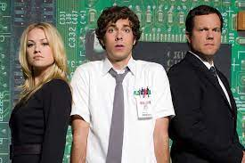
Chuck

Slide 9
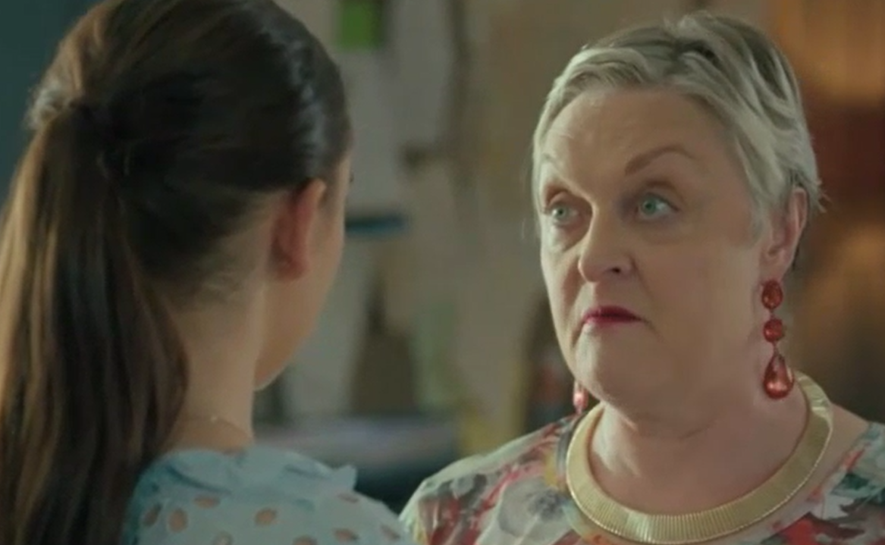
“Dis in die Bybel”
Notes:
Karen.

Slide 10
Matt 18
19“Boonop verseker Ek julle: As twee van julle hier op aarde saamstem oor enigiets wat julle van God wil vra, sal my hemelse Vader dit vir julle doen. 20Waar twee of drie bymekaar is, is Ek immers ook saam met hulle daar.”
Notes:
Om die vers te verstaan moet ons eers verstaan wat dit nie sê nie.
Buurvrou voorbeeld: Allan, steve, wie is by die venster, die buurvrou

Slide 11
Teleurstelling
Teleurstelling = verwagting > realiteit
Notes:
First off – Most of us have the wrong image about Judas.
Someone sinister, sneaky, with shifty eyes, he lies all the time, he hissed a little bit when he talked and muddered to himself under his breath.
The reality is that Judas was nothing like that. He was a very respected person, even one of the most trusted of the disciples. Now if your mind blows now and you cn’t believe that the person who betrayed Jesus was actually trusted, then just think about this. From 2 people who followed Jesus everywhere, he was the one elected by his pears to be in charge of the purse. Who in your group of 5 would you give the purse to? He was entrusted by those around him. Also think of when Jesus said

Slide 12
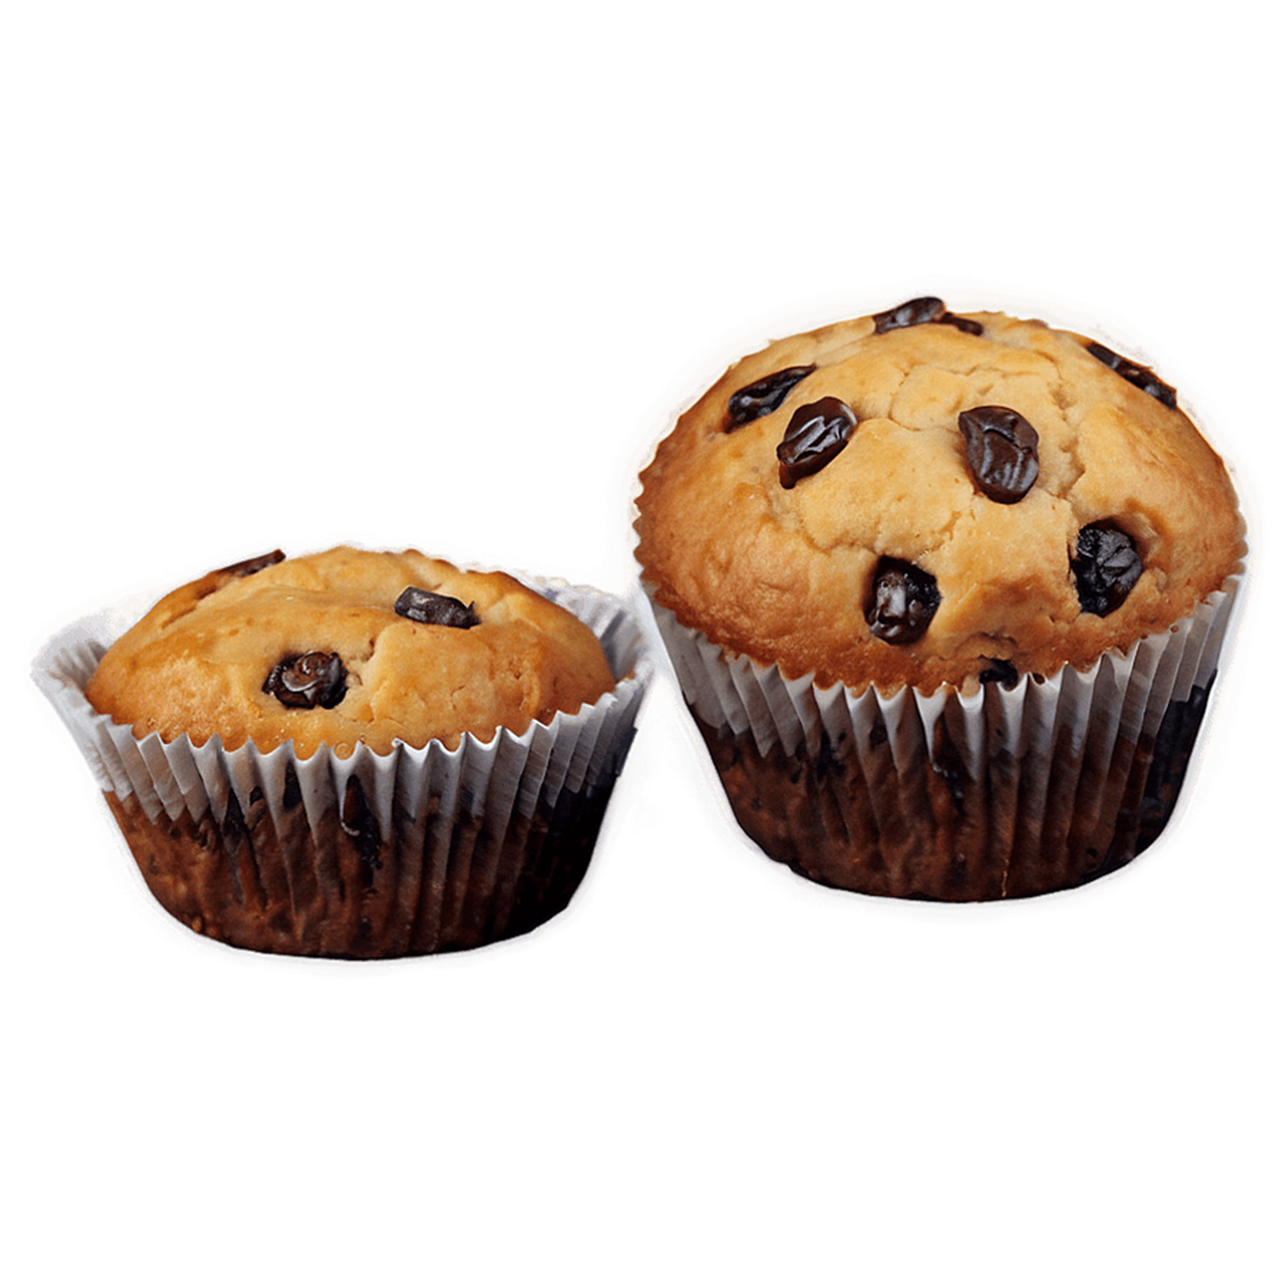
Teleurstelling
Teleurstelling = verwagting > realiteit
=
>
Notes:
First off – Most of us have the wrong image about Judas.
Someone sinister, sneaky, with shifty eyes, he lies all the time, he hissed a little bit when he talked and muddered to himself under his breath.
The reality is that Judas was nothing like that. He was a very respected person, even one of the most trusted of the disciples. Now if your mind blows now and you cn’t believe that the person who betrayed Jesus was actually trusted, then just think about this. From 2 people who followed Jesus everywhere, he was the one elected by his pears to be in charge of the purse. Who in your group of 5 would you give the purse to? He was entrusted by those around him. Also think of when Jesus said

Slide 13
Die belangrikheid van konteks
Notes:
First off – Most of us have the wrong image about Judas.
Someone sinister, sneaky, with shifty eyes, he lies all the time, he hissed a little bit when he talked and muddered to himself under his breath.
The reality is that Judas was nothing like that. He was a very respected person, even one of the most trusted of the disciples. Now if your mind blows now and you cn’t believe that the person who betrayed Jesus was actually trusted, then just think about this. From 2 people who followed Jesus everywhere, he was the one elected by his pears to be in charge of the purse. Who in your group of 5 would you give the purse to? He was entrusted by those around him. Also think of when Jesus said

Slide 14
Matt 18
Hoe ons medegelowiges moet reghelp
15“As een van jou medegelowiges iets verkeerds teen jou gedoen het, gaan wys hom daarop. Maar hou dit tussen julle twee. As hy sy fout insien en erken, het jy hom teruggewen. 16Maar as jy nie daarin slaag nie, neem nog een of twee saam met jou. So sal daar twee of drie getuies wees om te bevestig wat gesê word.
Notes:
To understand what this verse says, we must first understand what it does not say.
The context this is usually used in is in small groups or on outreaches

Slide 15
Matt 18
17Maar as hy nog steeds weier om te luister, moet jy dit aan die gemeente gaan meedeel. As hy egter ook weier om na die gemeente te luister, moet hy vir jou wees soos ’n ongelowige of ’n tollenaar. 18Dít verseker Ek julle: Watter dinge julle ook al op aarde bind, sal in die hemel gebind wees. En watter dinge julle ook op die aarde losmaak, sal in die hemel losgemaak wees.
Notes:
To understand what this verse says, we must first understand what it does not say.
The context this is usually used in is in small groups or on outreaches

Slide 16
Matt 18
19“Boonop verseker Ek julle: As twee van julle hier op aarde saamstem oor enigiets wat julle van God wil vra, sal my hemelse Vader dit vir julle doen. 20Waar twee of drie bymekaar is, is Ek immers ook saam met hulle daar.”
Notes:
To understand what this verse says, we must first understand what it does not say.
The context this is usually used in is in small groups or on outreaches

Slide 17
Matt 18 Toepassing
Die vers word nie gebruik om God se voorsiening of die krag van ‘n God vresende gemeenskap te beskryf nie.
Dit dien as ‘n instruksie, as leiding en as ‘n belofte van God wanneer ons volgens Sy opdrag, sonde in die kerk aanspreek.
Notes:
First off – Most of us have the wrong image about Judas.
Someone sinister, sneaky, with shifty eyes, he lies all the time, he hissed a little bit when he talked and muddered to himself under his breath.
The reality is that Judas was nothing like that. He was a very respected person, even one of the most trusted of the disciples. Now if your mind blows now and you cn’t believe that the person who betrayed Jesus was actually trusted, then just think about this. From 2 people who followed Jesus everywhere, he was the one elected by his pears to be in charge of the purse. Who in your group of 5 would you give the purse to? He was entrusted by those around him. Also think of when Jesus said

Slide 18
Matt 18 Toepassing
Die vers word nie gebruik om God se voorsiening of die krag van ‘n God vresende gemeenskap te beskryf nie.
God se voorsiening – Jer 29v11 (volgende keer)
Krag van God vresende gemeenskap – Heb 10v25
Notes:
First off – Most of us have the wrong image about Judas.
Someone sinister, sneaky, with shifty eyes, he lies all the time, he hissed a little bit when he talked and muddered to himself under his breath.
The reality is that Judas was nothing like that. He was a very respected person, even one of the most trusted of the disciples. Now if your mind blows now and you cn’t believe that the person who betrayed Jesus was actually trusted, then just think about this. From 2 people who followed Jesus everywhere, he was the one elected by his pears to be in charge of the purse. Who in your group of 5 would you give the purse to? He was entrusted by those around him. Also think of when Jesus said

Slide 19
Hebreërs 10
23Kom ons hou ook styf vas aan die hoop wat ons bely, want ons kan op God staatmaak; Hy sal doen wat Hy beloof het. 24Laat ons voortdurend aandag gee aan mekaar – oor hoe ons mekaar kan aanspoor tot liefde en goeie dade. 25En laat ons tog nie – soos party gemeentelede die gewoonte het – versuim om die gemeentebyeenkomste by te woon nie. Kom ons moedig mekaar aan, nog meer omdat ons sien dat die dag van Christus se koms al hoe nader kom.

Slide 20
Hebreërs 10
23Kom ons hou ook styf vas aan die hoop wat ons bely, want ons kan op God staatmaak; Hy sal doen wat Hy beloof het. 24Laat ons voortdurend aandag gee aan mekaar – oor hoe ons mekaar kan aanspoor tot liefde en goeie dade. 25En laat ons tog nie – soos party gemeentelede die gewoonte het – versuim om die gemeentebyeenkomste by te woon nie. Kom ons moedig mekaar aan, nog meer omdat ons sien dat die dag van Christus se koms al hoe nader kom.
Notes:
Hierdie is ‘n opdrag van God af – dit is omdat God weet wat die heel beste is. Dit verseker continue groei. Dit verhoed misleading, dit bou leiers op en die rig dissipels op.
Dinsdag en Saterdag.

Slide 21
My moontlike bydra
Hou op om kerk of selgroep by te woon
Hou op om ander wat wel bywoon te dissipel
Duld gesprekke waar ander toegelaat sal word om stadig maar seker weg te dryf van God af.
Notes:
First off – Most of us have the wrong image about Judas.
Someone sinister, sneaky, with shifty eyes, he lies all the time, he hissed a little bit when he talked and muddered to himself under his breath.
The reality is that Judas was nothing like that. He was a very respected person, even one of the most trusted of the disciples. Now if your mind blows now and you cn’t believe that the person who betrayed Jesus was actually trusted, then just think about this. From 2 people who followed Jesus everywhere, he was the one elected by his pears to be in charge of the purse. Who in your group of 5 would you give the purse to? He was entrusted by those around him. Also think of when Jesus said

Slide 22
My moontlike bydra
Hou op om kerk of selgroep by te woon
Hou op om ander wat wel bywoon te dissipel
Duld gesprekke waar ander toegelaat sal word om stadig maar seker weg te dryf van God af.
Aktiewe skinder
Aanvarding van skinder
Versuim om die nodige gesprekke te inisieer waar eenheid herstel moet word
Notes:
First off – Most of us have the wrong image about Judas.
Someone sinister, sneaky, with shifty eyes, he lies all the time, he hissed a little bit when he talked and muddered to himself under his breath.
The reality is that Judas was nothing like that. He was a very respected person, even one of the most trusted of the disciples. Now if your mind blows now and you cn’t believe that the person who betrayed Jesus was actually trusted, then just think about this. From 2 people who followed Jesus everywhere, he was the one elected by his pears to be in charge of the purse. Who in your group of 5 would you give the purse to? He was entrusted by those around him. Also think of when Jesus said

Slide 23
Ons aksiepunte vir vandag
Definieer Matt 18 korrek vir die met wie jy te doen kry (waar 2 of meer…..)
Dink aan ‘n gesprek waarvan jy deel was wat jy weer moet gaan besoek.
Dink aan ‘n gesprek wat jy gehoor het waar jy moet intree om 2 ander partye met mekaar te laat gaan praat. Al weet net een party daarvan.
Notes:
First off – Most of us have the wrong image about Judas.
Someone sinister, sneaky, with shifty eyes, he lies all the time, he hissed a little bit when he talked and muddered to himself under his breath.
The reality is that Judas was nothing like that. He was a very respected person, even one of the most trusted of the disciples. Now if your mind blows now and you cn’t believe that the person who betrayed Jesus was actually trusted, then just think about this. From 2 people who followed Jesus everywhere, he was the one elected by his pears to be in charge of the purse. Who in your group of 5 would you give the purse to? He was entrusted by those around him. Also think of when Jesus said

Slide 24
Ons aksiepunte vir vandag
Definieer Matt 18 korrek vir die met wie jy te doen kry (waar 2 of meer…..)
Dink aan ‘n gesprek waarvan jy deel was wat jy weer moet gaan besoek.
Dink aan ‘n gesprek wat jy gehoor het waar jy moet intree om 2 ander partye met mekaar te laat gaan praat. Al weet net een party daarvan.
Hierdie is ongelooflik belangrik om God se kerk te beskerm
Notes:
First off – Most of us have the wrong image about Judas.
Someone sinister, sneaky, with shifty eyes, he lies all the time, he hissed a little bit when he talked and muddered to himself under his breath.
The reality is that Judas was nothing like that. He was a very respected person, even one of the most trusted of the disciples. Now if your mind blows now and you cn’t believe that the person who betrayed Jesus was actually trusted, then just think about this. From 2 people who followed Jesus everywhere, he was the one elected by his pears to be in charge of the purse. Who in your group of 5 would you give the purse to? He was entrusted by those around him. Also think of when Jesus said

Slide 25
Neem aksie
Voor ons opstaan, stuur 1 whatsapp:
1. Ek moet gaan praat met............
2. Ek moet iemand gaan aanmoedig om ‘n gesprek te hê met iemand anders.
Notes:
In die week
Goeie vriend
Elke sel was anders, maar elkeen het gegaan oor geloof op een of ander manier.
“God sê, jy durf nie oor enige iets anders praat nie”

