Slide 1
The Truth will set You Free
Part 3
But what is the truth?
Renier Louwrens
Notes:
Ons gaan begin met ‘n abie belangrike konsep in die samelewing en dit staaf deur die Bybel. Daarna gaan ons kyk na ‘n voorbeeld hiervan en dit weer staaf in Matteus.
My commitment is om die skrif oop te breek soos God dit op my hart geplaas het die laaste 4 weke. Wat ek jou wil vr ais om die vrae wat ek gaan vra te beantwoord.

Slide 2
False ammunition series.
False ammunition
Danger
You shall not judge
12 Nov 2023
Matt 7:1
The false ammunition
Matt 7:3-5
Matt 18
The Truth
Jesus knocks on our hearts
18 Feb 2024
Easter
07 April 2024
Matt 26
The false ammunition
Matt 26
The truth
Rev 3:20
The false ammunition
Rev 3
John 3
The truth
Notes:
Today is going to be practical. Is that fine? Will you answer the questions?
If you were not here for the first sermons of this series, don’t stress, I am going to catch you up quickly, you an also get these sermons from the Shofar website. They were on 12 Nov and 18 Feb. If you were here, then also don’t worry, we are swiftly going to move over into the Easter leg of this series.
What is very important today is to note a couple of things which this sermon is not focussing on.
Prophecies – This story is full of prophecies being fulfilled and one can easily do a sermon about that. So if at some stage you think hey but what about the prophecy, know that it is there, but what God wants us to focus on in the next 30min is another mesasage.
Also. The main message from Pass over stays the death and resurrection of Jesus to

Slide 3
John 3 [ESV]
16 “For God so loved the world, that he gave his only Son, that whoever believes in him should not perish but have eternal life.
Notes:
Let the main thing stay the main thing
What is very important today is to note a couple of things which this sermon is not focussing on.
Prophecies – This story is full of prophecies being fulfilled and one can easily do a sermon about that. So if at some stage you think hey but what about the prophecy, know that it is there, but what God wants us to focus on in the next 30min is another mesasage.
Also. The main message from Pass over stays the death and resurrection of Jesus to

Slide 4
When what I believed does not work
Notes:
Recap – Wanneer dit wat jy nog altyd geglo het werklik en die waarheid is, uitdraai om in die oomblik wat jy dit die meeste nodig het, dit nie eintlik waar is nie.

Slide 5
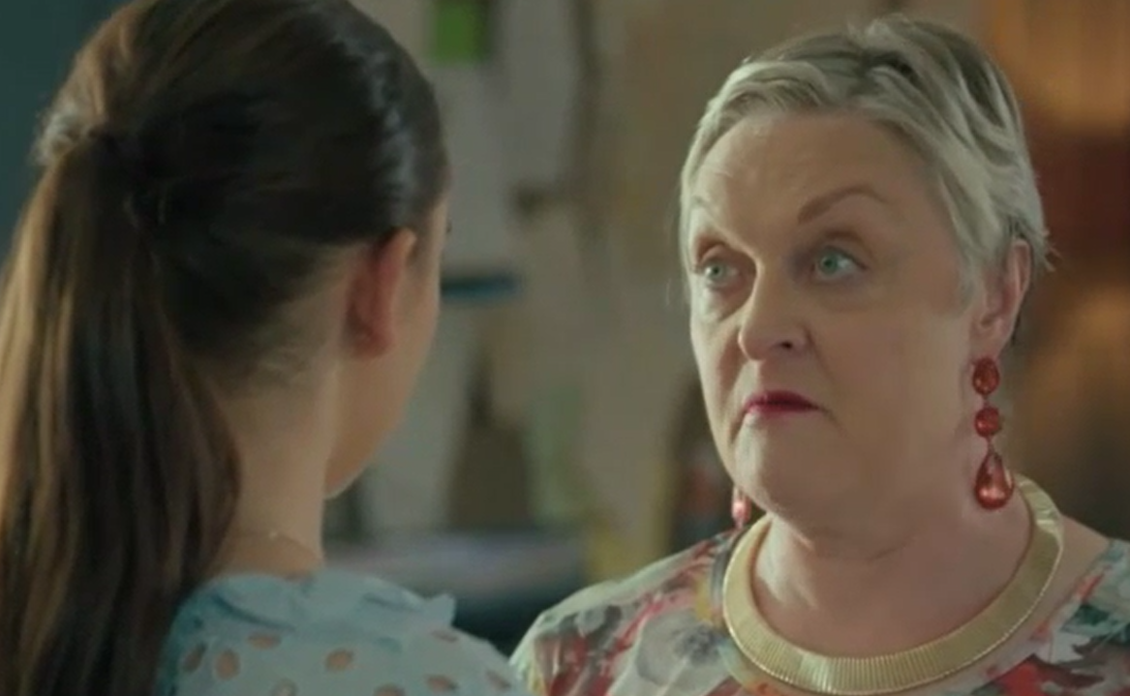
“Dis in die Bybel”
Notes:
Karen.

Slide 6
The Bible is the truth
Notes:
My promise to you again today is that we won’t base anything on opinions or feelings, but we will support it with the Word.

Slide 7
Survivor SA s Cast

Slide 8
Survivor SA Santoni

Slide 9
Survivor SA Anesu

Slide 10
Survivor SA Paul

Slide 11
Survivor SA s Cast
I am the hero of this season
Notes:
We all want to associate with the heroes of the stories, we all identify as the best.

Slide 12
Easter: Judas

Slide 13
Matt 26
47As Jesus was still speaking, Judas [Iscariot], one of the twelve [disciples], came up accompanied by a large crowd with swords and clubs, from the chief priests and elders of the people. 48Now the betrayer had given them a sign, saying, “Whomever I kiss, He is the one; seize Him.”
Notes:
First off – Most of us have the wrong image about Judas.
Someone sinister, sneaky, with shifty eyes, he lies all the time, he hissed a little bit when he talked and muddered to himself under his breath.
The reality is that Judas was nothing like that. He was a very respected person, even one of the most trusted of the disciples. Now if your mind blows now and you cn’t believe that the person who betrayed Jesus was actually trusted, then just think about this. From 2 people who followed Jesus everywhere, he was the one elected by his pears to be in charge of the purse. Who in your group of 5 would you give the purse to? He was entrusted by those around him. Also think of when Jesus said

Slide 14
Matt 26
49Immediately Judas went to Jesus and said, “Greetings (rejoice), Rabbi!” And he kissed Him [in a deliberate act of betrayal]. 50Jesus said to Judas, “Friend, do what you came for.” Then they came and seized Jesus and arrested Him.
Notes:
First off – Most of us have the wrong image about Judas.
Someone sinister, sneaky, with shifty eyes, he lies all the time, he hissed a little bit when he talked and muddered to himself under his breath.
The reality is that Judas was nothing like that. He was a very respected person, even one of the most trusted of the disciples. Now if your mind blows now and you cn’t believe that the person who betrayed Jesus was actually trusted, then just think about this. From 2 people who followed Jesus everywhere, he was the one elected by his pears to be in charge of the purse. Who in your group of 5 would you give the purse to? He was entrusted by those around him. Also think of when Jesus said

Slide 15
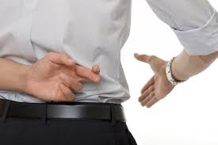
Judas
Untrustworthy
Sneaky
Liar
Notes:
First off – Most of us have the wrong image about Judas.
Someone sinister, sneaky, with shifty eyes, he lies all the time, he hissed a little bit when he talked and muddered to himself under his breath.
The reality is that Judas was nothing like that. He was a very respected person, even one of the most trusted of the disciples. Now if your mind blows now and you cn’t believe that the person who betrayed Jesus was actually trusted, then just think about this. From 2 people who followed Jesus everywhere, he was the one elected by his pears to be in charge of the purse. Who in your group of 5 would you give the purse to? He was entrusted by those around him. Also think of when Jesus said
Tell the person next to you 5 friends names.

Slide 16
John 13
9Some thought that, since Judas [as the treasurer of the group] had the money box, Jesus was telling him, “Buy what we need for the feast,” or that he was to give something to the poor.
Notes:
What is unnerving for me about Judas is how similar he is to you and me.

Slide 17
Matt 26 [ESV]
20When it was evening, Jesus reclined at table with the twelve. 21And as they were eating, he said, “Truly, I say to you, one of you will betray me.” 22And they were very sorrowful and began to say to him one after another, “Is it I, Lord?”
Notes:
In die week
Goeie vriend
Elke sel was anders, maar elkeen het gegaan oor geloof op een of ander manier.
“God sê, jy durf nie oor enige iets anders praat nie”

Slide 18
Matt 26 [AMP]
22Being deeply grieved and extremely distressed, each one of them began to say to Him, “Surely not I, Lord?”
Notes:
In die week
Goeie vriend
Elke sel was anders, maar elkeen het gegaan oor geloof op een of ander manier.
“God sê, jy durf nie oor enige iets anders praat nie”

Slide 19
Matt 26 [CEV]
22The disciples were very sad, and each one said to Jesus, “Lord, you can't mean me!”
Notes:
In die week
Goeie vriend
Elke sel was anders, maar elkeen het gegaan oor geloof op een of ander manier.
“God sê, jy durf nie oor enige iets anders praat nie”

Slide 20
Matt 26 [NKJV]
22And they were exceedingly sorrowful, and each of them began to say to Him, “Lord, is it I?”
Notes:
In die week
Goeie vriend
Elke sel was anders, maar elkeen het gegaan oor geloof op een of ander manier.
“God sê, jy durf nie oor enige iets anders praat nie”

Slide 21
Matt 26 [2024 Society Version]
21And as they were eating, he said, “Truly, I say to you, one of you will betray me.” 22And they all stood up, pointing at the one who they always knew could not be trusted. As one man they tackled Judas like Eben Etsebeth would, because they knew if someone had to betray Jesus it would in all likelihood be Judas.
Notes:
This proves to us, that Judas was a normal follower of Jesus. He was not the normal bad guy. If the other followed Jesus full heartedly and their lives testified of submission to Him, and they could not tell Judas would be the one to betray Jesus, then we can only understand that Judas was not much different to them.
But why did Judas do it then?

Slide 22
Then why did Judas do it
Notes:
In die week
Goeie vriend
Elke sel was anders, maar elkeen het gegaan oor geloof op een of ander manier.
“God sê, jy durf nie oor enige iets anders praat nie”

Slide 23
Then why did Judas do it
What he wanted - Jesus to overthrow and condemn the Roman Empire

Slide 24
Then why did Judas do it
What he wanted - Jesus to overthrow and condemn the Roman Empire
What he got - Jesus preaching grace and forgiveness
Notes:
Nothing frustrates a law abider more than grace for a law breaker. Have you ever stood in a line and then someone else just cuts the line for no apparent reason.

Slide 25
Then why did Judas do it
What he wanted - Jesus to overthrow and condemn the Roman Empire
What he got - Jesus preaching grace and forgiveness
Result – Disappointment in Jesus’ provision. Jesus did not deliver what he wanted from the Almighty - Price
Notes:
In die week
Goeie vriend
Elke sel was anders, maar elkeen het gegaan oor geloof op een of ander manier.
“God sê, jy durf nie oor enige iets anders praat nie”

Slide 26
What we learn from Judas
What is your price for Jesus – What does Jesus need to provide to you to keep you in the Word or retain your loayalty.
Notes:
What is the point of following Jesus if He does not do these thing for me?
Maybe you give God your Sunday morning but not your Saturday nights? Maybe there is a relationship you need to address but you are not willing?

Slide 27
When did Judas betray Jesus
Notes:
In die week
Goeie vriend
Elke sel was anders, maar elkeen het gegaan oor geloof op een of ander manier.
“God sê, jy durf nie oor enige iets anders praat nie”

Slide 28
When did Judas betray Jesus
When he kissed him – The act of betrayal
Notes:
In die week
Goeie vriend
Elke sel was anders, maar elkeen het gegaan oor geloof op een of ander manier.
“God sê, jy durf nie oor enige iets anders praat nie”

Slide 29
When did Judas betray Jesus
When he kissed him – The act of betrayal
When he decided to go to the Roman soldiers – The heart position of betrayal
Notes:
In die week
Goeie vriend
Elke sel was anders, maar elkeen het gegaan oor geloof op een of ander manier.
“God sê, jy durf nie oor enige iets anders praat nie”

Slide 30
What we learn from Judas
What is your price for Jesus – What does Jesus need to provide to you to keep you in the Word?
Where in your heart have you already betrayed Jesus?
Notes:
During this week I was preparing for this sermon and I remember one morning how I thought that it is realy important for me to get to my quiet time, because tonight I am going to work on my sermon again and I don’t want to build anything into this sermon which is not from God. That sounds very noble, and my intentions were pure, but as I continued to work through this sermon, God first preached to me before he brought this to the congregation. If I go to God in order forHim to help me, even with something as important as a sermon to a congregationg, then I am missing the point. The same point which Judas missed.
The point is that Jesus is the ultimate reward and His presence in our lives is the ultimate blessing. For Judas Jesus was a means to an end. For me He was the library to build my sermon. And for each one of us, He is the means to some end. If you have a living relationship with Jesus, I want to ask you what God is asking all of us. Will the time you spend in prayer whilst praying for someone or something, be enough for you, even if that thing never comes? Are you content with just having quiet time and nothing more. This is a loaded question.
Goeie vriend
Elke sel was anders, maar elkeen het gegaan oor geloof op een of ander manier.
“God sê, jy durf nie oor enige iets anders praat nie”

Slide 31
What is Jesus for me?
A powerful means to an end? – I truly believe Jesus is the son of God and can do anything for me.
The destination in who's presence I want to be – I am so privileged that the Maker wants to spend time with me.
Notes:
During this week I was preparing for this sermon and I remember one morning how I thought that it is realy important for me to get to my quiet time, because tonight I am going to work on my sermon again and I don’t want to build anything into this sermon which is not from God. That sounds very noble, and my intentions were pure, but as I continued to work through this sermon, God first preached to me before he brought this to the congregation. If I go to God in order forHim to help me, even with something as important as a sermon to a congregationg, then I am missing the point. The same point which Judas missed.
The point is that Jesus is the ultimate reward and His presence in our lives is the ultimate blessing. For Judas Jesus was a means to an end. For me He was the library to build my sermon. And for each one of us, He is the means to some end. If you have a living relationship with Jesus, I want to ask you what God is asking all of us. Will the time you spend in prayer whilst praying for someone or something, be enough for you, even if that thing never comes? Are you content with just having quiet time and nothing more. This is a loaded question.

Slide 32
What we learn from Judas
What is your price for Jesus – What does Jesus need to provide to you to keep you in the Word?
Where in your heart have you already betrayed Jesus?
What are you longing Jesus to do for you more than longing for Him? – #dissappointmentcoming
Notes:
During this week I was preparing for this sermon and I remember one morning how I thought that it is realy important for me to get to my quiet time, because tonight I am going to work on my sermon again and I don’t want to build anything into this sermon which is not from God. That sounds very noble, and my intentions were pure, but as I continued to work through this sermon, God first preached to me before he brought this to the congregation. If I go to God in order forHim to help me, even with something as important as a sermon to a congregationg, then I am missing the point. The same point which Judas missed.
The point is that Jesus is the ultimate reward and His presence in our lives is the ultimate blessing. For Judas Jesus was a means to an end. For me He was the library to build my sermon. And for each one of us, He is the means to some end. If you have a living relationship with Jesus, I want to ask you what God is asking all of us. Will the time you spend in prayer whilst praying for someone or something, be enough for you, even if that thing never comes? Are you content with just having quiet time and nothing more. This is a loaded question.
Goeie vriend
Elke sel was anders, maar elkeen het gegaan oor geloof op een of ander manier.
“God sê, jy durf nie oor enige iets anders praat nie”

Slide 33
What if this is really not me?
Notes:
In die week
Goeie vriend
Elke sel was anders, maar elkeen het gegaan oor geloof op een of ander manier.
“God sê, jy durf nie oor enige iets anders praat nie”

Slide 34
What if this is really not me?
Matt 26: 30 And when they had sung a hymn, they went out to the Mount of Olives. 31Then Jesus said to them, “You will all fall away because of me this night.
Notes:
In die week
Goeie vriend
Elke sel was anders, maar elkeen het gegaan oor geloof op een of ander manier.
“God sê, jy durf nie oor enige iets anders praat nie”

Slide 35
What if this is really not me?
Matt 26: 30 And when they had sung a hymn, they went out to the Mount of Olives. 31Then Jesus said to them, “You will all fall away because of me this night.
Not me
Notes:
In die week
Goeie vriend
Elke sel was anders, maar elkeen het gegaan oor geloof op een of ander manier.
“God sê, jy durf nie oor enige iets anders praat nie”

Slide 36
What we learn from Judas
What is your price for Jesus – What does Jesus need to provide to you to keep you in the Word?
Where in your heart have you already betrayed Jesus?
What are you longing Jesus to do for you more than longing for Him? – #dissappointmentcoming
Notes:
During this week I was preparing for this sermon and I remember one morning how I thought that it is realy important for me to get to my quiet time, because tonight I am going to work on my sermon again and I don’t want to build anything into this sermon which is not from God. That sounds very noble, and my intentions were pure, but as I continued to work through this sermon, God first preached to me before he brought this to the congregation. If I go to God in order forHim to help me, even with something as important as a sermon to a congregationg, then I am missing the point. The same point which Judas missed.
The point is that Jesus is the ultimate reward and His presence in our lives is the ultimate blessing. For Judas Jesus was a means to an end. For me He was the library to build my sermon. And for each one of us, He is the means to some end. If you have a living relationship with Jesus, I want to ask you what God is asking all of us. Will the time you spend in prayer whilst praying for someone or something, be enough for you, even if that thing never comes? Are you content with just having quiet time and nothing more. This is a loaded question.
Goeie vriend
Elke sel was anders, maar elkeen het gegaan oor geloof op een of ander manier.
“God sê, jy durf nie oor enige iets anders praat nie”

Slide 37
How it could have ended
3When Judas, His betrayer, saw that Jesus was condemned, he was gripped with remorse and returned the thirty pieces of silver to the chief priests and the elders, 4saying, “I have sinned by betraying innocent blood.” They replied, “What is that to us? See to that yourself!” 5And throwing the pieces of silver into the temple sanctuary, he left; and went away and hanged himself.
Notes:
In die week
Goeie vriend
Elke sel was anders, maar elkeen het gegaan oor geloof op een of ander manier.
“God sê, jy durf nie oor enige iets anders praat nie”

Slide 38
How it could have ended
5When they had finished breakfast, Jesus said to Simon Peter, “Simon, son of John, do you love me more than these?” He said to him, “Yes, Lord; you know that I love you.” He said to him, “Feed my lambs.” 16He said to him a second time, “Simon, son of John, do you love me?” He said to him, “Yes, Lord; you know that I love you.” He said to him, “Tend my sheep.”
Notes:
In die week
Goeie vriend
Elke sel was anders, maar elkeen het gegaan oor geloof op een of ander manier.
“God sê, jy durf nie oor enige iets anders praat nie”

Slide 39
How it could have ended
17He said to him the third time, “Simon, son of John, do you love me?” Peter was grieved because he said to him the third time, “Do you love me?” and he said to him, “Lord, you know everything; you know that I love you.” Jesus said to him, “Feed my sheep.
Notes:
In die week
Goeie vriend
Elke sel was anders, maar elkeen het gegaan oor geloof op een of ander manier.
“God sê, jy durf nie oor enige iets anders praat nie”

Slide 40
What we learn from Judas
What is your price for Jesus – What does Jesus need to provide to you to keep you in the Word?
Where in your heart have you already betrayed Jesus?
What are you longing Jesus to do for you more than longing for Him? – #dissappointmentcoming
Notes:
During this week I was preparing for this sermon and I remember one morning how I thought that it is realy important for me to get to my quiet time, because tonight I am going to work on my sermon again and I don’t want to build anything into this sermon which is not from God. That sounds very noble, and my intentions were pure, but as I continued to work through this sermon, God first preached to me before he brought this to the congregation. If I go to God in order forHim to help me, even with something as important as a sermon to a congregationg, then I am missing the point. The same point which Judas missed.
The point is that Jesus is the ultimate reward and His presence in our lives is the ultimate blessing. For Judas Jesus was a means to an end. For me He was the library to build my sermon. And for each one of us, He is the means to some end. If you have a living relationship with Jesus, I want to ask you what God is asking all of us. Will the time you spend in prayer whilst praying for someone or something, be enough for you, even if that thing never comes? Are you content with just having quiet time and nothing more. This is a loaded question.
Goeie vriend
Elke sel was anders, maar elkeen het gegaan oor geloof op een of ander manier.
“God sê, jy durf nie oor enige iets anders praat nie”

Slide 41
What now that I know I am Judas?
Take this time and pray into the following:
Lord what is my price for you, help me to break it down.
Lord where have I betrayed you, help me to set it right NOW.
Lord what do I go to You for more than I go to You for You, change my heart.
Lord I love You
Notes:
In die week
Goeie vriend
Elke sel was anders, maar elkeen het gegaan oor geloof op een of ander manier.
“God sê, jy durf nie oor enige iets anders praat nie”

