Slide 1
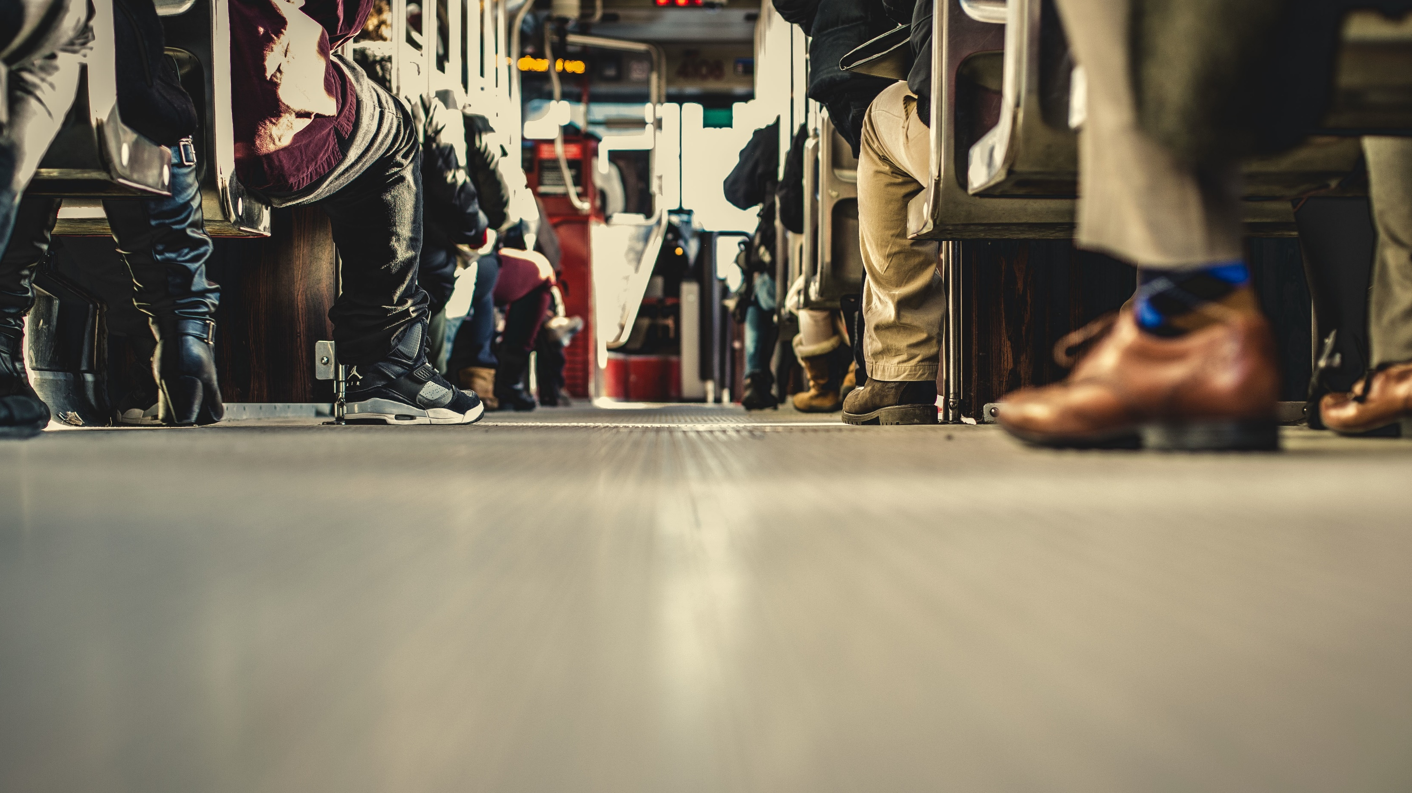
1 Tim 1:12-17
Paul’s Testimony

Slide 2
1 Tim 1:12-17
¹² I thank him who has given me strength, Christ Jesus our Lord, because he judged me faithful, appointing me to his service, ¹³ though formerly I was a blasphemer, persecutor, and insolent opponent. But I received mercy because I had acted ignorantly in unbelief,
Caption

Slide 3
1 Tim 1:12-17
¹⁴ and the grace of our Lord overflowed for me with the faith and love that are in Christ Jesus. ¹⁵ The saying is trustworthy and deserving of full acceptance, that Christ Jesus came into the world to save sinners, of whom I am the foremost.
Caption

Slide 4
1 Tim 1:12-17
¹⁶ But I received mercy for this reason, that in me, as the foremost, Jesus Christ might display his perfect patience as an example to those who were to believe in him for eternal life. ¹⁷ To the King of the ages, immortal, invisible, the only God, be honor and glory forever and ever. Amen.
Caption

Slide 5
1 Tim 1:16
¹⁶ But I received mercy for this reason, that in me, as the foremost, Jesus Christ might display his perfect patience as an example to those who were to believe in him for eternal life.
Caption

Slide 6
1 Tim 1:15
¹⁵ The saying is trustworthy and deserving of full acceptance, that Christ Jesus came into the world to save sinners, of whom I am the foremost.
Caption

Slide 7
Paul’s Testimony
Jesus came into the world to save sinners.
Caption

Slide 8
1 Tim 1:13-14
¹³ though formerly I was a blasphemer, persecutor, and insolent opponent. But I received mercy because I had acted ignorantly in unbelief, ¹⁴ and the grace of our Lord overflowed for me with the faith and love that are in Christ Jesus.
Caption

Slide 9
Paul’s Testimony
Jesus came into the world to save sinners.
There is no salvation without sanctification.
Caption

Slide 10
1 Tim 1:12
¹² I thank him who has given me strength, Christ Jesus our Lord, because he judged me faithful, appointing me to his service,
Caption

Slide 11
Paul’s Testimony
Jesus came into the world to save sinners.
There is no salvation without sanctification.
God is the one who empowers us for Ministry.
Caption

Slide 12
Eph 2:5-7
⁵ even when we were dead in our trespasses, made us alive together with Christ—by grace you have been saved— ⁶ and raised us up with him and seated us with him in the heavenly places in Christ Jesus, ⁷ so that in the coming ages he might show the immeasurable riches of his grace in kindness toward us in Christ Jesus.
Caption

Slide 13
Paul’s Testimony
Jesus came into the world to save sinners.
There is no salvation without sanctification.
God is the one who empowers us for Ministry.
Our personal salvation should testify of the same.
Caption

Slide 14
1 Tim 1:12/17
¹² I thank him who has given me strength, Christ Jesus our Lord
¹⁷ To the King of the ages, immortal, invisible, the only God, be honor and glory forever and ever. Amen.
Caption

