Slide 1
Potjiekos
Renier Louwrens

Slide 2
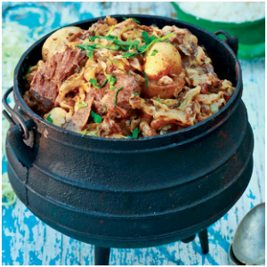
What makes a good pot?

Slide 3
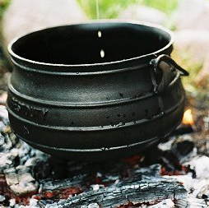
What makes a god pot?

Slide 4
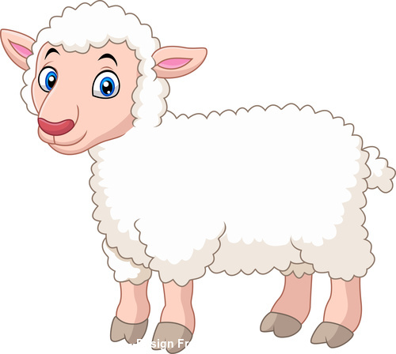
What makes a good pot?

Slide 5
What makes a good pot?
Fil 4

Slide 6
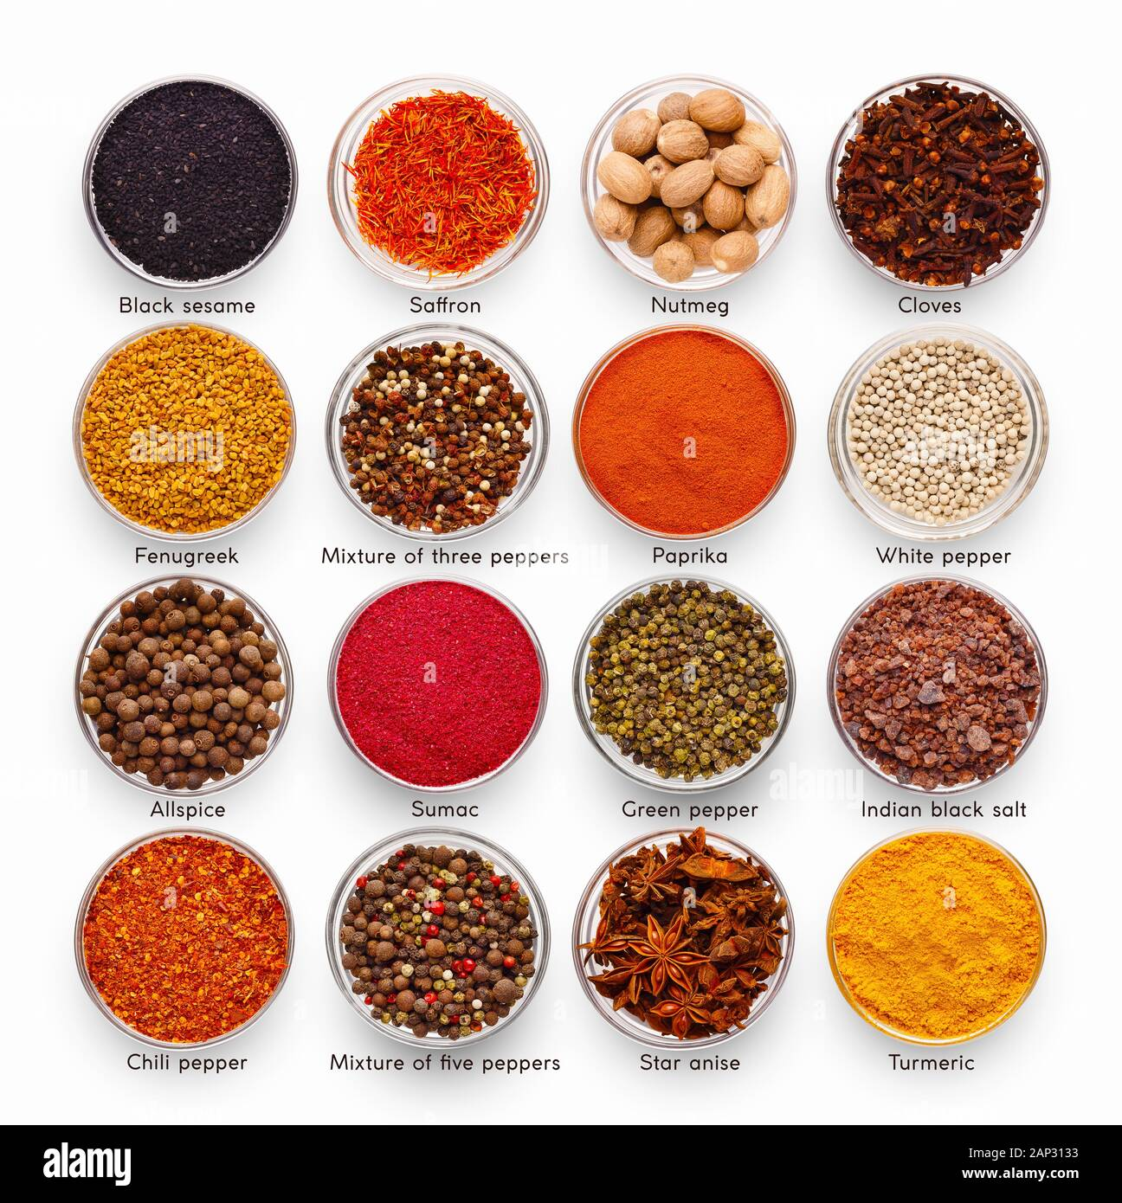
What makes a good pot?
Fil 4
Ruth 2

Slide 7
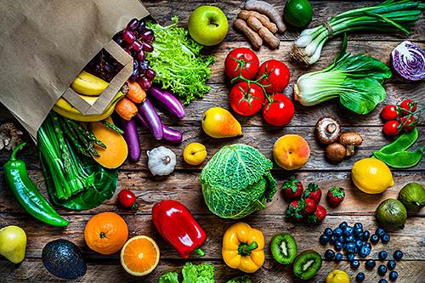
What makes a good pot?
Acts 16
Fil 4
Ruth 2

Slide 8
Philippians 4
1My dear, dear friends! I love you so much. I do want the very best for you. You make me feel such joy, fill me with such pride. Don’t waver. Stay on track, steady in God.
2I urge Euodia and Syntyche to iron out their differences and make up. God doesn’t want his children holding grudges.

Slide 9
Philippians 4
3And, oh, yes, Syzygus, since you’re right there to help them work things out, do your best with them. These women worked for the Message hand in hand with Clement and me, and with the other veterans—worked as hard as any of us. Remember, their names are also in the Book of Life.
4-5Celebrate God all day, every day. I mean, revel in him!

Slide 10
Philippians 4
Make it as clear as you can to all you meet that you’re on their side, working with them and not against them. Help them see that the Master is about to arrive. He could show up any minute!
6-7Don’t fret or worry. Instead of worrying, pray. Let petitions and praises shape your worries into prayers, letting God know your concerns.

Slide 11
Philippians 4
Before you know it, a sense of God’s wholeness, everything coming together for good, will come and settle you down. It’s wonderful what happens when Christ displaces worry at the center of your life. 8-9Summing it all up, friends, I’d say you’ll do best by filling your minds and meditating on things true, noble, reputable, authentic, compelling, gracious

Slide 12
Philippians 4
the best, not the worst; the beautiful, not the ugly; things to praise, not things to curse. Put into practice what you learned from me, what you heard and saw and realized. Do that, and God, who makes everything work together, will work you into his most excellent harmonies

Slide 13
Philippians 4
I’m glad in God, far happier than you would ever guess—happy that you’re again showing such strong concern for me. Not that you ever quit praying and thinking about me. You just had no chance to show it. Actually, I don’t have a sense of needing anything personally. I’ve learned by now to be quite content whatever my circumstances.

Slide 14
Philippians 4
I’m just as happy with little as with much, with much as with little. I’ve found the recipe for being happy whether full or hungry, hands full or hands empty. Whatever I have, wherever I am, I can make it through anything in the One who makes me who I am. I don’t mean that your help didn’t mean a lot to me—it did. It was a beautiful thing that you came alongside me in my troubles.

Slide 15
What makes a good pot?
Hand 16
Fil 4
Rut 2

Slide 16
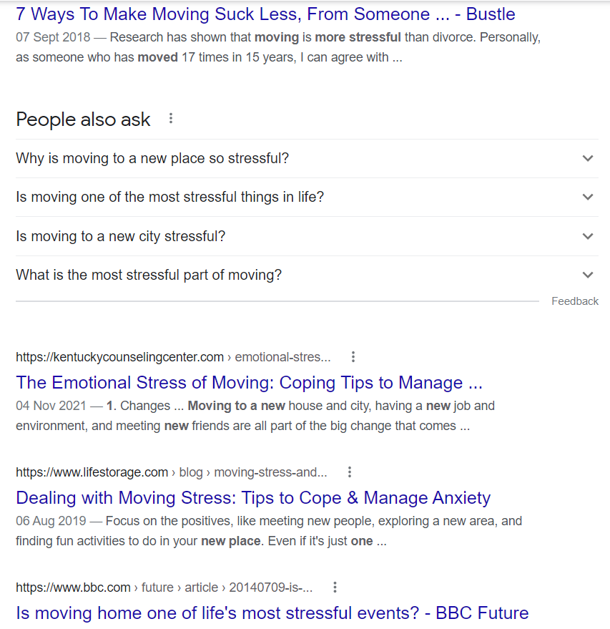

Slide 17
Ruth 2
It so happened that Naomi had a relative by marriage, a man prominent and rich, connected with Elimelech’s family. His name was Boaz.
2One day Ruth, the Moabite foreigner, said to Naomi, “I’m going to work; I’m going out to glean among the sheaves, following after some harvester who will treat me kindly.”
Naomi said, “Go ahead, dear daughter.”

Slide 18
Ruth 2
And so she set out. She went and started gleaning in a field, following in the wake of the harvesters. Eventually she ended up in the part of the field owned by Boaz, her father-in-law Elimelech’s relative. A little later Boaz came out from Bethlehem, greeting his harvesters, “God be with you!” They replied, “And God bless you!”
5Boaz asked his young servant who was foreman over the farm hands, “Who is this young woman? Where did she come from?”

Slide 19
Ruth 2
The foreman said, “Why, that’s the Moabite girl, the one who came with Naomi from the country of Moab. She asked permission. ‘Let me glean,’ she said, ‘and gather among the sheaves following after your harvesters.’ She’s been at it steady ever since, from early morning until now, without so much as a break.”

Slide 20
Ruth 2
Then Boaz spoke to Ruth: “Listen, my daughter. From now on don’t go to any other field to glean—stay right here in this one. And stay close to my young women. Watch where they are harvesting and follow them. And don’t worry about a thing; I’ve given orders to my servants not to harass you. When you get thirsty, feel free to go and drink from the water buckets that the servants have filled.”

Slide 21
Ruth 2
She dropped to her knees, then bowed her face to the ground. “How does this happen that you should pick me out and treat me so kindly—me, a foreigner?”
11-12Boaz answered her, “I’ve heard all about you—heard about the way you treated your mother-in-law after the death of her husband

Slide 22
Ruth 2
10Rut het diep gebuig voor Boas en gevra: “Waarom is u so goed vir my en stel u belang in my, in 'n buitelander?”
11Boas antwoord haar toe: “Ek weet van alles wat jy vir jou skoonma gedoen het na die dood van haar man en dat jy jou ouers en jou geboorteland verlaat het en na 'n volk toe gekom het waarvan jy vantevore niks geweet het nie.

Slide 23
Ruth 2
She dropped to her knees, then bowed her face to the ground. “How does this happen that you should pick me out and treat me so kindly—me, a foreigner?”
11-12Boaz answered her, “I’ve heard all about you—heard about the way you treated your mother-in-law after the death of her husband

Slide 24
Ruth 2
10Rut het diep gebuig voor Boas en gevra: “Waarom is u so goed vir my en stel u belang in my, in 'n buitelander?”
11Boas antwoord haar toe: “Ek weet van alles wat jy vir jou skoonma gedoen het na die dood van haar man en dat jy jou ouers en jou geboorteland verlaat het en na 'n volk toe gekom het waarvan jy vantevore niks geweet het nie.

Slide 25
Ruth 2
and how you left your father and mother and the land of your birth and have come to live among a bunch of total strangers. God reward you well for what you’ve done—and with a generous bonus besides from God, to whom you’ve come seeking protection under his wings.”
13She said, “Oh sir, such grace, such kindness—I don’t deserve it. You’ve touched my heart, treated me like one of your own. And I don’t even belong here!”

Slide 26
Ruth 2
At the lunch break, Boaz said to her, “Come over here; eat some bread. Dip it in the wine.”
So she joined the harvesters. Boaz passed the roasted grain to her. She ate her fill and even had some left over.

Slide 27
Ruth 2
When she got up to go back to work, Boaz ordered his servants: “Let her glean where there’s still plenty of grain on the ground—make it easy for her. Better yet, pull some of the good stuff out and leave it for her to glean. Give her special treatment.”

Slide 28
What makes a good pot?
Hand 16
Fil 4
Rut 2

Slide 29
Acts 16
A slave girl is delivered
One day, on our way to the place of prayer, a slave girl ran into us. She was a psychic and, with her fortunetelling, made a lot of money for the people who owned her. She started following Paul around, calling everyone’s attention to us by yelling out, “These men are working for the Most High God. They’re laying out the road of salvation for you!”.”
Notes:
Hoe gebeur dit dat kinders van God in die tronk beland?Die Satan het natuurlik ’n groot aandeel hierin.En, soos wat baie kere gebeur, maak hy van slegte mense gebruik om sy plannetjies vir hom uit te voer. Wat gebeur het,is dt...Hierdie boek Handelinge vertel vir ons hoe die evangeliegevorder het van Jerusalem af tot in Rome, die hoofstad van die destydse Romeinse ryk.Hierdie boek begin met ’n handjievol dissipels daar in Jerusalem-daar waar die Here Jesus gekruisig is-en waar Hy uit die dood uit opgestaan het-en waarvandaan Hy na die hemelopgevaar het-en waar die Heilige Gees uitgestort is,

Slide 30
Acts 16
She did this for a number of days until Paul, finally fed up with her, turned and commanded the spirit that possessed her, “Out! In the name of Jesus Christ, get out of her!” And it was gone, just like that.
Notes:
Ek het aspris die opskrif gelos. Kyk net hoe great is dit.

Slide 31
Acts 16
Paul and Silas beaten up and imprisoned When her owners saw that their lucrative little business was suddenly bankrupt, they went after Paul and Silas, roughed them up and dragged them into the market square. Then the police arrested them and pulled them into a court with the accusation, “These men are disturbing the peace—
Notes:
Ek het aspris die opskrif gelos. Kyk net hoe great is dit.

Slide 32
Acts 16
dangerous Jewish agitators subverting our Roman law and order.” By this time the crowd had turned into a restless mob out for blood.
Notes:
Ek het aspris die opskrif gelos. Kyk net hoe great is dit.

Slide 33
Acts 16
The judges went along with the mob, had Paul and Silas’s clothes ripped off and ordered a public beating. After beating them black-and-blue, they threw them into jail, telling the jailkeeper to put them under heavy guard so there would be no chance of escape. He did just that—threw them into the maximum security cell in the jail and clamped leg irons on them.
Notes:
Ek het aspris die opskrif gelos. Kyk net hoe great is dit.

Slide 34
Acts 16
Along about midnight, Paul and Silas were at prayer and singing a robust hymn to God. The other prisoners couldn’t believe their ears. Then, without warning, a huge earthquake! The jailhouse tottered, every door flew open, all the prisoners were loose
Notes:
Dink gou hieraan. Jy vat hou na hou. Lelike woorde, onregverdige hantering, seer fisies en emosioneel. Om daarna te bgin bid kan moeilik wees. Maar wat dit ook is in hierdie situasie is ‘n getuinis van God vir die wagte en mede gevangenis.

Slide 35
Acts 16
27-28Startled from sleep, the jailer saw all the doors swinging loose on their hinges. Assuming that all the prisoners had escaped, he pulled out his sword and was about to do himself in, figuring he was as good as dead anyway, when Paul stopped him: “Don’t do that! We’re all still here! Nobody’s run away!
Notes:
Ek het aspris die opskrif gelos. Kyk net hoe great is dit.

Slide 36
Acts 16
29-31The jailer got a torch and ran inside. Badly shaken, he collapsed in front of Paul and Silas. He led them out of the jail and asked, “Sirs, what do I have to do to be saved, to really live?” They said, “Put your entire trust in the Master Jesus. Then you’ll live as you were meant to live—and everyone in your house included!”
Notes:
Dink gou hieraan. Jy vat hou na hou. Lelike woorde, onregverdige hantering, seer fisies en emosioneel. Om daarna te bgin bid kan moeilik wees. Maar wat dit ook is in hierdie situasie is ‘n getuinis van God vir die wagte en mede gevangenis.

Slide 37
Acts 16
They went on to spell out in detail the story of the Master—the entire family got in on this part. They never did get to bed that night. The jailer made them feel at home, dressed their wounds, and then—he couldn’t wait till morning!—was baptized, he and everyone in his family. There in his home, he had food set out for a festive meal. It was a night to remember:
Notes:
Dink gou hieraan. Jy vat hou na hou. Lelike woorde, onregverdige hantering, seer fisies en emosioneel. Om daarna te bgin bid kan moeilik wees. Maar wat dit ook is in hierdie situasie is ‘n getuinis van God vir die wagte en mede gevangenis.

Slide 38
Acts 16
He and his entire family had put their trust in God; everyone in the house was in on the celebration
Notes:
Dink gou hieraan. Jy vat hou na hou. Lelike woorde, onregverdige hantering, seer fisies en emosioneel. Om daarna te bgin bid kan moeilik wees. Maar wat dit ook is in hierdie situasie is ‘n getuinis van God vir die wagte en mede gevangenis.

Slide 39
Dink
u
vir
’n
oomblik
in
Paulus
en
Silas
se
situasie
in:
1
Hd
28:31
2
Hd
16:9
4
-
onskuldig
gearresteer;
-
sonder
’n
verhoor
veroordeel;
-
wreed
met
stokke
geslaan;
-
net
so,
met
onversorgde
wonde
en
waarskynlik
sonder
kos,
in
die
binneste
sel
van
die
tronk
gesmyt
;
-
waar
hulle
in
die
stikdonker
sit/l
met
hulle
voete
in
’n
houtblok
vasgeklem
–
asof
hulle
uiters
gevaarlike
misdadigers
is!
What Paulus and Silas endured?
Innocent arrest;
Sanctioned without being heard;
Beaten ruthlessly;
Thrown into jail with unattended wounds and no food
Kept in the deepest sell (dangerous criminals)
Notes:
Daar’s nie eintlik rede vir lofsange nie!Daar’s eintlik baie rede vir woede en bitterheid:-die meeste mense in daardie situasie sou hulle nag omgekla het oor hulle pyn en oor die onregverdige behandeling wat hulle gekry het;-hoe maklik kon Paulus of Silasnie gedink het nie:ek offer my hele lewe vir die werk van die Here op, en kyk wat laat Hy met my gebeur!-s mens nog dink aan iemand wat in daardie situasie bid, dan stel jy jou iemand voor wat dinge bid soos:Here, waar was U vandag?Hoe kan U niks doen nie as sulke dinge met U kinders gebeur?

Slide 40
Dink
u
vir
’n
oomblik
in
Paulus
en
Silas
se
situasie
in:
1
Hd
28:31
2
Hd
16:9
4
-
onskuldig
gearresteer;
-
sonder
’n
verhoor
veroordeel;
-
wreed
met
stokke
geslaan;
-
net
so,
met
onversorgde
wonde
en
waarskynlik
sonder
kos,
in
die
binneste
sel
van
die
tronk
gesmyt
;
-
waar
hulle
in
die
stikdonker
sit/l
met
hulle
voete
in
’n
houtblok
vasgeklem
–
asof
hulle
uiters
gevaarlike
misdadigers
is!
How did they do it?
They knew their actions weren’t driven by earthly needs but by Godly praise
When God is truly the most important in your life, to praise Him becomes your number 1 priority. This influences how we pray.
Notes:
Daar’s nie eintlik rede vir lofsange nie!Daar’s eintlik baie rede vir woede en bitterheid:-die meeste mense in daardie situasie sou hulle nag omgekla het oor hulle pyn en oor die onregverdige behandeling wat hulle gekry het;-hoe maklik kon Paulus of Silasnie gedink het nie:ek offer my hele lewe vir die werk van die Here op, en kyk wat laat Hy met my gebeur!-s mens nog dink aan iemand wat in daardie situasie bid, dan stel jy jou iemand voor wat dinge bid soos:Here, waar was U vandag?Hoe kan U niks doen nie as sulke dinge met U kinders gebeur?

Slide 41
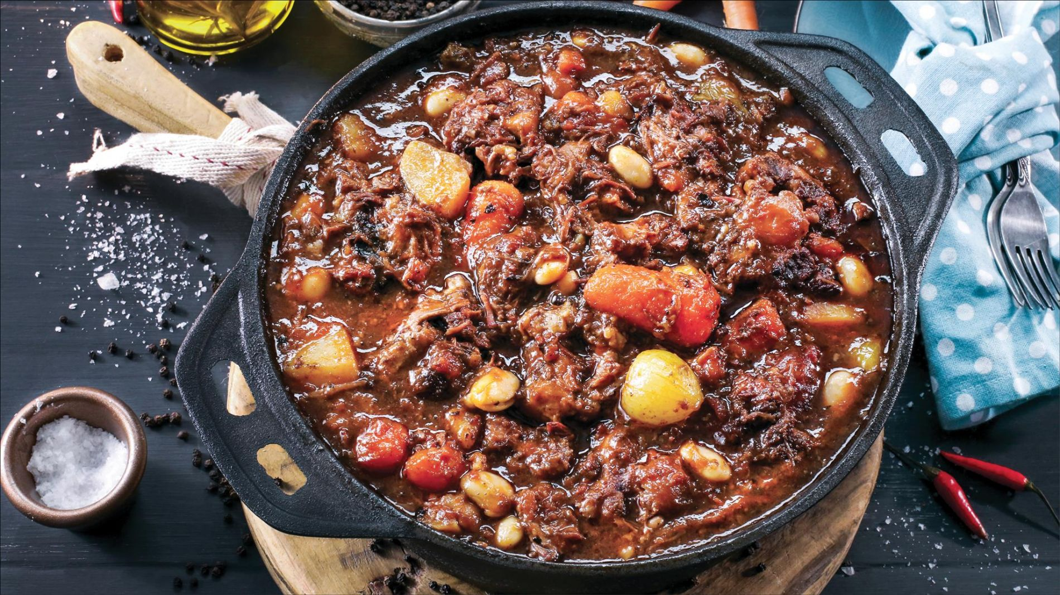
(8 hours later)

Slide 42
Dink
u
vir
’n
oomblik
in
Paulus
en
Silas
se
situasie
in:
1
Hd
28:31
2
Hd
16:9
4
-
onskuldig
gearresteer;
-
sonder
’n
verhoor
veroordeel;
-
wreed
met
stokke
geslaan;
-
net
so,
met
onversorgde
wonde
en
waarskynlik
sonder
kos,
in
die
binneste
sel
van
die
tronk
gesmyt
;
-
waar
hulle
in
die
stikdonker
sit/l
met
hulle
voete
in
’n
houtblok
vasgeklem
–
asof
hulle
uiters
gevaarlike
is!
The dished up truth
Lie down your worries at the cross – Our anxiety about our worldly problems are true and real, but God can attend to these long before we even know about it or can see it (Boaz). Ask God into which fields you should go for His predetermined help.
Notes:
Daar’s nie eintlik rede vir lofsange nie!Daar’s eintlik baie rede vir woede en bitterheid:-die meeste mense in daardie situasie sou hulle nag omgekla het oor hulle pyn en oor die onregverdige behandeling wat hulle gekry het;-hoe maklik kon Paulus of Silasnie gedink het nie:ek offer my hele lewe vir die werk van die Here op, en kyk wat laat Hy met my gebeur!-s mens nog dink aan iemand wat in daardie situasie bid, dan stel jy jou iemand voor wat dinge bid soos:Here, waar was U vandag?Hoe kan U niks doen nie as sulke dinge met U kinders gebeur?

Slide 43
Dink
u
vir
’n
oomblik
in
Paulus
en
Silas
se
situasie
in:
1
Hd
28:31
2
Hd
16:9
4
-
onskuldig
gearresteer;
-
sonder
’n
verhoor
veroordeel;
-
wreed
met
stokke
geslaan;
-
net
so,
met
onversorgde
wonde
en
waarskynlik
sonder
kos,
in
die
binneste
sel
van
die
tronk
gesmyt
;
-
waar
hulle
in
die
stikdonker
sit/l
met
hulle
voete
in
’n
houtblok
vasgeklem
–
asof
hulle
uiters
gevaarlike
is!
The dished up truth
2) Find your joy in the lord- To find our joy in the Lord does not mean to ask Him to bless us with joy in the world, it means to be truly surrendered to Him and understanding the joy of being saved from hell. His presence is the only constant and therefore is our joy in Him as well.
Notes:
Daar’s nie eintlik rede vir lofsange nie!Daar’s eintlik baie rede vir woede en bitterheid:-die meeste mense in daardie situasie sou hulle nag omgekla het oor hulle pyn en oor die onregverdige behandeling wat hulle gekry het;-hoe maklik kon Paulus of Silasnie gedink het nie:ek offer my hele lewe vir die werk van die Here op, en kyk wat laat Hy met my gebeur!-s mens nog dink aan iemand wat in daardie situasie bid, dan stel jy jou iemand voor wat dinge bid soos:Here, waar was U vandag?Hoe kan U niks doen nie as sulke dinge met U kinders gebeur?

Slide 44
NAGMAAL
ONTHOU SY OPOFFERING

Slide 45
COMMUNION
REMEMBER HIS SACRIFICE

Slide 46
MINISTRY

Slide 47
BEDIENING

Slide 48
KOM GENIET ‘N KOFFIE SAAM MET ONS

Slide 49
COME AND ENJOY A COFFEE WITH US

