Slide 1
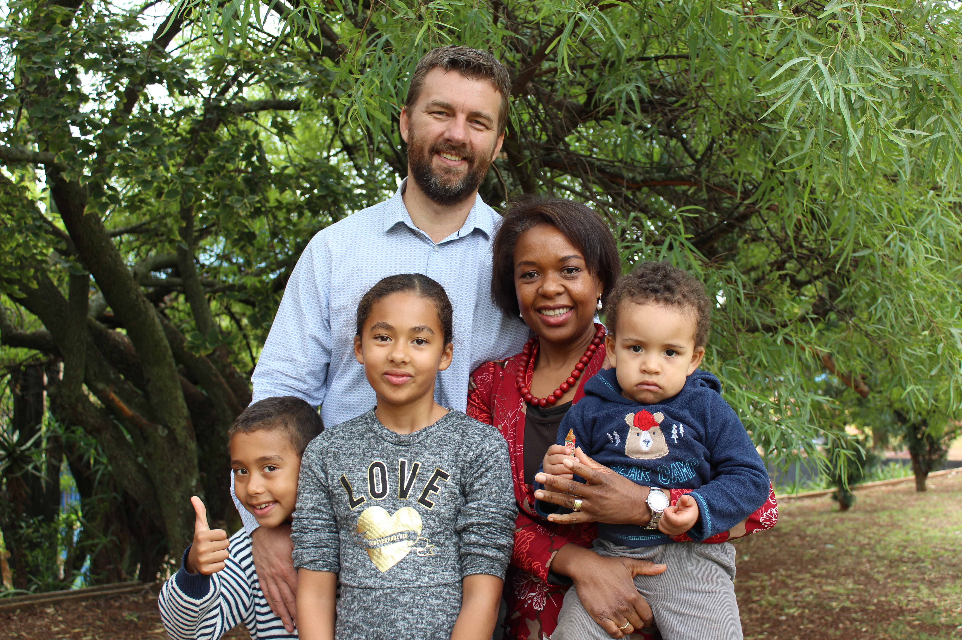
Jesus’ Campaign Warnings (Luke 9.57-62)
Ps. Hennie Swart

Slide 2
Luke 9.57-62
⁵⁷As they were walking along the road, a man said to him, “I will follow you wherever you go.”
⁵⁸Jesus replied, “Foxes have dens and birds have nests, but the Son of Man has no place to lay his head.”
⁵⁹He said to another man, “Follow me.”
But he replied, “Lord, first let me go and bury my father.” ⁶⁰Jesus said to him, “Let the dead bury their own dead, but you go and proclaim the kingdom of God.”
⁶¹Still another said, “I will follow you, Lord; but first let me go back and say goodbye to my family.”
⁶²Jesus replied, “No one who puts a hand to the plow and looks back is fit for service in the kingdom of God.”

Slide 3
1 Kings 19.19-21
¹⁹So Elijah went from there and found Elisha son of Shaphat. He was plowing with twelve yoke of oxen, and he himself was driving the twelfth pair. Elijah went up to him and threw his cloak around him. ²⁰Elisha then left his oxen and ran after Elijah. “Let me kiss my father and mother goodbye,” he said, “and then I will come with you.”
“Go back,” Elijah replied. “What have I done to you?” ²¹So Elisha left him and went back. He took his yoke of oxen and slaughtered them. He burned the plowing equipment to cook the meat and gave it to the people, and they ate. Then he set out to follow Elijah and became his servant.

