Slide 1
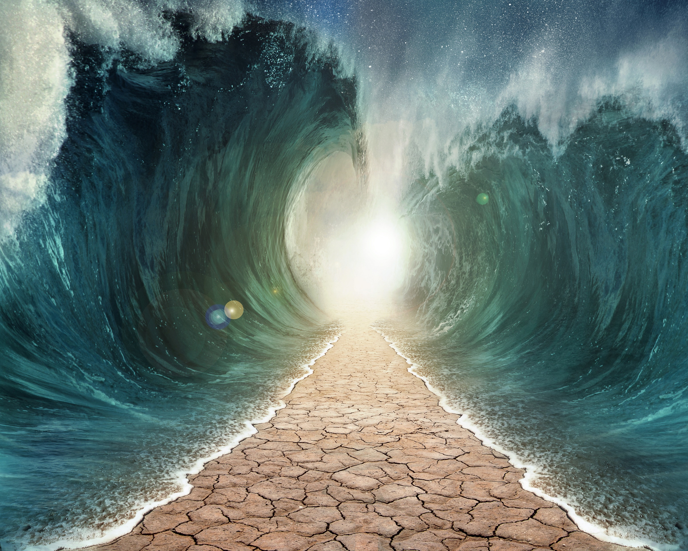
GOD
MAKES
IT MOVE!

Slide 2
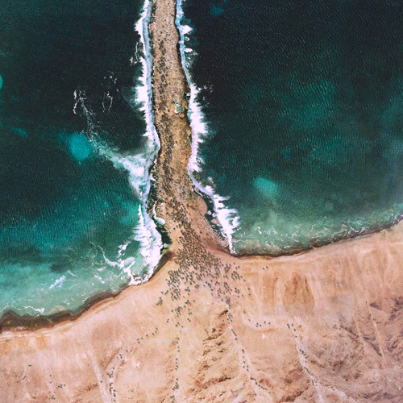
Psalm 114
¹ When the Israelites escaped from Egypt—
when the family of Jacob left that foreign land—
² the land of Judah became God’s sanctuary,
and Israel became his kingdom.

Slide 3
Psalm 114
³ The Red Sea saw them coming and hurried out of their way!
The water of the Jordan River turned away.
⁴ The mountains skipped like rams,
the hills like lambs!

Slide 4
Psalm 114
⁵ What’s wrong, Red Sea, that made you hurry out of their way?
What happened, Jordan River, that you turned away?
⁶ Why, mountains, did you skip like rams? Why, hills, like lambs?

Slide 5
Psalm 114
⁷ Tremble, O earth, at the presence of the Lord,
at the presence of the God of Jacob.
⁸ He turned the rock into a pool of water;
yes, a spring of water flowed from solid rock.

Slide 6
Exodus 17:6-7
So Moses struck the rock as he was told, and water gushed out as the elders looked on.
⁷ Moses named the place Massah (which means “test”) and Meribah (which means “arguing”) because the people of Israel argued with Moses and tested the Lord by saying,
“Is the Lord here with us or not?”

Slide 7
GOD
MAKES
IT MOVE!
We are not called to be powerful
The earth responds to HIS PRESENCE

Slide 8
GOD
MAKES
IT MOVE!
Everything moves in HIS PRESENCE
Are you
MOVED
yet?

Slide 9
GOD
MAKES
IT MOVE!
For it to move, we have to MOVE!
Unless you MOVE!
it won’t

Slide 10
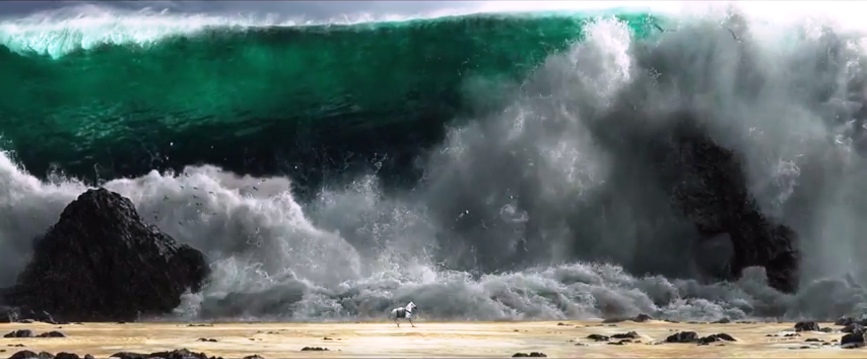

Slide 11
