Slide 1


Slide 2
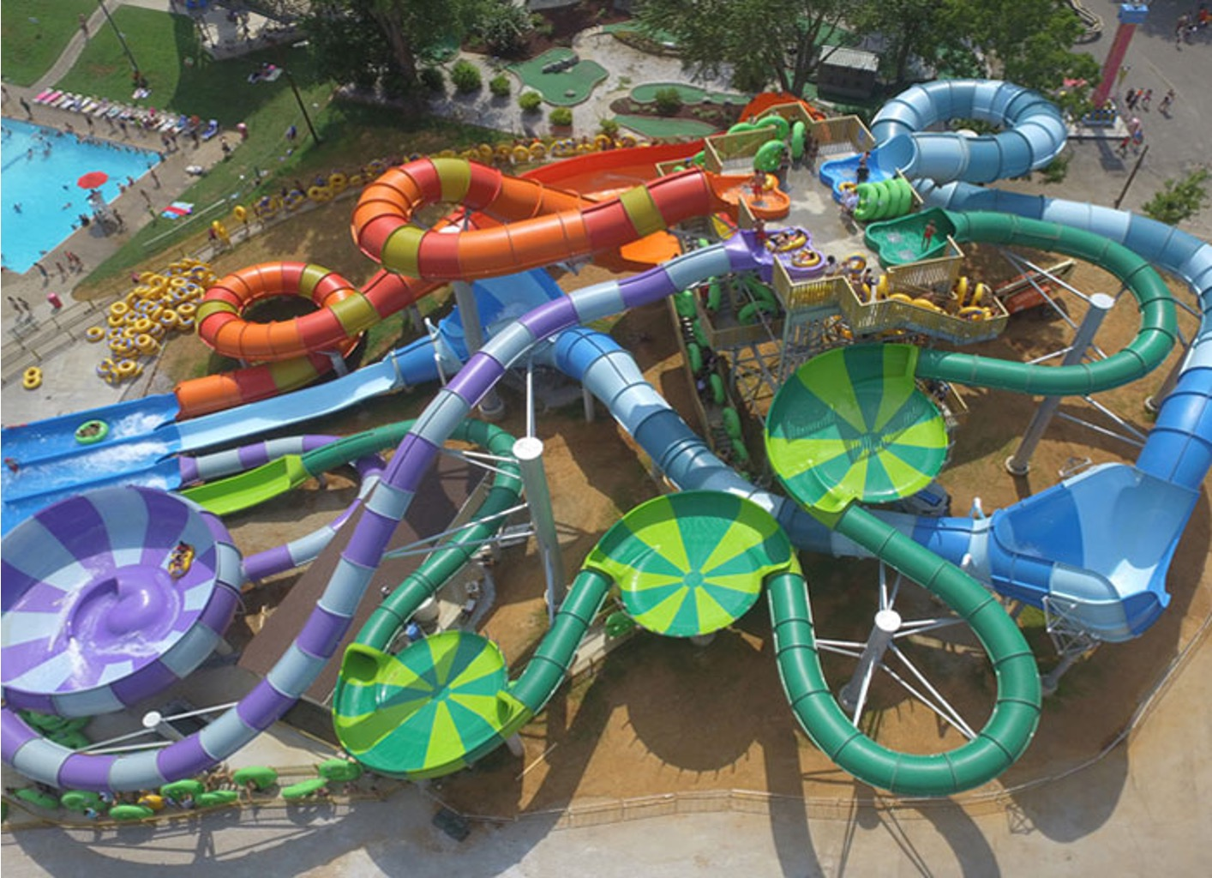

Slide 3

a choice of life or death
OUR
WORDS
ARE
powerful
Craig Marsh
19 March 2023

Slide 4

WORDS EFFECT OUR WORLD
Focus: What is the importance of the words we speak daily?
First stop off is Scripture.
Secondly we go to science and biology.
How does this apply to our church family?

Slide 5
Genesis 1: 3-4 (ESV)
³ And God said, “Let there be light,” and there was light. ⁴ And God saw that the light was good. And God separated the light from the darkness.

Slide 6
Genesis 1: 26 (ESV)
²⁶ Then God said, “Let us make man in our image, after our likeness. And let them have dominion over the fish of the sea and over the birds of the heavens and over the livestock and over all the earth and over every creeping thing that creeps on the earth.”

Slide 7
Genesis 1: 27 (ESV)
²⁷ So God created man in his own image, in the image of God he created him; male and female he created them.

Slide 8
Proverbs 18: 21 (ESV)
²¹ Death and life are in the power of the tongue,
and those who love it will eat its fruits.

Slide 9
James 3: 5-6 (ESV)
⁵ So also the tongue is a small member, yet it boasts of great things. How great a forest is set ablaze by such a small fire! ⁶ And the tongue is a fire, a world of unrighteousness. The tongue is set among our members, staining the whole body, setting on fire the entire course of life, and set on fire by hell.

Slide 10
Matthew 15: 11 (ESV)
¹¹ it is not what goes into the mouth that defiles a person, but what comes out of the mouth; this defiles a person.”

Slide 11
What did Jesus tell us about our words?
Matthew 15: 11 (ESV)
¹¹ it is not what goes into the mouth that defiles a person, but what comes out of the mouth; this defiles a person.”

Slide 12
Matthew 12: 33-34 (ESV)
³³ “Either make the tree good and its fruit good, or make the tree bad and its fruit bad, for the tree is known by its fruit. ³⁴ You brood of vipers! How can you speak good, when you are evil? For out of the abundance of the heart the mouth speaks.

Slide 13
Matthew 12: 35-37 (ESV)
³⁵ The good person out of his good treasure brings forth good, and the evil person out of his evil treasure brings forth evil. ³⁶ I tell you, on the day of judgment people will give account for every careless word they speak, ³⁷ for by your words you will be justified, and by your words you will be condemned.”

Slide 14
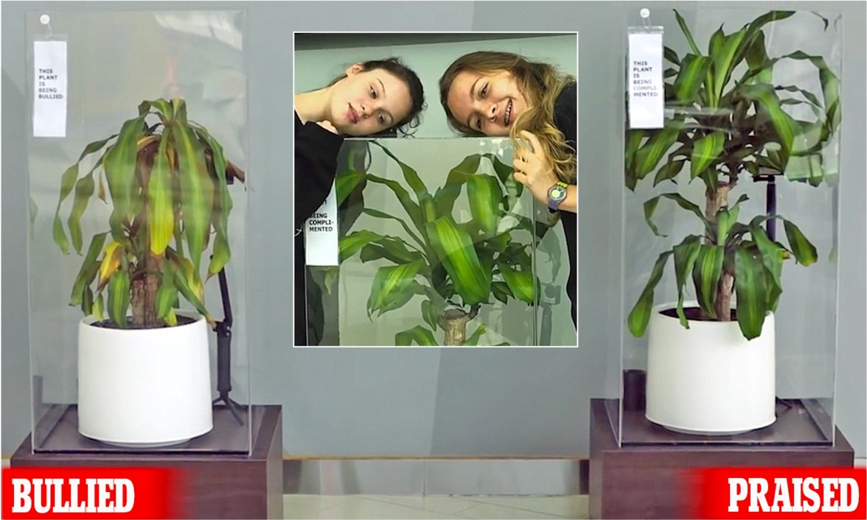

Slide 15
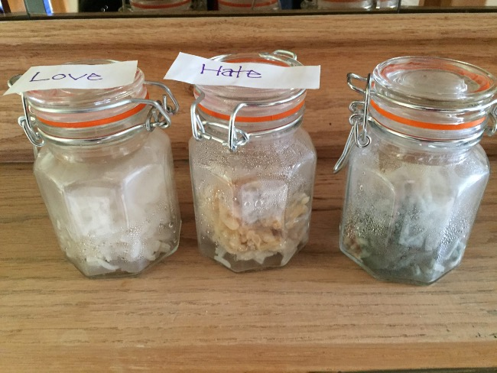

Slide 16
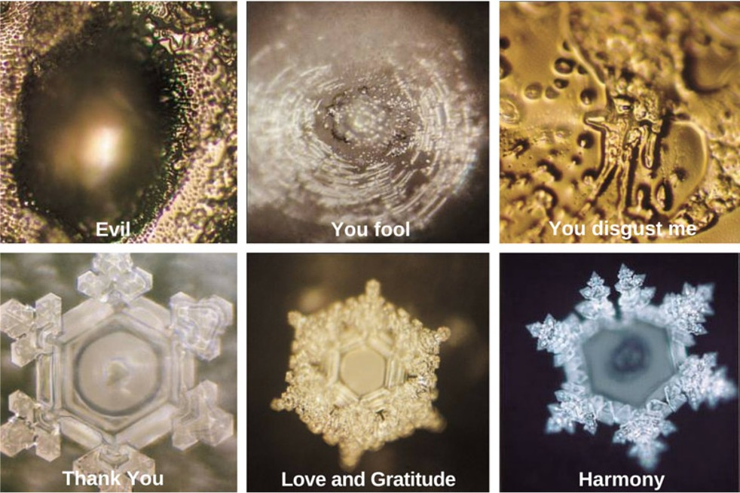

Slide 17
What does this have to do with the season we are currently facing in our church as a family and how could we best apply what is being shared with us today?

Slide 18
Sharing our trip progress – Accountability can only start when we pursue a relationship with others with in our community. This begins with speaking up, with sharing with one another on where we are at.
Make every conversation count – Words of vulnerability have the potential of a powerful testimony.

Slide 19
Healing – Words of vulnerability have the powerful potential for inner healing and deliverance / Freedom. When we accept Jesus as our Lord and savior we are transformed and the condition of our heart changes, changing the very words that come out of our mouths to words of Life.

Slide 20
Romans 10: 8-9 (ESV)
⁸ But what does it say? “The word is near you, in your mouth and in your heart” (that is, the word of faith that we proclaim); ⁹ because, if you confess with your mouth that Jesus is Lord and believe in your heart that God raised him from the dead, you will be saved.

Slide 21
Romans 10: 10 (ESV)
¹⁰ For with the heart one believes and is justified, and with the mouth one confesses and is saved.

