Slide 1
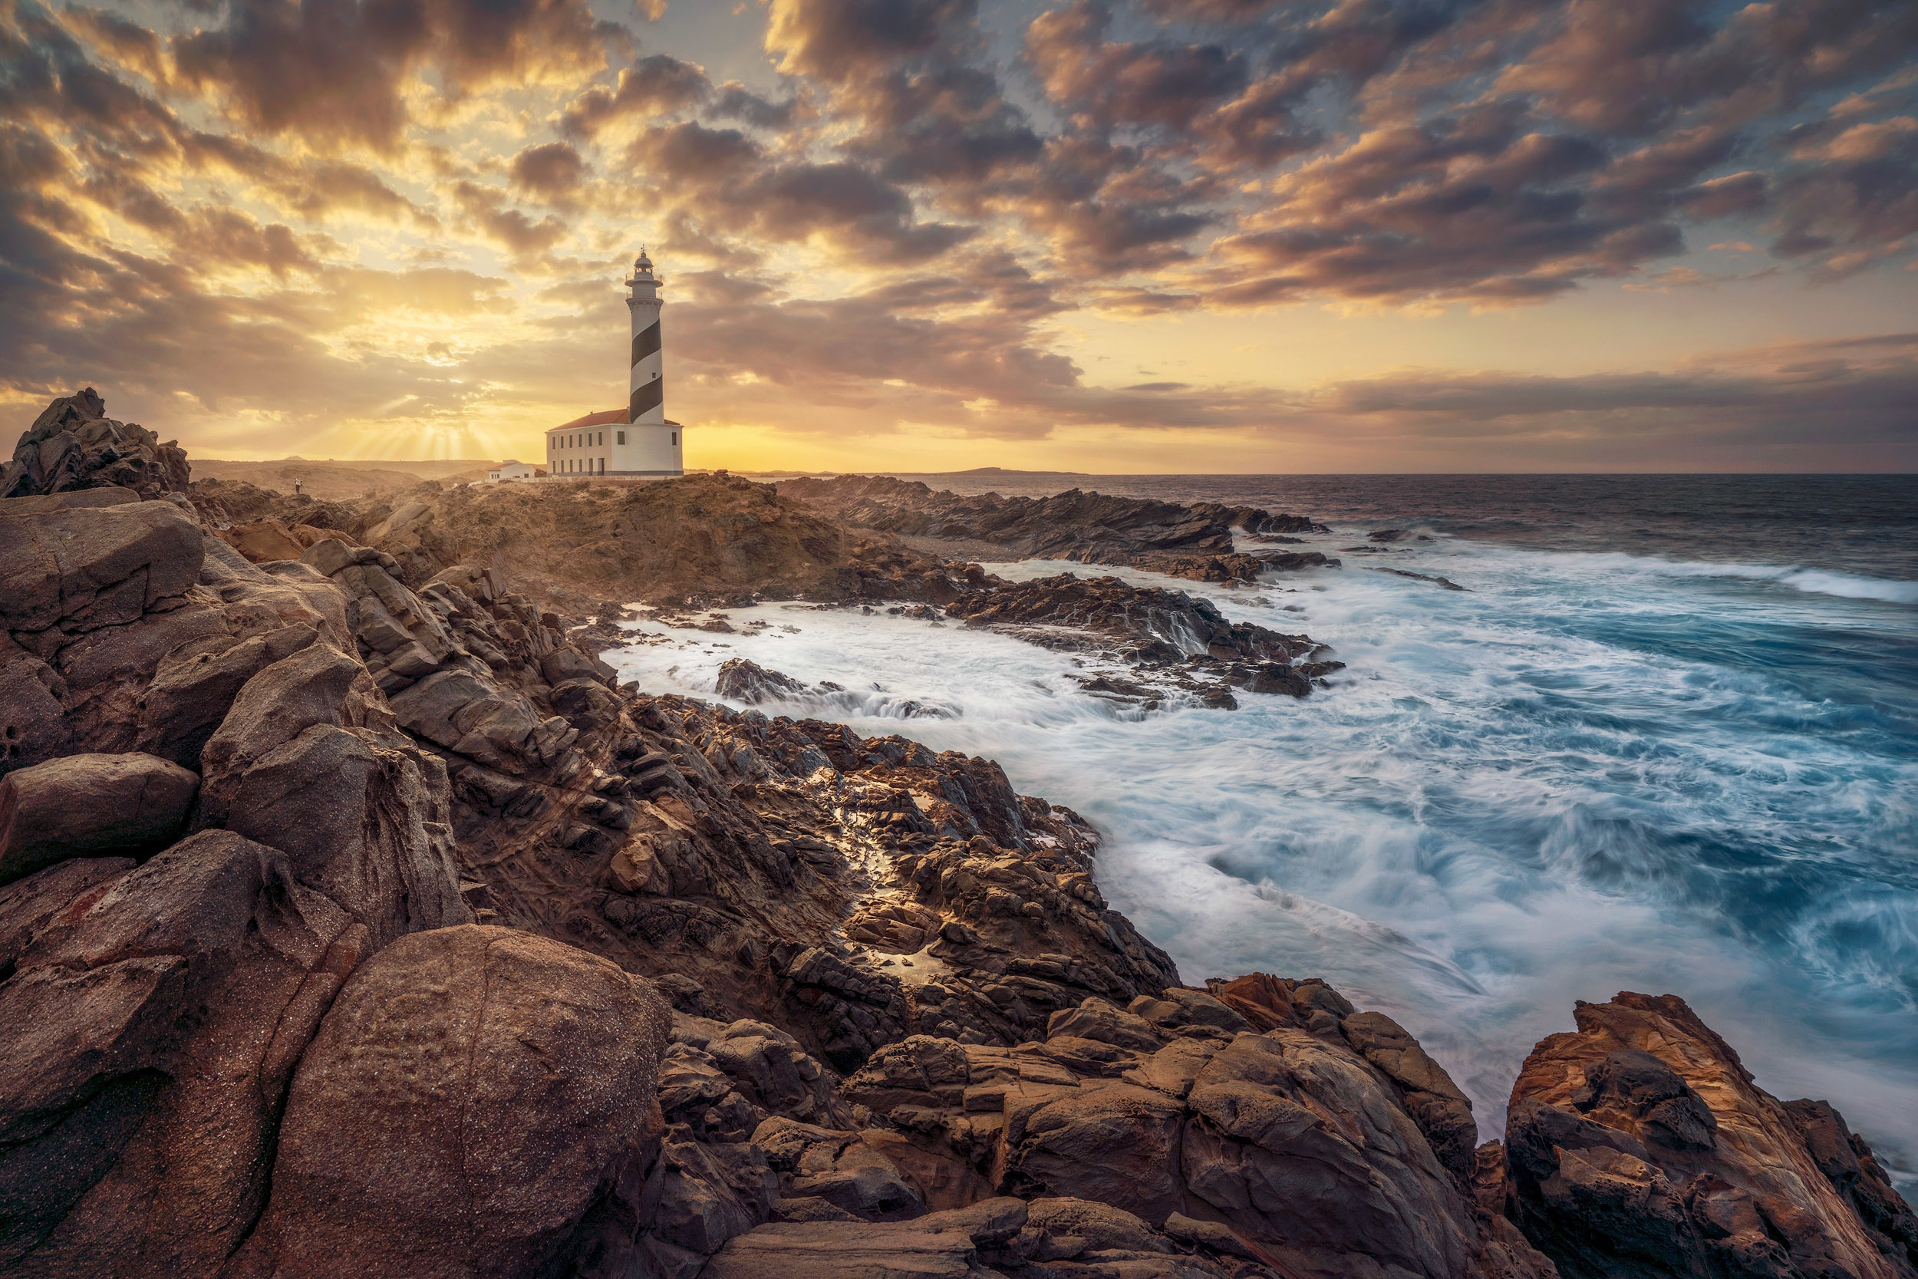
Hennie Coetzer
12 March 2023
Steadfast
FAITH

Slide 2
James 1: 2-9
2 Count it all joy, my brothers, when you meet trials of various kinds, 3 for you know that the testing of your faith produces steadfastness. 4 And let steadfastness have its full effect, that you may be perfect and complete, lacking in nothing. 5 If any of you lacks wisdom, let him ask God, who gives generously to all without reproach, and it will be given him.

Slide 3
James 1: 2-9
6 But let him ask in faith, with no doubting, for the one who doubts is like a wave of the sea that is driven and tossed by the wind. 7 For that person must not suppose that he will receive anything from the Lord; 8 he is a double-minded man, unstable in all his ways.

Slide 4
1. Trials and Faith
James 1:2-4 - 2 Count it all joy, my brothers, when you meet trials of various kinds, 3 for you know that the testing of your faith produces steadfastness. 4 And let steadfastness have its full effect, that you may be perfect and complete, lacking in nothing.

Slide 5
2. Wisdom and Faith
James 1:5 If any of you lacks wisdom, let him ask God, who gives generously to all without reproach, and it will be given him.

Slide 6
3. Doubt and Faith
James 1:6 – 8 - 6 But let him ask in faith, with no doubting, for the one who doubts is like a wave of the sea that is driven and tossed by the wind. 7 For that person must not suppose that he will receive anything from the Lord; 8 he is a double-minded man, unstable in all his ways.

Slide 7
4. Faith
Faith - belief, trust, generally of the leaning of the entire human personality upon God or the Messiah in absolute trust and confidence in His power, wisdom and goodness.

Slide 8
Three concepts of Faith
Faithfulness to God alone and cooperation with Him
“By faith and not sight” 2 Cor 5:7 – Interpret the world in a Godly way.
All that is hidden will be revealed when Christ returns

Slide 9
Prayer points:
Do I KNOW the testing of my faith produces steadfastness?
Do I experience God’s generous wisdom?
What areas of my life are unstable?
Do I have confident faith in God?

