Slide 1
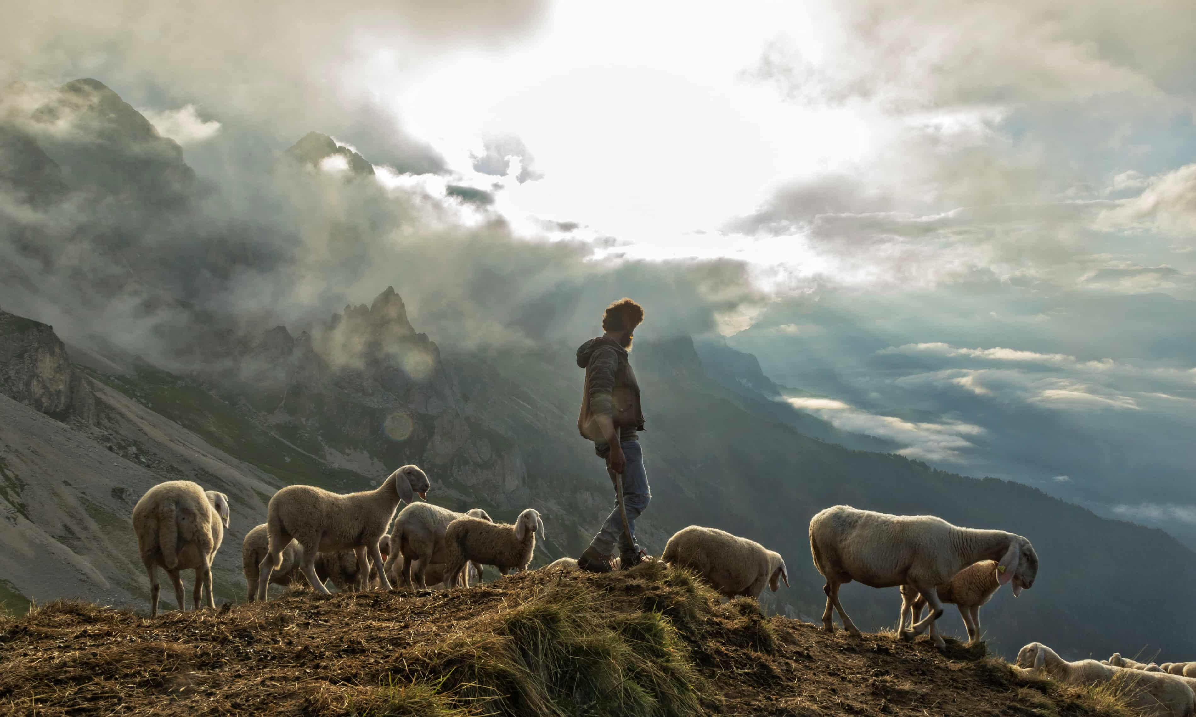
OBEY
my voice
Hennie Coetzer
29 January 2023

Slide 2
Gen 27: 18 – 27
18 So he went in to his father and said, “My father.” And he said, “Here I am. Who are you, my son?” 19 Jacob said to his father, “I am Esau your firstborn. I have done as you told me; now sit up and eat of my game, that your soul may bless me.” 20 But Isaac said to his son, “How is it that you have found it so quickly, my son?” He answered, “Because the LORD your God granted me success.”

Slide 3
Gen 27: 18 – 27
25 Then Isaac said to Jacob, “Please come near, that I may feel you, my son, to know whether you are really my son Esau or not.” 22 So Jacob went near to Isaac his father, who felt him and said, “The voice is Jacob’s voice, but the hands are the hands of Esau.” 23 And he did not recognize him, because his hands were hairy like his brother Esau’s hands. So he blessed him. 24 He said, “Are you really my son Esau?” He answered, “I am.”

Slide 4
Gen 27: 18 – 27
25 Then he said, “Bring it near to me, that I may eat of my son’s game and bless you.” So he brought it near to him, and he ate; and he brought him wine, and he drank. 26 Then his father Isaac said to him, “Come near and kiss me, my son.” 27 So he came near and kissed him. And Isaac smelled the smell of his garments and blessed him…

Slide 5
Who are you?
How is it that you have found it so quickly?
Please come near that I may feel you?
Are you really…?
Come near and kiss me…

Slide 6
John 10: 1-5
1“Truly, truly, I say to you, he who does not enter the sheepfold by the door but climbs in by another way, that man is a thief and a robber. 2 But he who enters by the door is the shepherd of the sheep. 3 To him the gatekeeper opens. The sheep hear his voice, and he calls his own sheep by name and leads them out.

Slide 7
John 10: 1-5
4 When he has brought out all his own, he goes before them, and the sheep follow him, for they know his voice. 5 A stranger they will not follow, but they will flee from him, for they do not know the voice of strangers.”

Slide 8
Response:
Have I heard the voice of Jesus calling me by name and responded?
Am I following Jesus’s voice as He leads?
When I am unsure of whose voice I hear, who do I test with?

