Slide 1
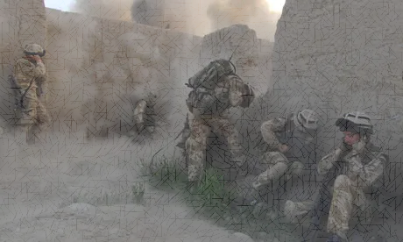
Matthew 16:2-3 He answered and said to them, ‘When it is evening you say , “It will be fair weather, for the sky is red”; and in the morning, “It will be foul weather today, for the sky is red and threatening.” Hypocrites! You know how to discern the face of the sky, but you cannot discern the signs of the times.
What might these words of Jesus mean to us today? What are the times that we are living in?

Slide 2
The church in the West are living in a judged kingdom
Based on Romans 1 (among others)
Where is the focus of the church?
How are we positioning ourselves in the middle of this judgement?

Slide 3
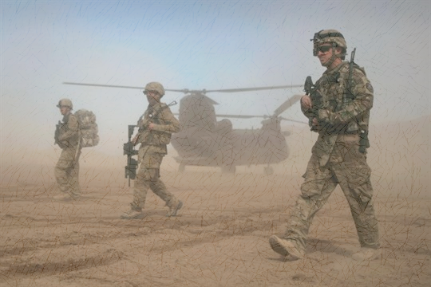
DISCERNING THE TIMES
We need to be strengthened supernaturally
2 Timothy 2 :1-7

Slide 4
2 Timothy 2:1-7 (ESV)
You then, my child, be strengthened by the grace that is in Christ Jesus, and what you have heard from me in the presence of many witnesses entrust to faithful men, who will be able to teach others also. Share in suffering as a good soldier of Christ Jesus.

Slide 5
2 Timothy 2:1-7 (ESV)
No soldier gets entangled in civilian pursuits, since his aim is to please the one who enlisted him.
An athlete is not crowned unless he competes according to the rules.
It is the hard-working farmer who ought to have the first share of the crops.
Think over what I say, for the Lord will give you understanding in everything.

Slide 6
Verse 7:
Think over what I say, for the Lord will give you understanding in everything.

Slide 7
2 Timothy 2:1-7
You then, my child, be strengthened by the grace that is in Christ Jesus
Why do Paul think that I will need strengthening?
What grace is Paul talking about?
Grace In Christ Jesus?

Slide 8
Ephesians 2:8 (NKJV)
For by grace you have been saved through faith, and that not of yourselves; it is the gift of God,

Slide 9
1 Corinthians 15:10 (NKJV)
But by the grace of God I am what I am, and His grace toward me was not in vain; but I labored more abundantly than they all, yet not I, but the grace of God which was with me.

Slide 10
2 Timothy 2:1-7
You then, my child, be strengthened by the grace that is in Christ Jesus, and what you have heard from me in the presence of many witnesses entrust to faithful men, who will be able to teach others also. Share in suffering as a good soldier of Christ Jesus.

Slide 11
2 Timothy 2:3
and what you have heard from me… entrust to faithful men, who will be able to teach others also.
1 Cor 2:13-14 These things we also speak, not in words which man’s wisdom teaches but which the Holy Spirit teaches, comparing spiritual things with spiritual. But the natural man does not receive the things of the Spirit of God, for they are foolishness to him; nor can he know them, because they are spiritually discerned.

Slide 12
2 Timothy 2:3
Share in suffering as a good soldier of Christ Jesus.
As a soldier
As an athlete
As a farmer
We need supernatural strength to Entrust the gospel to others who can teach others. Enduring suffering as we share this gospel like the list above.

Slide 14
As a soldier
“No soldier gets entangled in civilian pursuits, since his aim is to please the one who enlisted him.”
- Focused on his task not what is going on around him
- Fight to please The One Who enlisted him.

Slide 15
As an athlete
“An athlete is not crowned unless he competes according to the rules.”
Walking the walk with integrity
Run according to the rules of the race

Slide 16
As a farmer
“It is the hard-working farmer who ought to have the first share of the crops.”
Hard work
Against the uncontrollable nature and its elements
Resilient

Slide 17
Never forgetting that it is;
By God’s grace at work in me. The way He worked in Jesus, that through His grace, I may achieve victory…
STEP ONE:
POSITION MYSELF IN GOD’S GRACE

