Slide 1
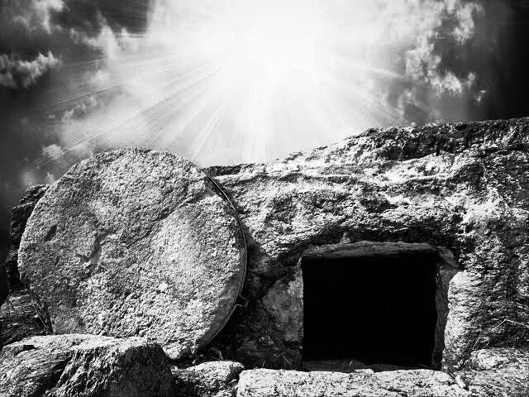
Not Set in Stone
by Pastor Hennie Swart

Slide 2
Introduction
As sceptical modern people we think, “If it sounds too good to be true it usually is!”
For example, we don’t believe those email hoaxes congratulating us on inheriting millions.
What about the claim that Jesus rose from the dead and can give us eternal life? Sound too good to be true?
For many people death is set in stone – people who die stay dead!

Slide 3
Matthew 27:50-28.17
And when Jesus had cried out again in a loud voice, he gave up his spirit.At that moment the curtain of the temple was torn in two from top to bottom. The earth shook, the rocks split and the tombs broke open. The bodies of many holy people who had died were raised to life. They came out of the tombs after Jesus’ resurrection and went into the holy city and appeared to many people.When the centurion and those with him who were guarding Jesus saw the earthquake and all that had happened, they were terrified, and exclaimed, “Surely he was the Son of God!”
Many women were there, watching from a distance. They had followed Jesus from Galilee to care for his needs. Among them were Mary Magdalene, Mary the mother of James and Joseph, and the mother of Zebedee’s sons.

Slide 4
Matthew 27:50-28.17
As evening approached, there came a rich man from Arimathea, named Joseph, who had himself become a disciple of Jesus. Going to Pilate, he asked for Jesus’ body, and Pilate ordered that it be given to him. Joseph took the body, wrapped it in a clean linen cloth, and placed it in his own new tomb that he had cut out of the rock. He rolled a big stone in front of the entrance to the tomb and went away. Mary Magdalene and the other Mary were sitting there opposite the tomb.The Guard at the TombThe next day, the one after Preparation Day, the chief priests and the Pharisees went to Pilate.
“Sir,” they said, “we remember that while he was still alive that deceiver said, ‘After three days I will rise again.’ So give the order for the tomb to be made secure until the third day.

Slide 5
Matthew 27:50-28.17
Otherwise, his disciples may come and steal the body and tell the people that he has been raised from the dead. This last deception will be worse than the first.”
“Take a guard,” Pilate answered. “Go, make the tomb as secure as you know how.” So they went and made the tomb secure by putting a seal on the stone and posting the guard.
After the Sabbath, at dawn on the first day of the week, Mary Magdalene and the other Mary went to look at the tomb. There was a violent earthquake, for an angel of the Lord came down from heaven and, going to the tomb, rolled back the stone and sat on it. His appearance was like lightning, and his clothes were white as snow.

Slide 6
Matthew 27:50-28.17
The guards were so afraid of him that they shook and became like dead men. The angel said to the women, “Do not be afraid, for I know that you are looking for Jesus, who was crucified. He is not here; he has risen, just as he said. Come and see the place where he lay. Then go quickly and tell his disciples: ‘He has risen from the dead and is going ahead of you into Galilee. There you will see him.’ Now I have told you.”
So the women hurried away from the tomb, afraid yet filled with joy, and ran to tell his disciples. Suddenly Jesus met them. “Greetings,” he said. They came to him, clasped his feet and worshiped him. Then Jesus said to them, “Do not be afraid. Go and tell my brothers to go to Galilee; there they will see me.”

Slide 7
Matthew 27:50-28.17
While the women were on their way, some of the guards went into the city and reported to the chief priests everything that had happened. When the chief priests had met with the elders and devised a plan, they gave the soldiers a large sum of money, telling them, “You are to say, ‘His disciples came during the night and stole him away while we were asleep.’ If this report gets to the governor, we will satisfy him and keep you out of trouble.”
So the soldiers took the money and did as they were instructed. And this story has been widely circulated among the Jews to this very day.
Then the eleven disciples went to Galilee, to the mountain where Jesus had told them to go. When they saw him, they worshiped him; but some doubted.

Slide 8
Outline
This passage teaches us:
Why Joseph put a stone before the tomb.
Why the chief priest tried to keep the stone there.
Why the angel rolled the stone away.

Slide 9
Deuteronomy 21:22-23
If someone guilty of a capital offense is put to death and their body is exposed on a pole, you must not leave the body hanging on the pole overnight. Be sure to bury it that same day, because anyone who is hung on a pole is under God’s curse. You must not desecrate the land the Lord your God is giving you as an inheritance.

Slide 10
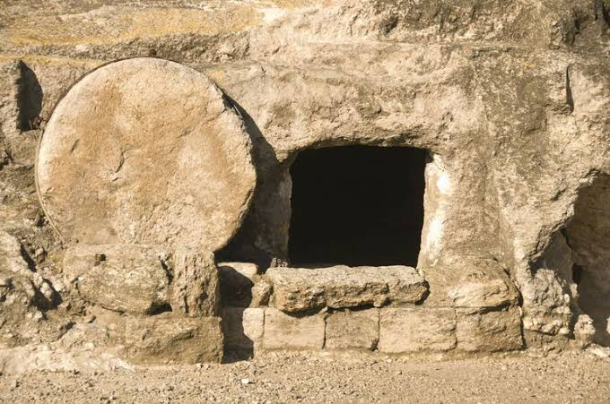
agenda
Jjj

Slide 11
Acts 12:18-19
In the morning, there was no small commotion among the soldiers as to what had become of Peter.
After Herod had a thorough search made for him and did not find him, he cross-examined the guards and ordered that they be executed.

Slide 13
Conclusion
After the Resurrection of Jesus, death is not set in stone!
If you allow Jesus to take you to the grave, He’ll also take you through the grave.

Slide 15
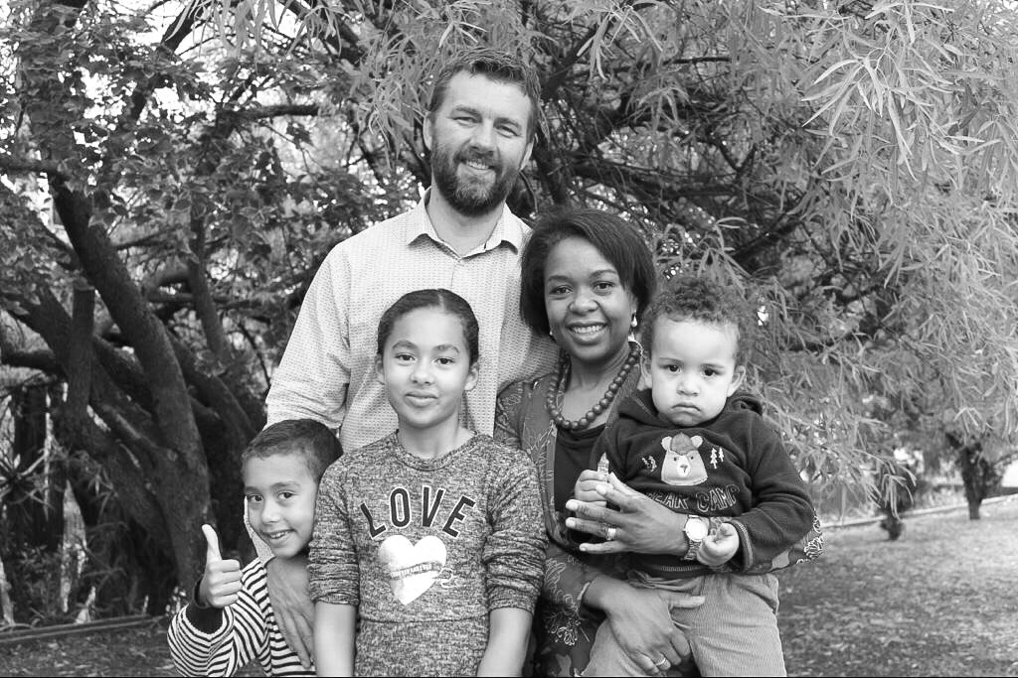
Sermon Title
by Pastor Hennie Swart

Slide 16
Not Set in Stone
by Pastor Hennie Swart

