Slide 1
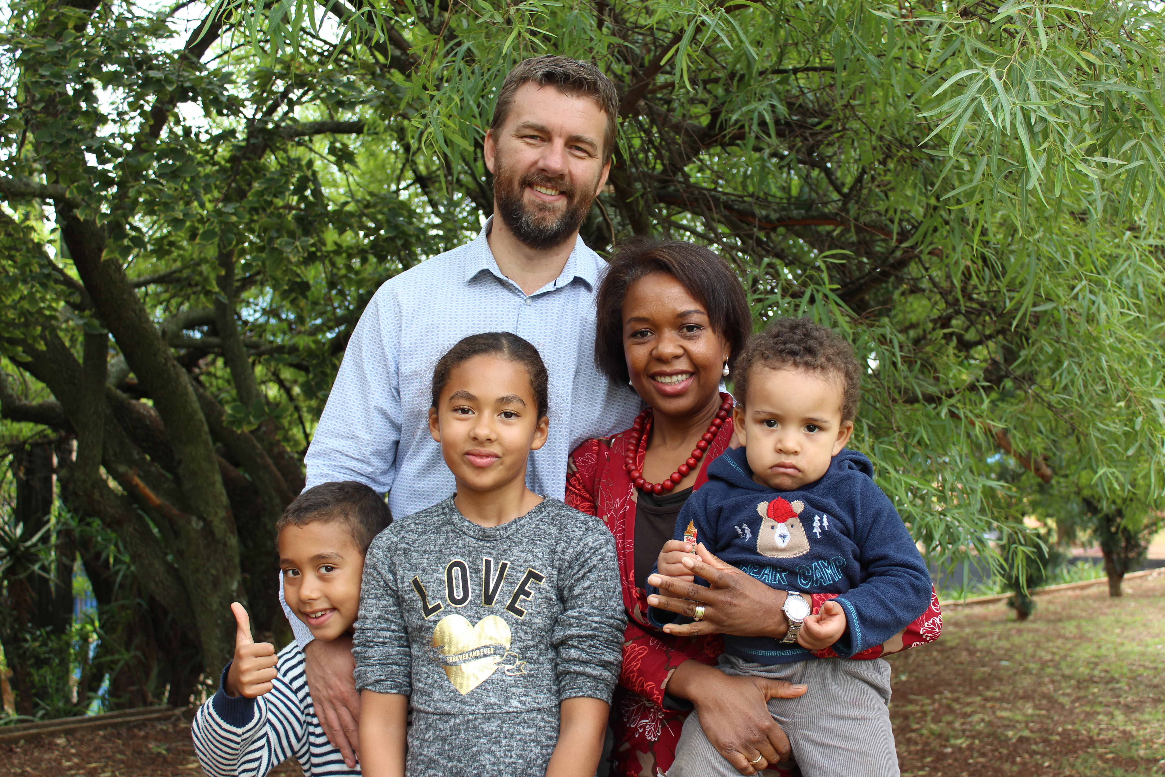
How can the Ark come to me
(2 Samuel 6.1-16)
Ps. Hennie Swart

Slide 2
2 Samuel 6.1-16 NIV
1David again brought together out of Israel chosen men, thirty thousand in all. ²He and all his men set out from Baalah of Judah﻿﻿ to bring up from there the ark of God, which is called by the Name,﻿﻿ the name of the Lord Almighty, who is enthroned between the cherubim that are on the ark. ³They set the ark of God on a new cart and brought it from the house of Abinadab, which was on the hill. Uzzah and Ahio, sons of Abinadab, were guiding the new cart ⁴with the ark of God on it,﻿﻿ and Ahio was walking in front of it. ⁵David and the whole house of Israel were celebrating with all their might before the Lord, with songs﻿﻿ and with harps, lyres, tambourines, sistrums and cymbals.
Notes:
Whereas modern people say that those who speak to themselves are crazy, here God speaks to Himself, as does David and many other Bible characters.

Slide 3
2 Samuel 6.1-16 NIV
⁶When they came to the threshing floor of Nacon, Uzzah reached out and took hold of the ark of God, because the oxen stumbled. ⁷The Lord’s anger burned against Uzzah because of his irreverent act; therefore God struck him down and he died there beside the ark of God.
⁸Then David was angry because the Lord’s wrath had broken out against Uzzah, and to this day that place is called Perez Uzzah.﻿﻿ ⁹David was afraid of the Lord that day and said, “How can the ark of the Lord ever come to me?” ¹⁰He was not willing to take the ark of the Lord to be with him in the City of David. Instead, he took it aside to the house of Obed-Edom the Gittite.
Notes:
Whereas modern people say that those who speak to themselves are crazy, here God speaks to Himself, as does David and many other Bible characters.

Slide 4
2 Samuel 6.1-16 NIV
¹¹The ark of the Lord remained in the house of Obed-Edom the Gittite for three months, and the Lord blessed him and his entire household.
¹²Now King David was told, “The Lord has blessed the household of Obed-Edom and everything he has, because of the ark of God.” So David went down and brought up the ark of God from the house of Obed-Edom to the City of David with rejoicing. ¹³When those who were carrying the ark of the Lord had taken six steps, he sacrificed a bull and a fattened calf.
Notes:
Whereas modern people say that those who speak to themselves are crazy, here God speaks to Himself, as does David and many other Bible characters.

Slide 5
2 Samuel 6.1-16 NIV
¹⁴David, wearing a linen ephod, danced before the Lord with all his might, ¹⁵while he and the entire house of Israel brought up the ark of the Lord with shouts and the sound of trumpets.
¹⁶As the ark of the Lord was entering the City of David, Michal daughter of Saul watched from a window. And when she saw King David leaping and dancing before the Lord, she despised him in her heart.
Notes:
Whereas modern people say that those who speak to themselves are crazy, here God speaks to Himself, as does David and many other Bible characters.

Slide 6
Outline
The need for the ark
The danger of the ark
The gospel of the ark

